Slide 1
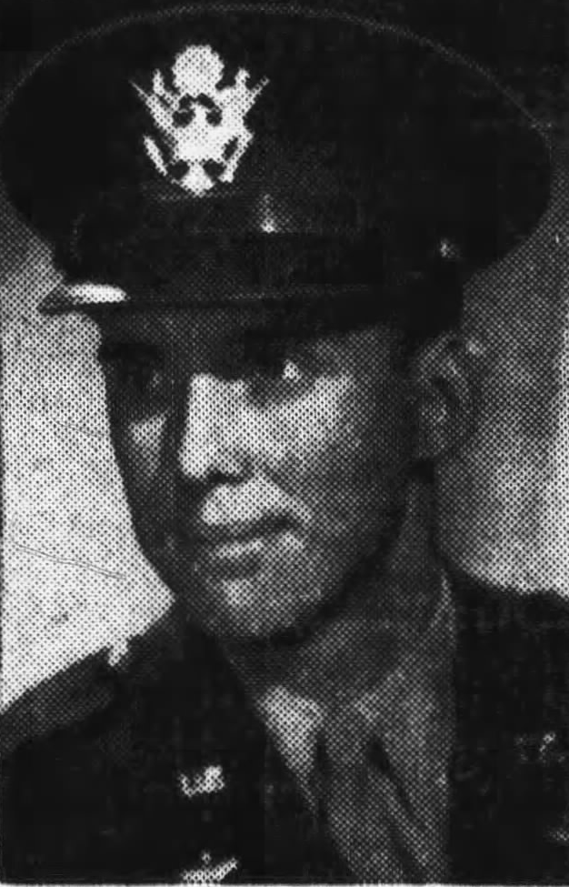
STORY #5A SYNOPSIS
1st Lt. Lloyd Bentsen, Jr. October 16, 1944
717th BS, 449th BG
B-24 Liberator bomber
Bomber Pilot
Bombing mission to St. Valentin Tank works in Steyr, Austria
Primary target not located- alternate targets bombed including St. Vert Marshalling Yard by Bentsen crew
One engine inoperative, two engines sporadic
Jettisoned all possible equipment
Landed on Vis successfully with no crew members hurt
Bentsen returned to base that day by P-38 recon plane
Crew returned to base at 1700
Born- Texas 23 Years Old

Slide 2

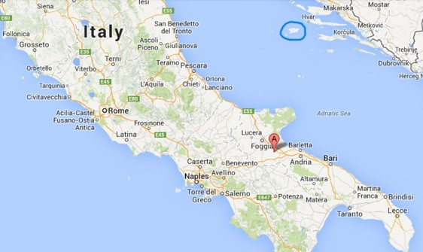
449th Bomber Group
VIS
Grottaglie, Italy - Nov 1943- April 1945
Three bomber squadrons: 716th, 717th, 718th and 719th
B-24 Liberator heavy bombers with 10-man crews: pilot, co-pilot, navigator, bombardier, radio operator/waist gunner, engineer/waist gunner, nose gunner, tail gunner, ball turret gunner, and top gunner
Flew 254 combat missions to France, Italy, Germany, Poland, Austria, Hungary, Rumania, Czechoslovakia and the Balkans
Dropped 14,951 tons of bombs – 135 aircraft lost in combat
Grottaglie
#

Slide 3
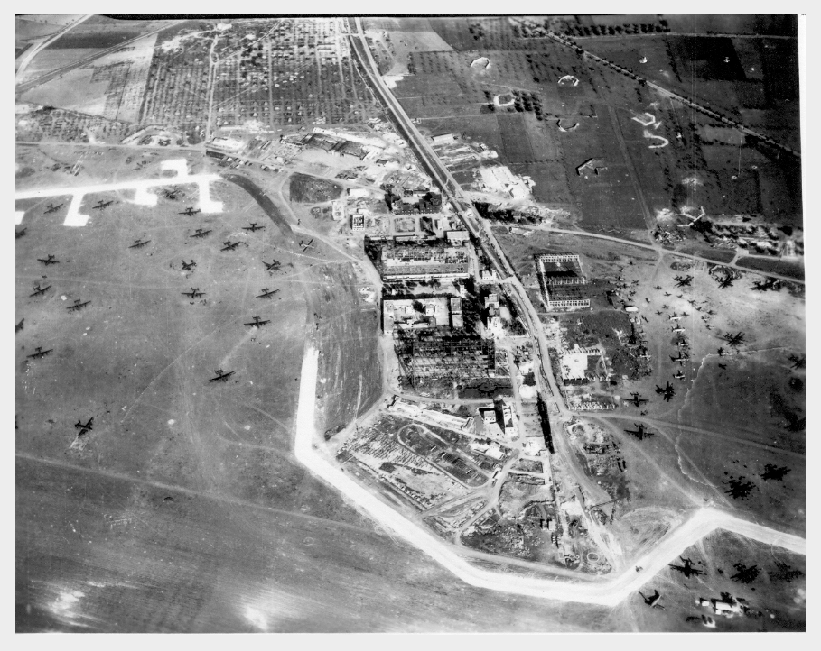
Grottaglie Airfield

Slide 4
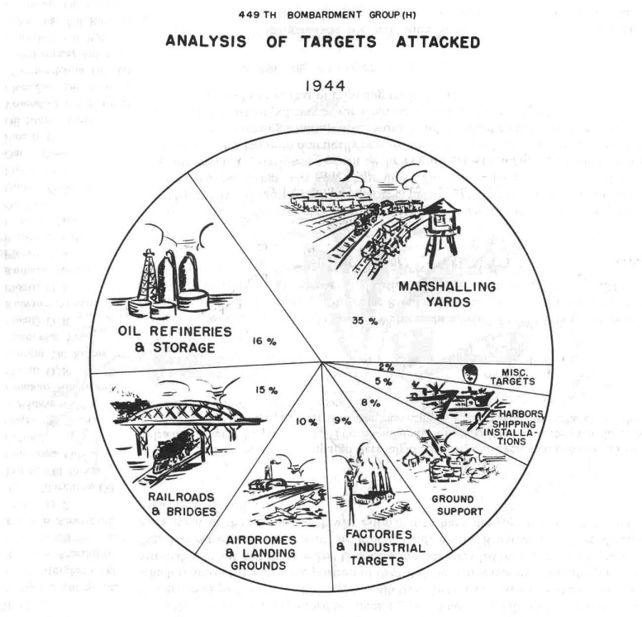
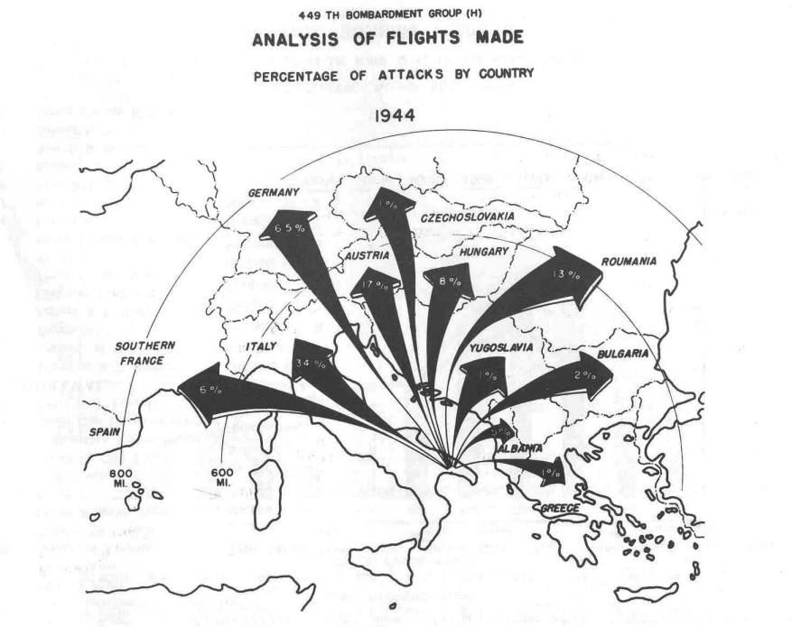

Slide 5
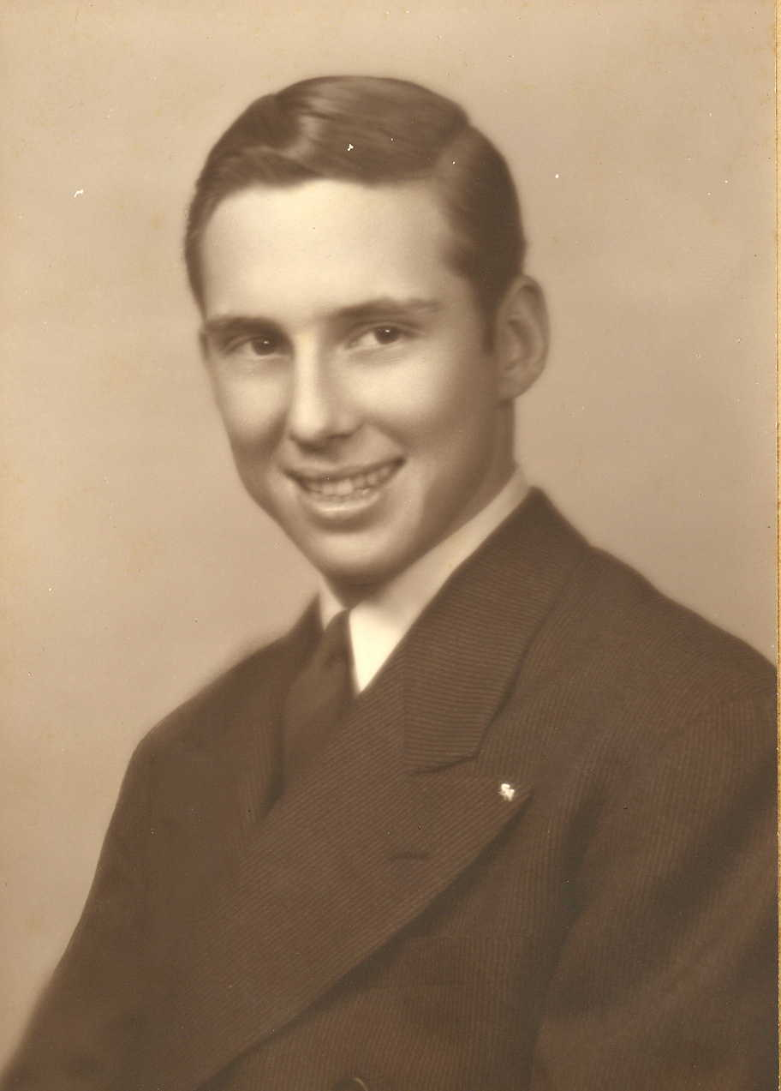
Lloyd Millard Bentsen, Jr.
Born on February 11, 1921 in Mission, Texas & grew up there
Son of Lloyd Millard Bentsen, Sr. & Edna Colbath
Two brothers and a sister
Father was real estate developer
Graduated Sharyland H.S. in 1936 at age 15
Eagle Scout
Graduated Univ. of Texas Law School in 1942, admitted to the bar

Slide 6
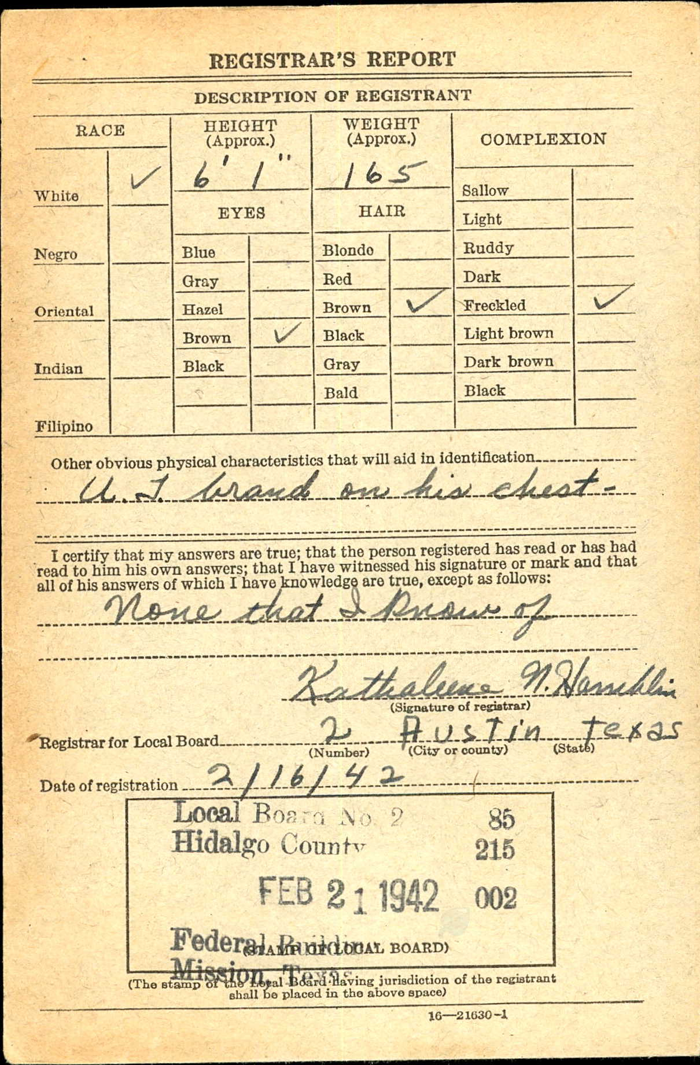
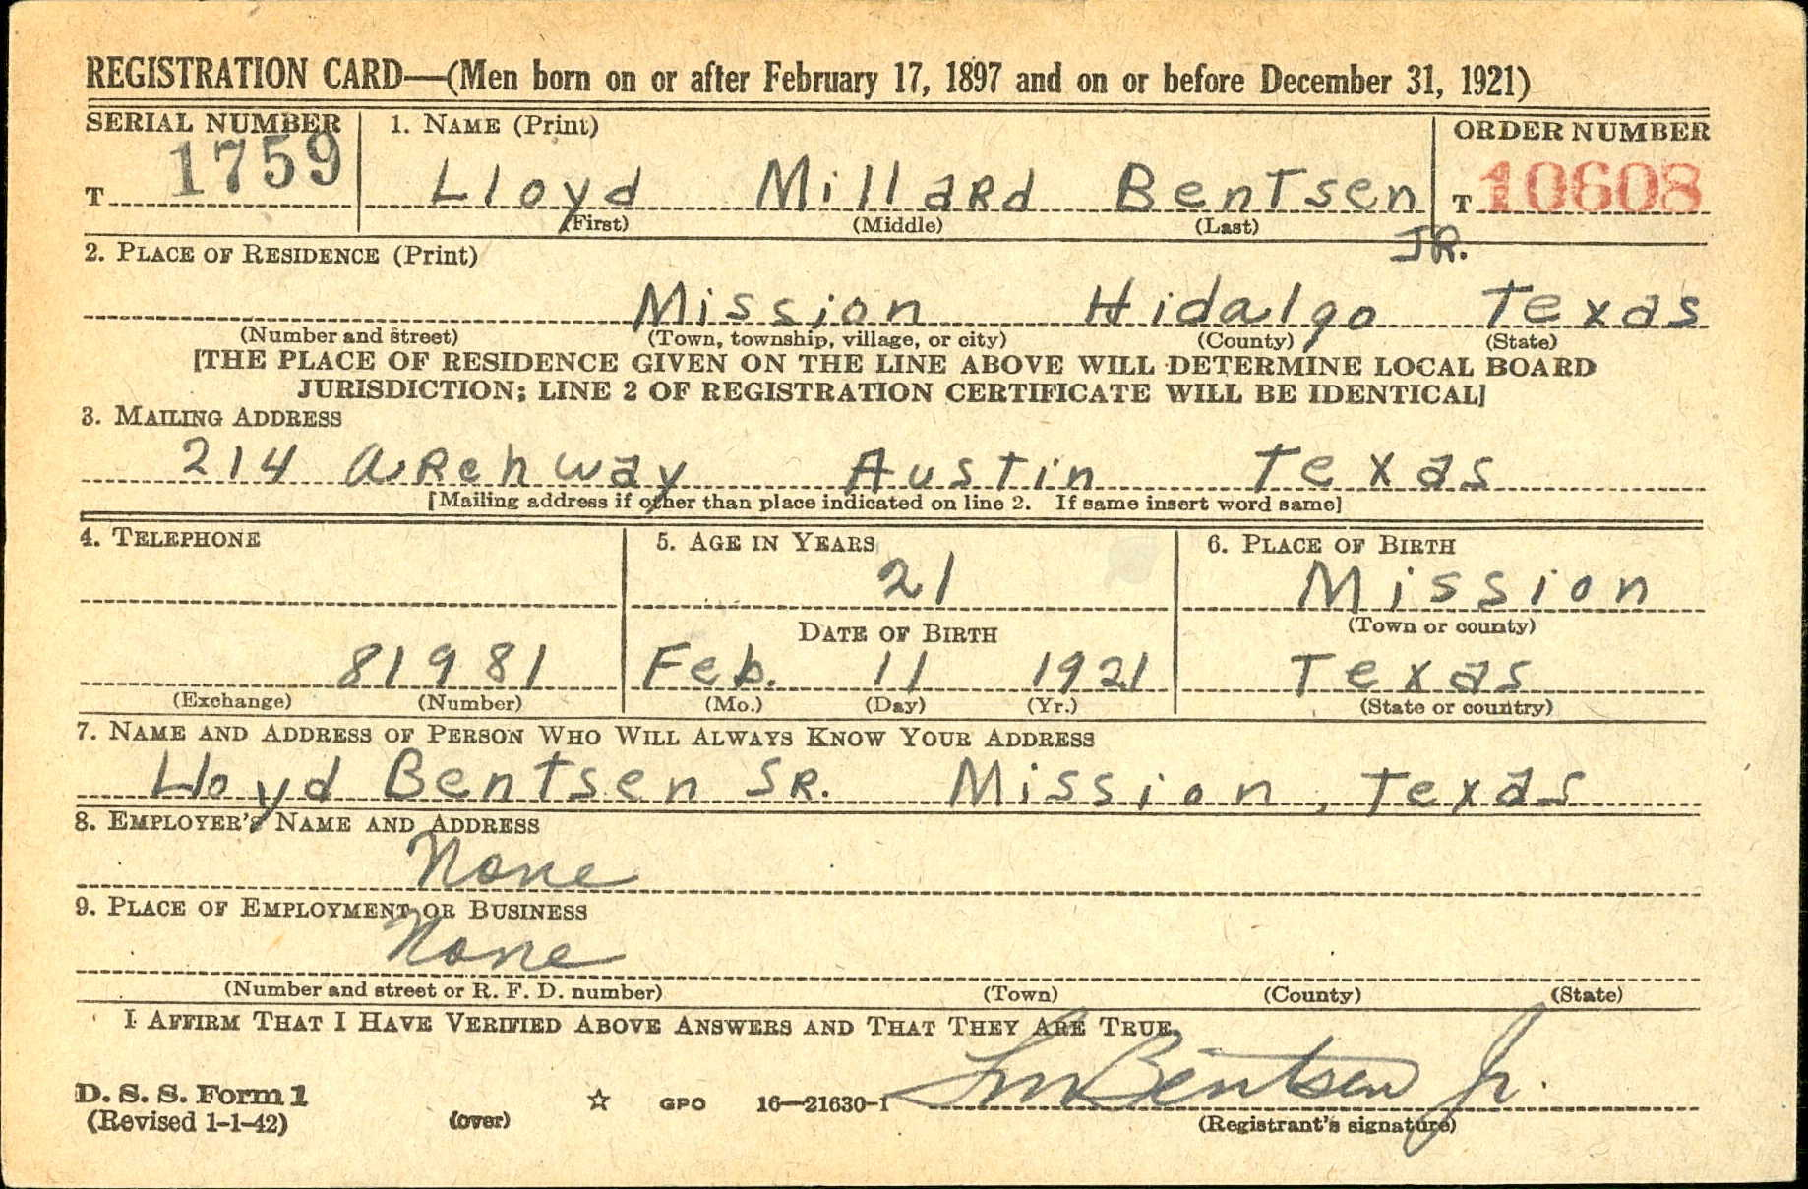

Slide 7
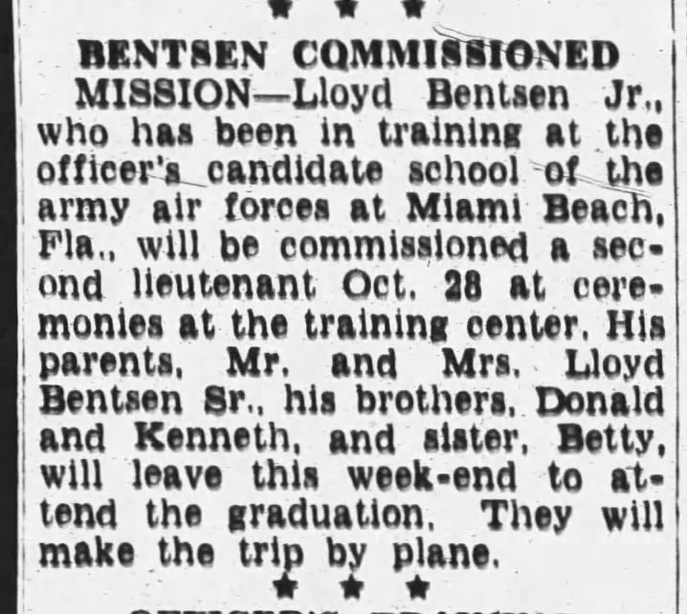
Military Career – 1942-1945
Enlisted on April 11, 1942 at age 21
11 Bentsens from Mission enlisted
Commissioned October 28, 1942- stationed with AF HQ staff in Wash. D.C.
4 months in Brazil on an AAF intelligence mission
Transferred to flight training school in Nashville in June 1943
Married Beryl Ann Longino Nov 27, 1943
Lived in Columbus, Mississippi after marriage while in flight training

Slide 8
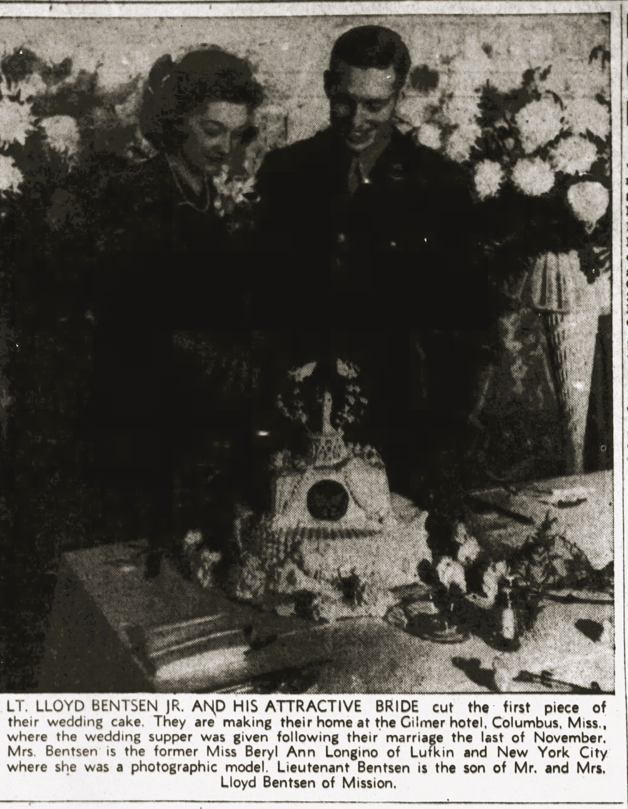
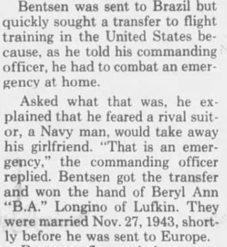

Slide 9
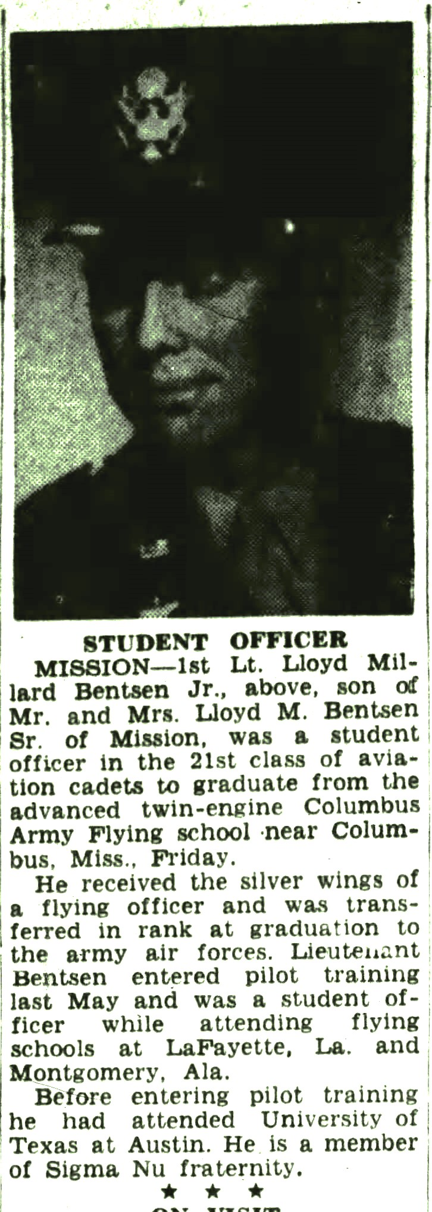
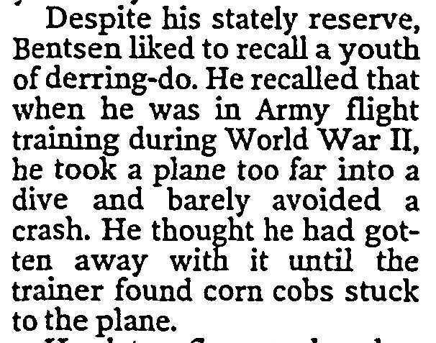
Graduated from Columbus Army Flying School Jan. 15, 1944 & received his silver wings
B-24 flight training and other training through June 1944

Slide 10
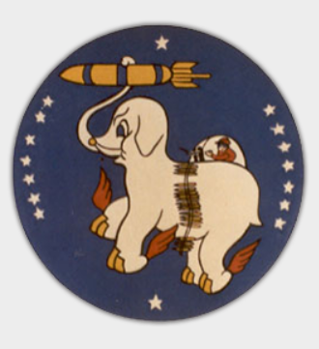
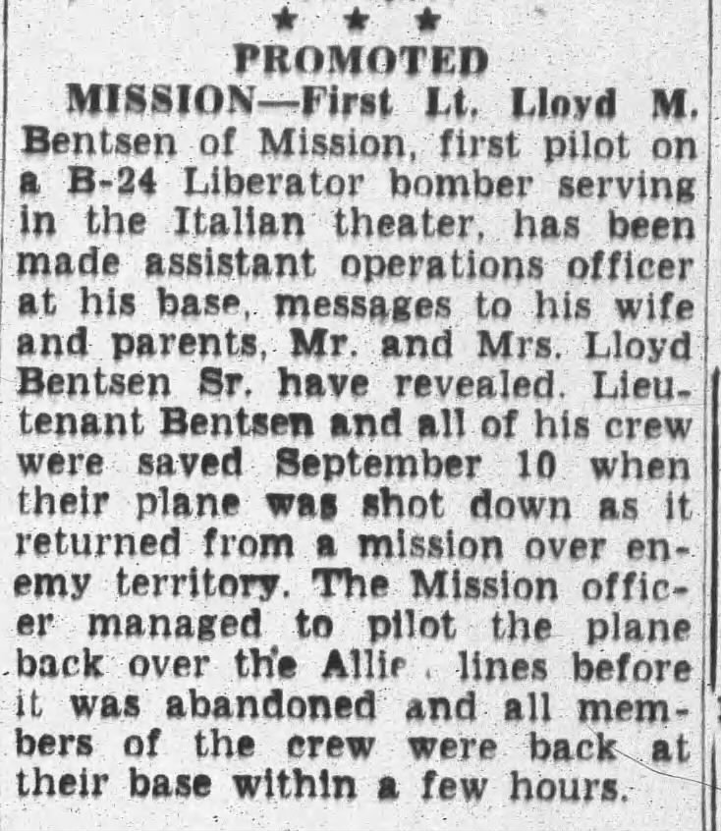
717th Bomb Squadron
1Lt Bentsen joined the 717th in Grottaglie, Italy in July 1944 without a crew
Flew missions with operations-assigned crews
Shot up by flak on mission to Trieste Port on September 10th
Landed on friendly field at Pescara, Italy- back to Grottaglie at 2030
Promoted to assistant operations officer
Bentsen would fly on 46 credited missions

Slide 11
October 16, 1944
Mission to Steyr, Austria – Bentsen crew bombed alternate target St. Vert Marshalling Yard
One engine out, two others sporadic
Jettisoned all equipment, barely made it to Vis
Successful, but rocky landing
No crew hurt
Bentsen returned to base by P-38 and crew later at 1700
Second crew from 719th BS piloted by Lt. William Allen also landed on Vis successfully

Slide 12
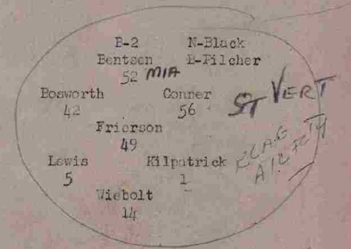
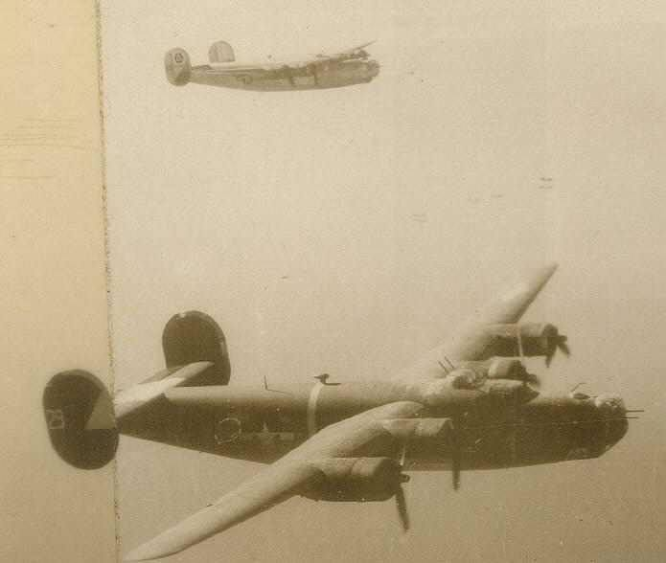
Box B-2 led by Lt. Bentsen
Courtesy of Mark Coffee, 449th BG Association historian

Slide 13
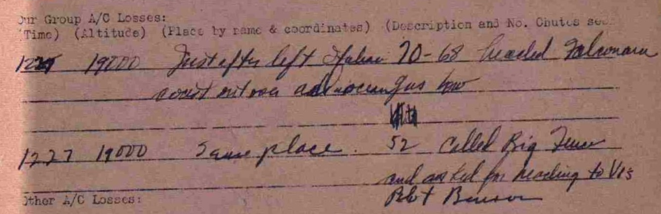
Bentsen in plane #52 called Big Fence (navigational aid station) and asked for reading to Vis
Courtesy of Mark Coffee, 449th BG Association historian

Slide 14
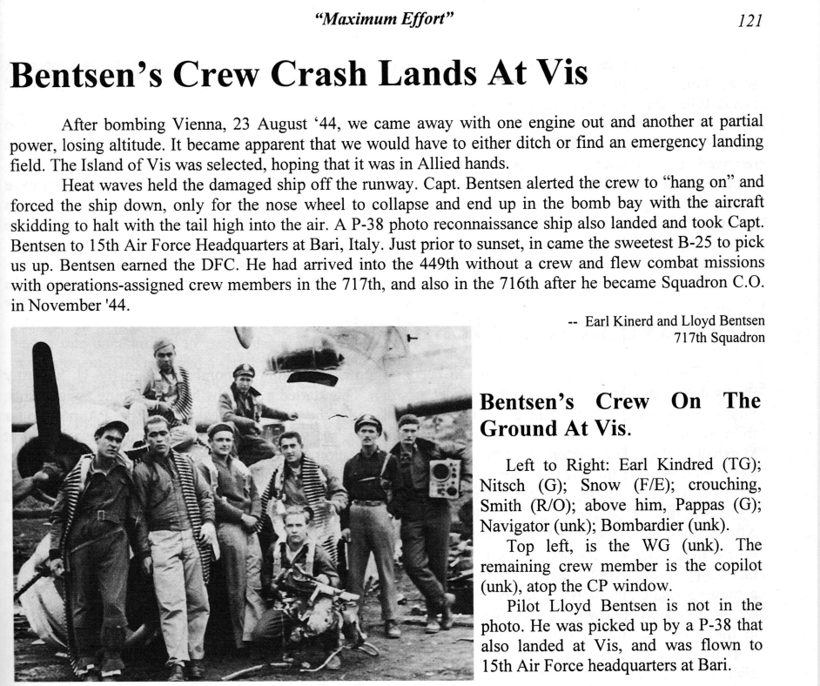
Account by Tail Gunner S/Sgt Earl Kindred account written later
CREW:
Pilot: 1Lt Lloyd Bentsen
Co-Pilot: Unknown
Tail Gunner: Earl Kindred
Gunner: Vasilios Pappaconstantinou
Gunner: Joseph Netsch
Engineer: David Snow
Radio Opr: Walter Smith
Navigator: James Black
Bombardier: David Pilcher
Waist Gunner: Unknown

Slide 15
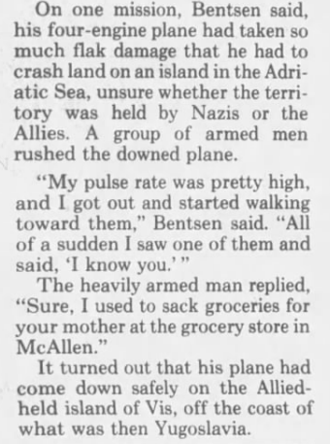
“Bentsen Recalls Fear, Valor of his War Years “(Austin_American_Statesman_Sun__Jun_5__1994)

Slide 16
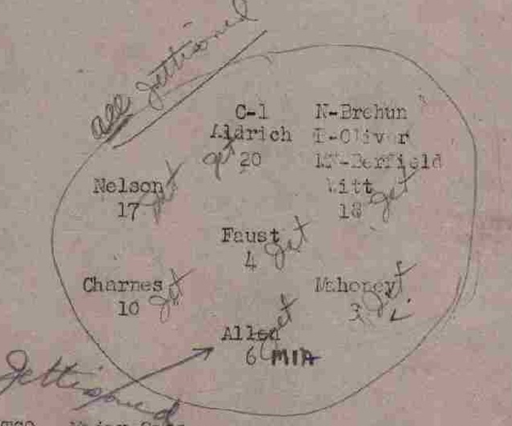
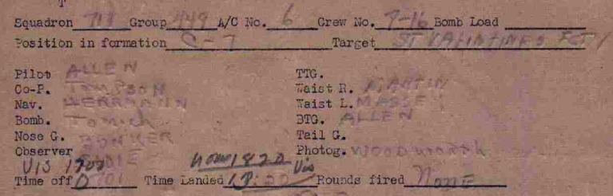
Lt. William Allen & crew from 719th BS in #6 also landed on Vis successfully that day
Courtesy of Mark Coffee, 449th BG Association historian

Slide 17
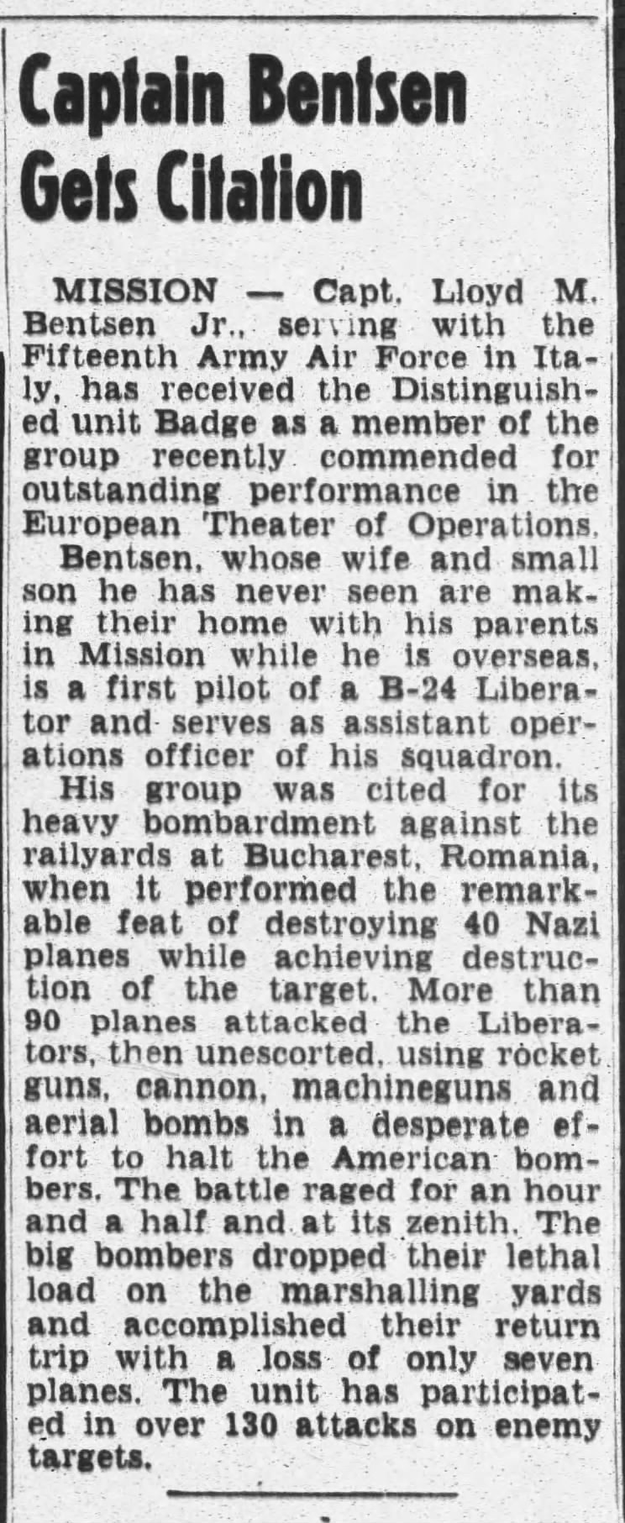
Promoted to Captain & 449th BG received Distinguished Unit Badge in October 1944 (though he wasn’t on that April 4th mission)

Slide 18
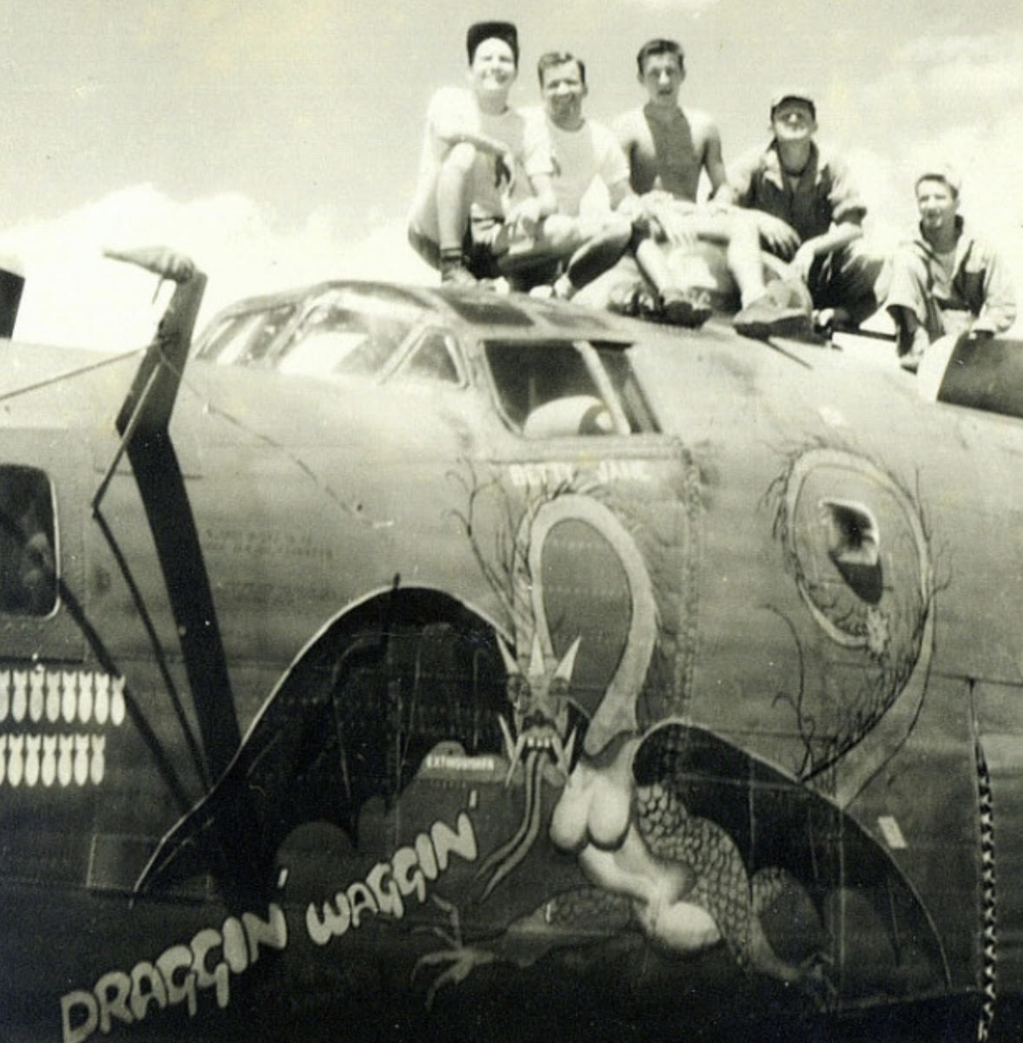
One of the B-24s Bentsen flew “Betty Jane” for his wife
Courtesy of Mark Coffee, 449th BG Association historian

Slide 19
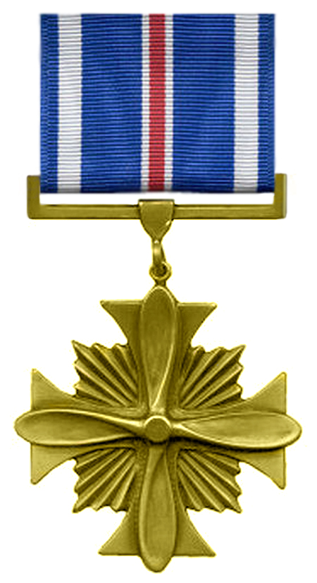
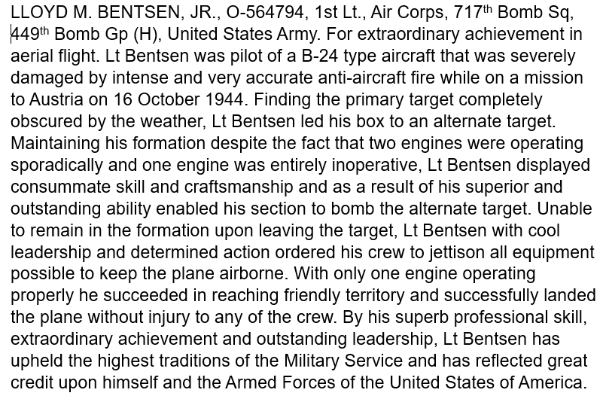
Awarded the Distinguished Flying Cross for Vis Landing on January 9 1945

Slide 20

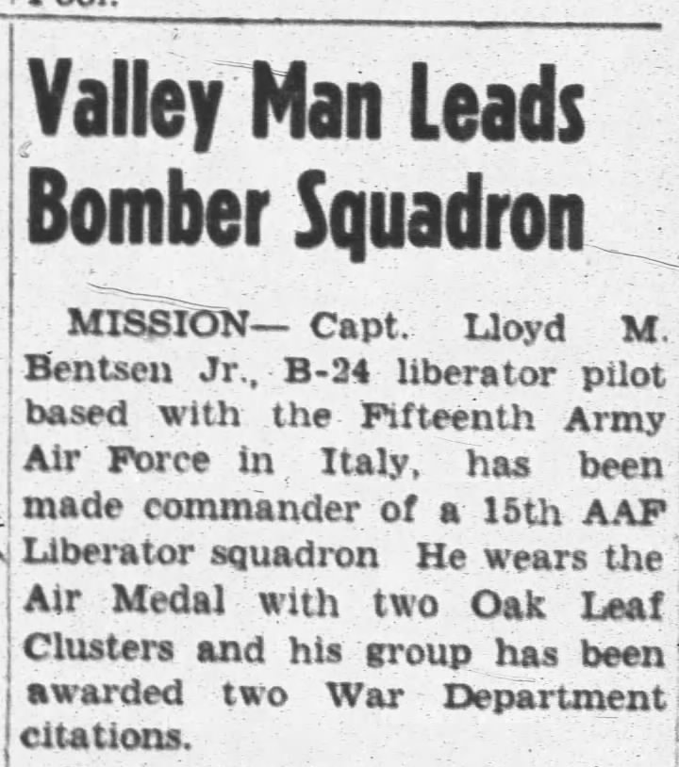
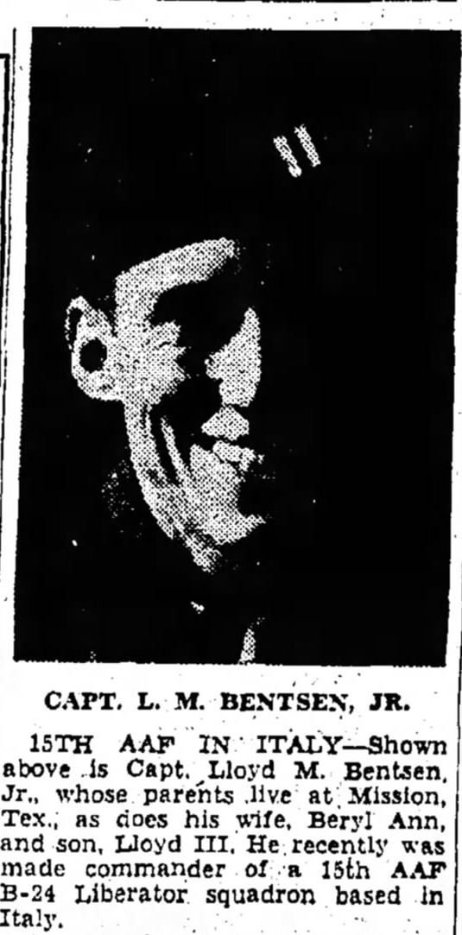
Commander of 716th BS from November 1944 through February 1945

Slide 21
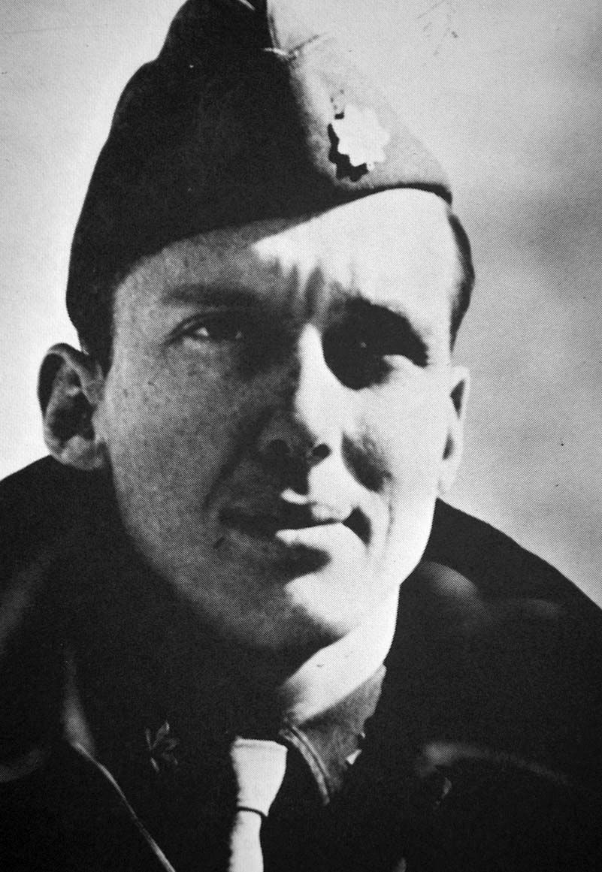
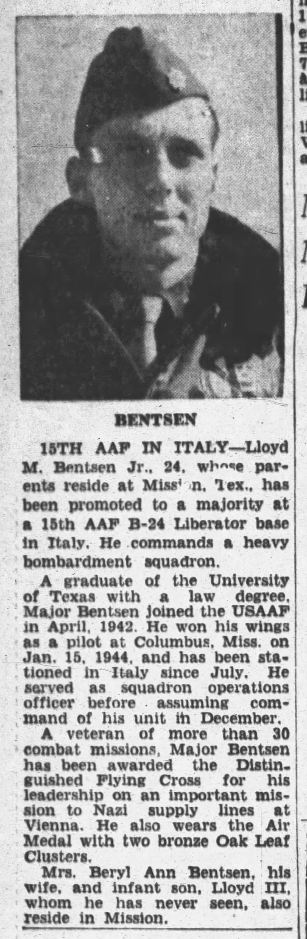
Promoted to Major February 1945 – age 24

Slide 22
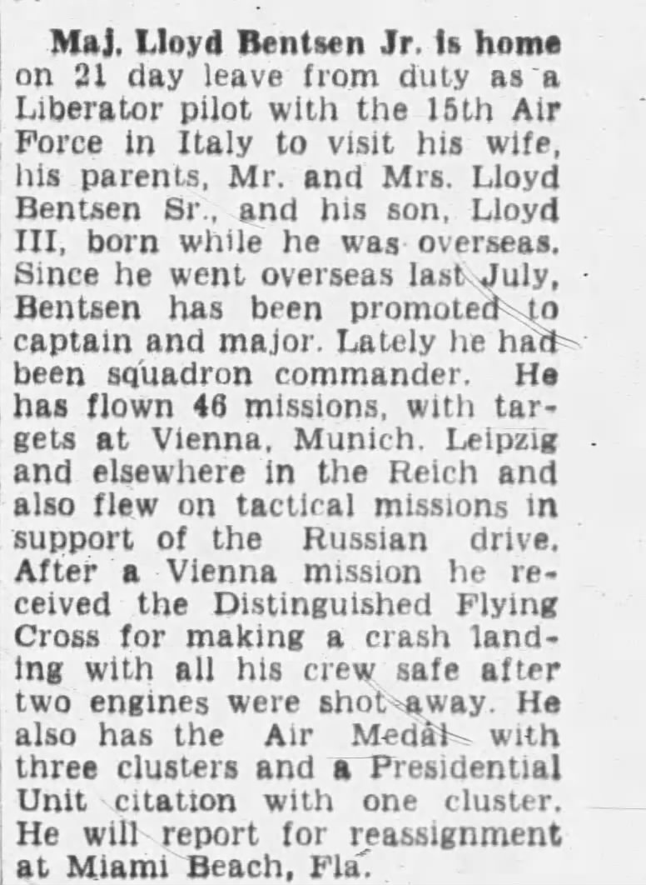
Returned to U.S. in April 1945 saw his son, Lloyd, III (born 9/29/1944) for first time

Slide 23
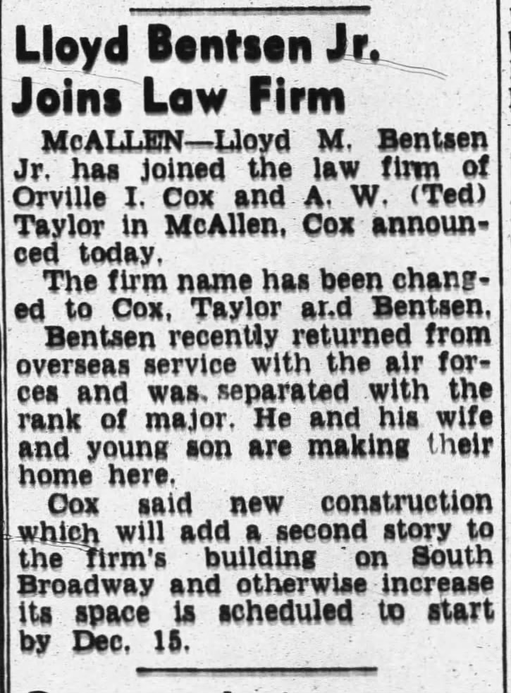
Lloyd Bentsen- Post War
Separated as Major in 1945 & joined Texas State Guard
Retired in 1947 as Lt. Colonel
Served in US Air Force Reserve from 1950-1957
Retired as a Colonel
Joined law firm in late 1945

Slide 24
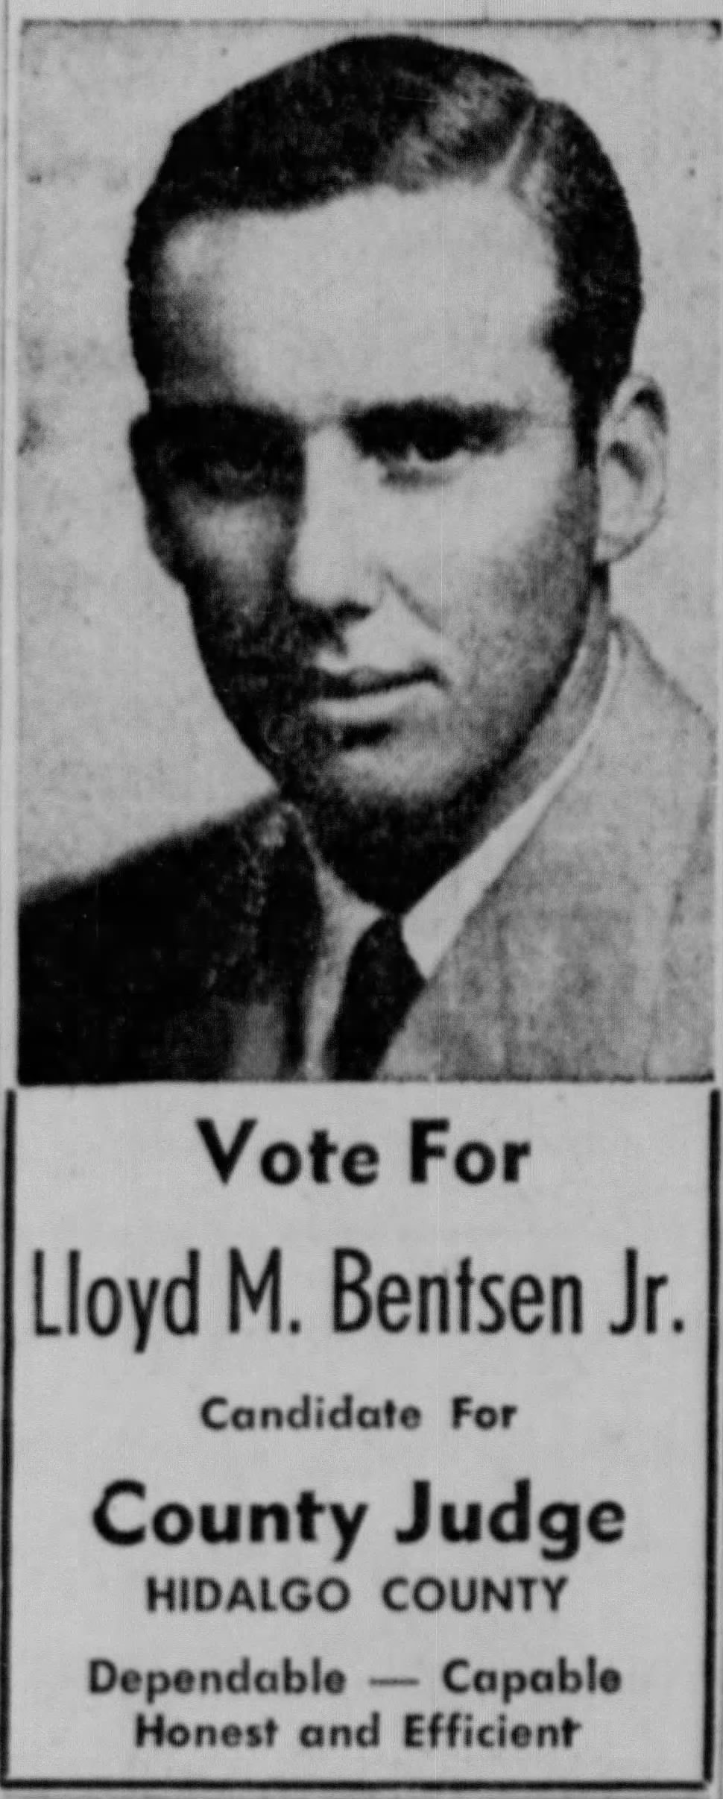
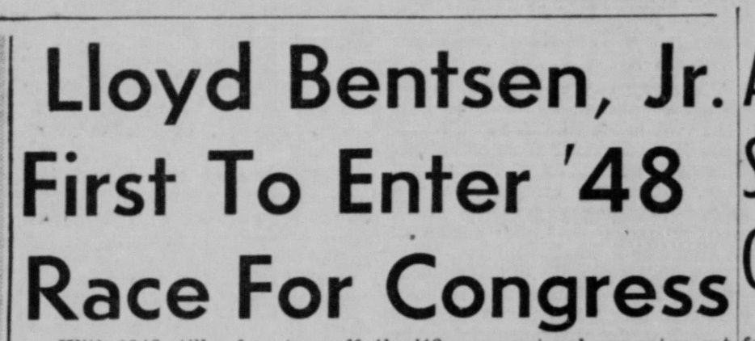
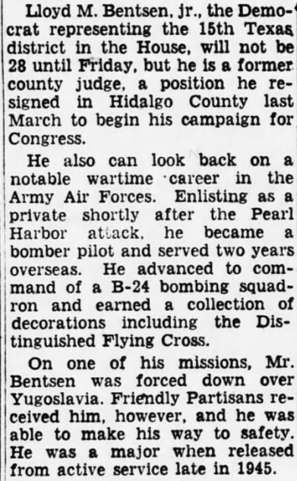
Political Career 1946-1994
Youngest judge in Hidalgo County, Texas in 1946
US Representative 1948-1955
Hiatus from politics 1956-1970
Distinguished US Senator 1971-1993
Ran for Vice President in 1988 on Democratic ticket with Michael Dukakis but lost to the Bush/Quayle ticket
Treasury Secretary 1993-4 under Clinton

Slide 25
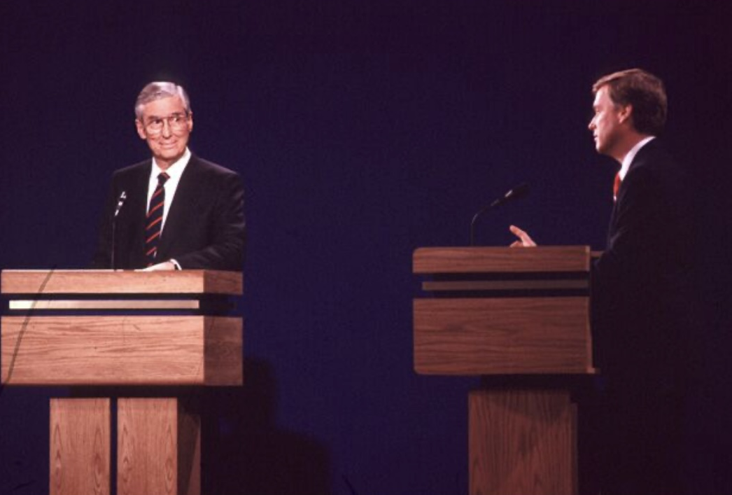
Famous 1988 VP debate zinger aimed at opponent Senator Quayle

Slide 26
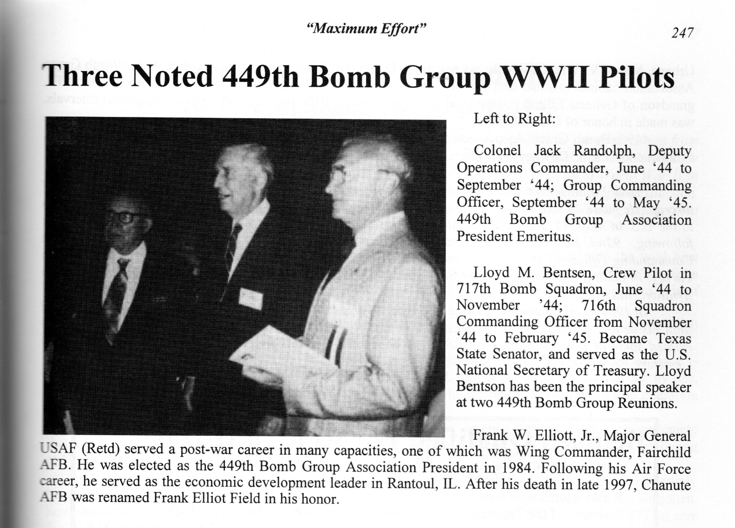
Keynote speaker at two 450th BG Association reunions
Courtesy of Mark Coffee, 449th BG Association historian

Slide 27
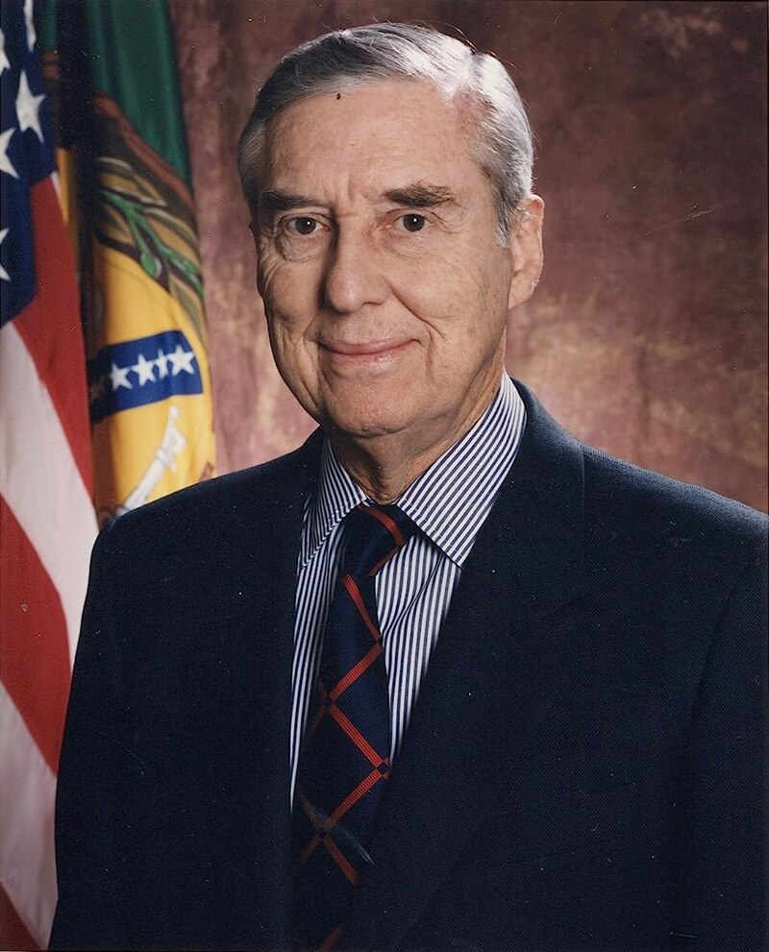
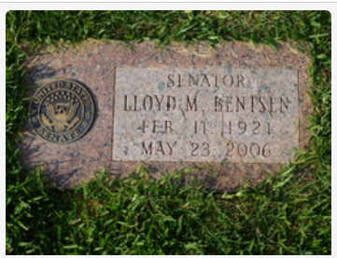
Rest in Peace
War Hero
Dedicated and effective politician
Successful Texas businessman
Presidential Medal of Freedom in 1999 for his service to the country
Died at age 85 in 2006
#

