Slide 1
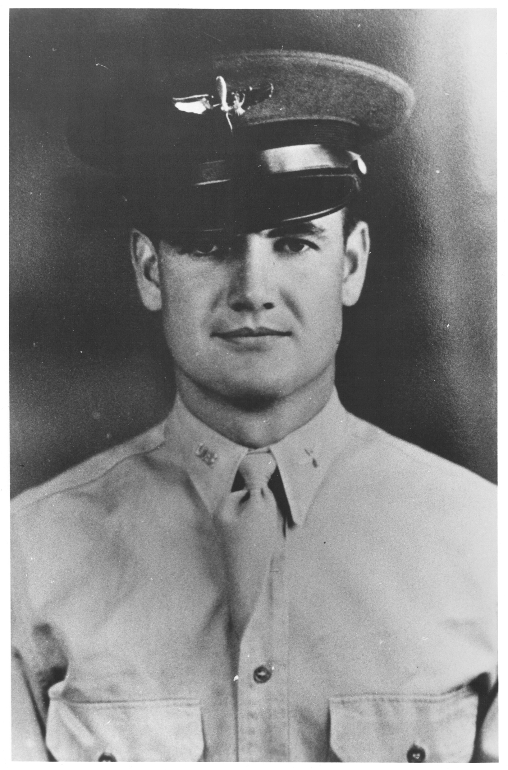
STORY #4A SYNOPSIS
1st Lt. George McGovern December 20, 1944
741st BS, 455th BG
B-24J Liberator bomber
Bomber Pilot
Bombing mission to Skoda Works in Pilsen, Czechoslovakia
One engine gone then dropped bombs
Second engine hit and on fire
Barely made it to Vis island on return
Landed successfully with no casualties
Crew returned to base the next day by C-47 transport
Born- South Dakota 22 Years Old
Except where indicated with #, all pictures & documents courtesy of the Senator George McGovern Collection, Dakota Wesleyan Univ. Archives, Dakota Wesleyan University, Mitchell, South Dakota
MANY THANKS TO UNIVERSITY ARCHIVIST LAURIE LANGLAND , JD, MA

Slide 2
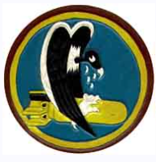
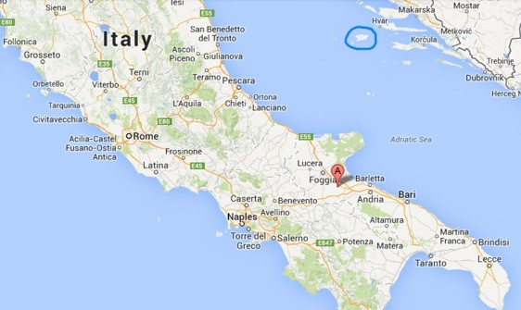
455th Bomber Group
VIS
San Giovanni
San Giovanni, Italy - Feb 1944- April 1945
Three bomber squadrons: 740th, 741st, 742nd and 743rd
B-24 Liberator heavy bombers with 10-man crews: pilot, co-pilot, navigator, bombardier, radio operator/waist gunner, engineer/waist gunner, nose gunner, tail gunner, ball turret gunner, and top gunner
Flew 255 combat missions to France, Italy, Germany, Poland, Austria, Hungary, Rumania, Czechoslovakia and the Balkans
Dropped 13,250 tons of bombs – 118 aircraft lost in combat
#

Slide 3
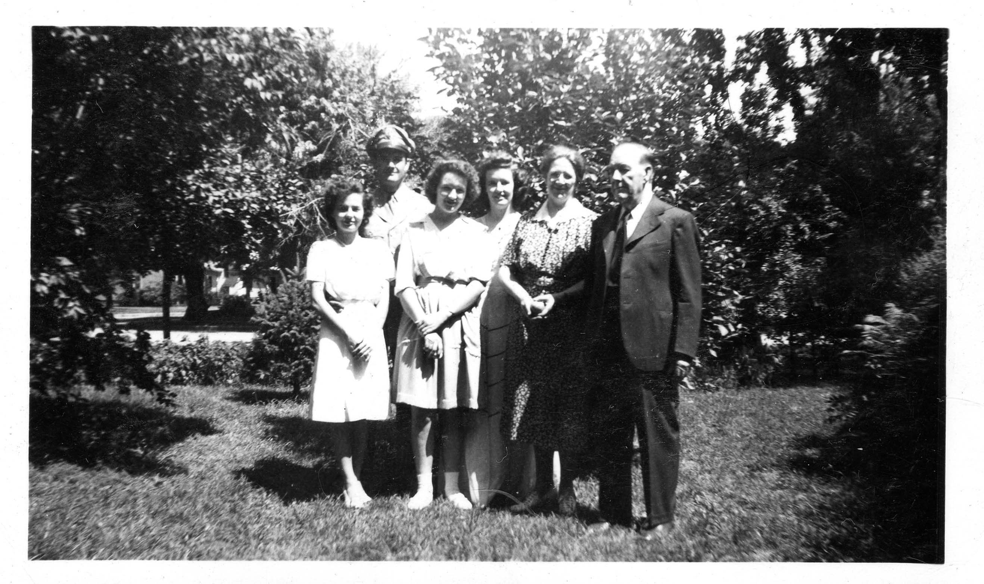
George Stanley McGovern
Born on July 19, 1922 in Avon, South Dakota & grew up in small town of Mitchell, SD
Son of Reverend Joseph C. McGovern & Frances McLean
One brother & two sisters
Family was very poor
Graduated Mitchell H.S. in 1940- very skillful debater
Civilian pilot’s license in 1941
Enlisted July 31, 1942, but no training yet available
McGovern family, left to right:
Eleanor, George, Mildred, Olive,
Frances and Joseph

Slide 4
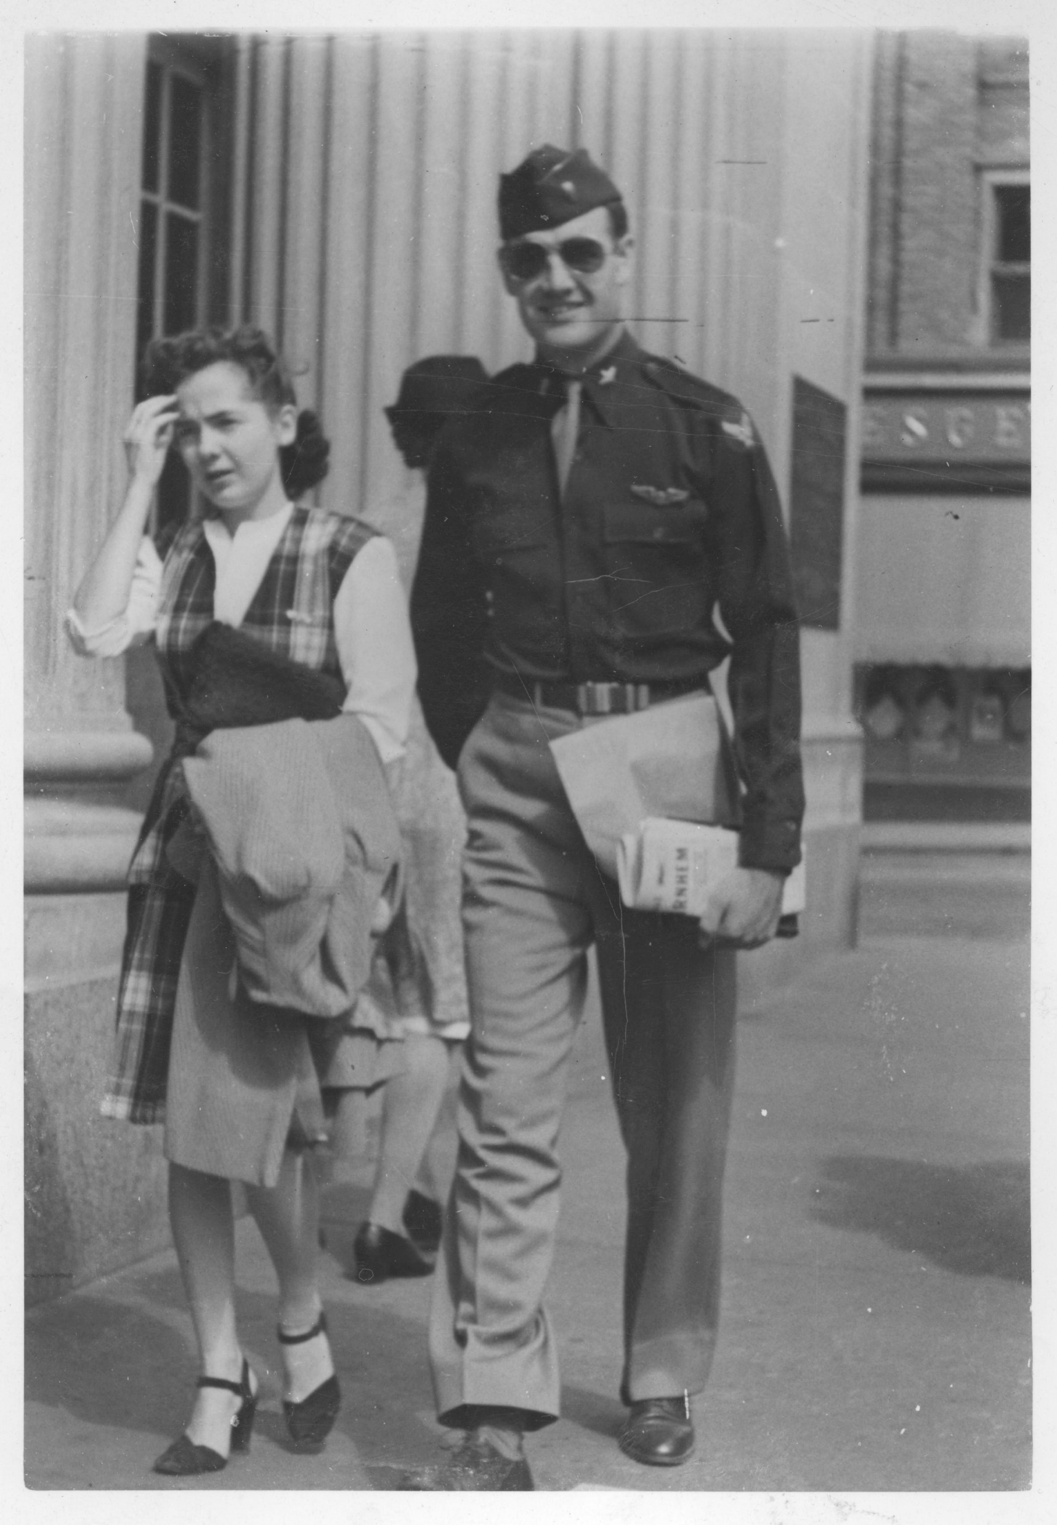
Attended Dakota Wesleyan Univ. 3 years
Called up in February 1943
Married Eleanor Stegeberg Oct. 31, 1943
Training in Texas, Kansas, Nebraska & Idaho
"Learning how to fly the B‑24 was the toughest part of the training. It was a difficult airplane to fly, physically, because in the early part of the war they didn't have hydraulic controls. If you can imagine driving a Mack truck without any power steering or power brakes, that's about what it was like at the controls.”

Slide 5
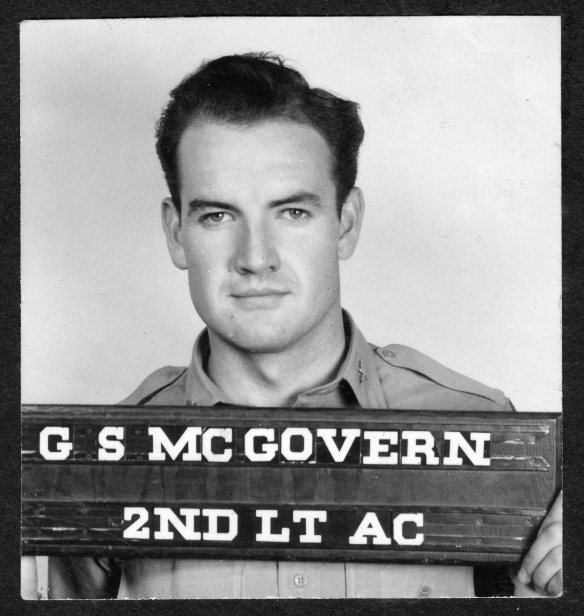
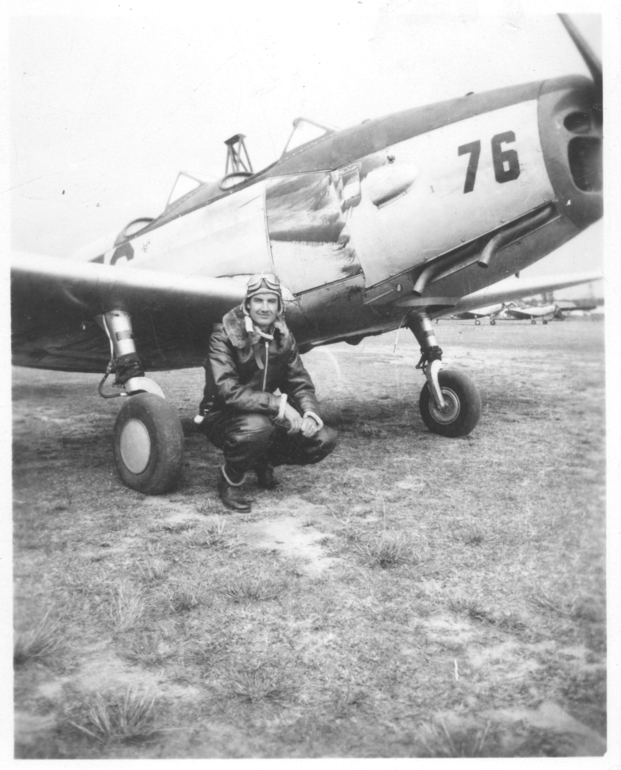
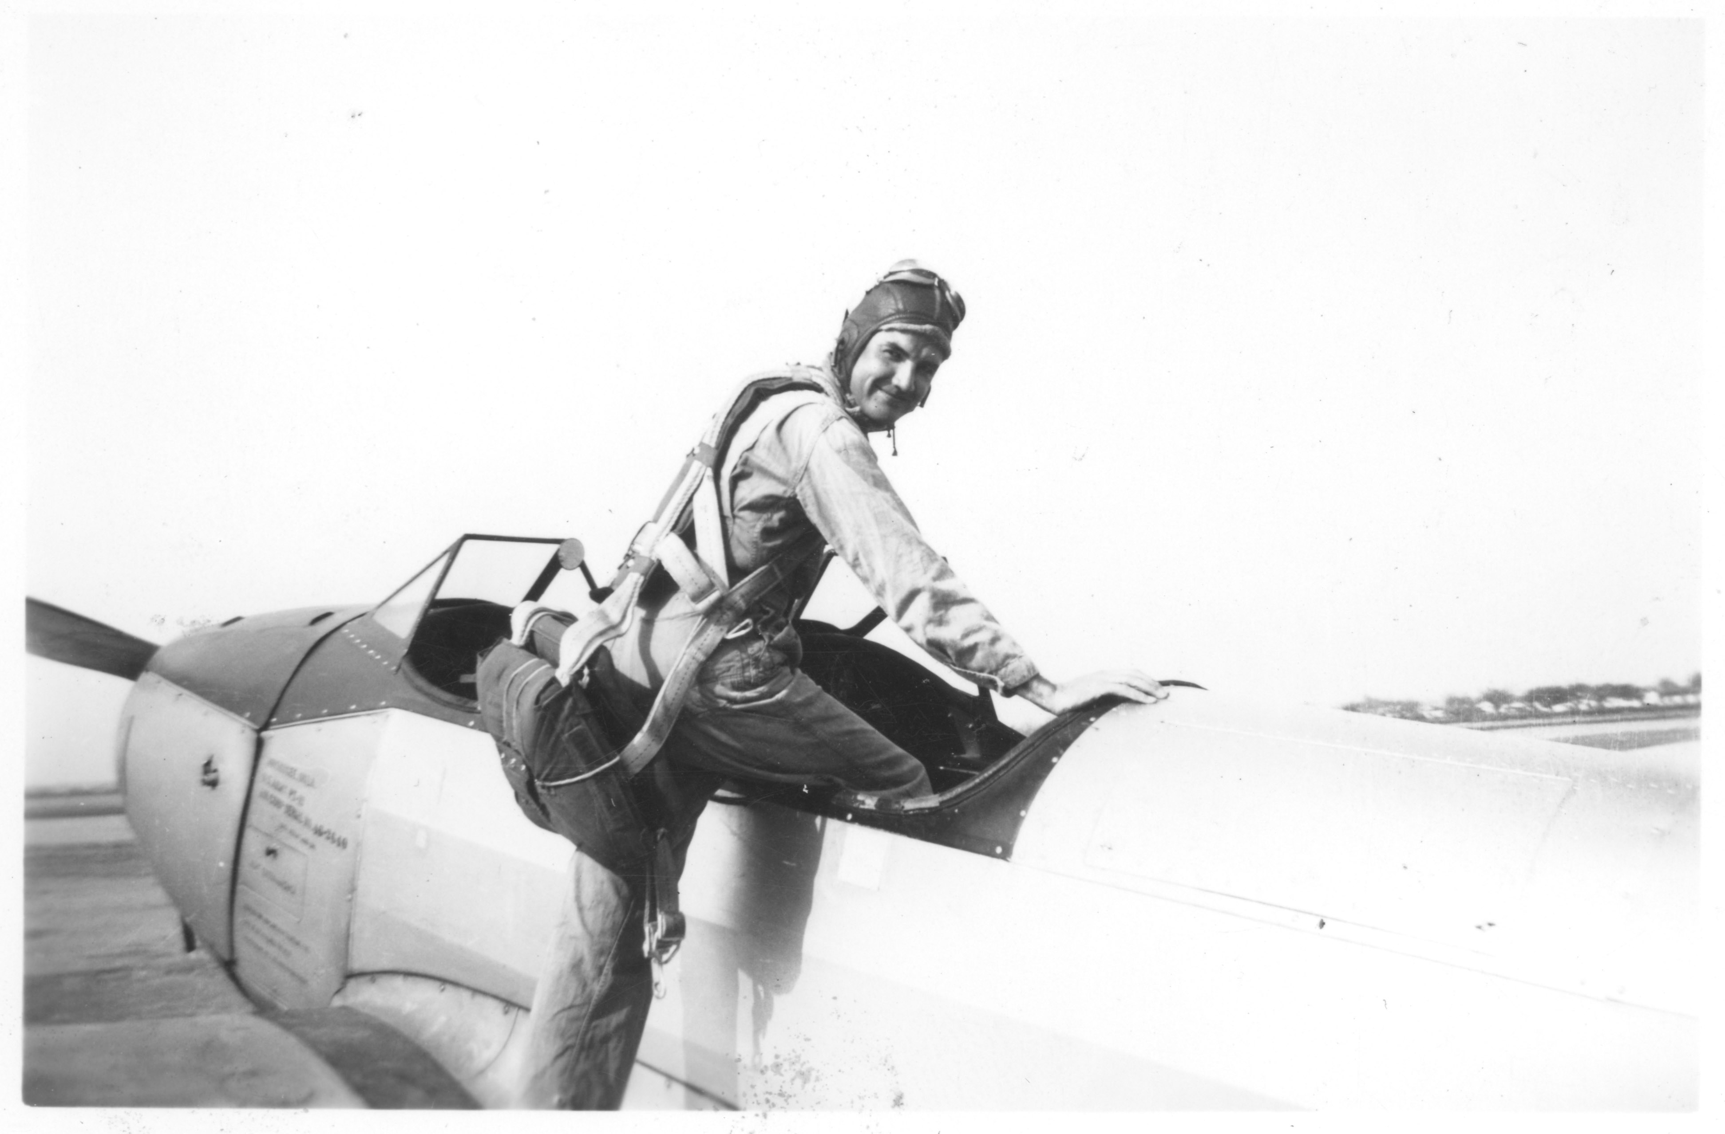

Slide 6
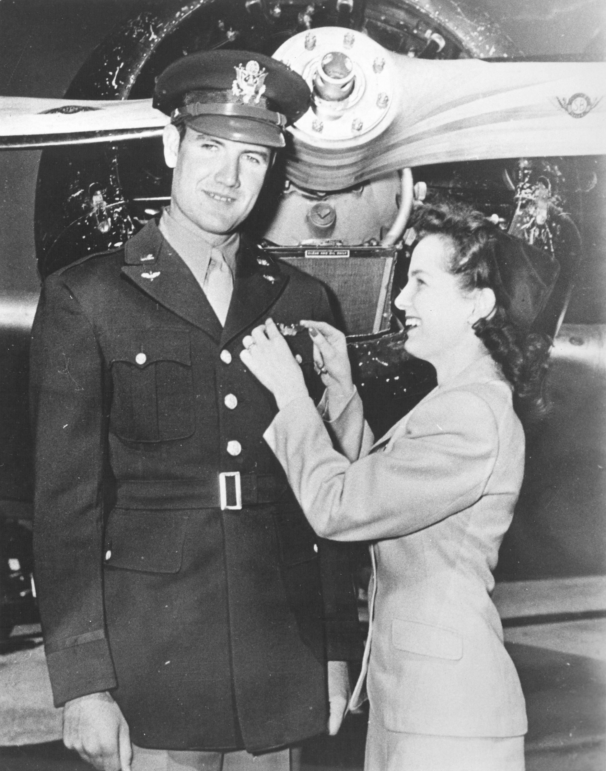
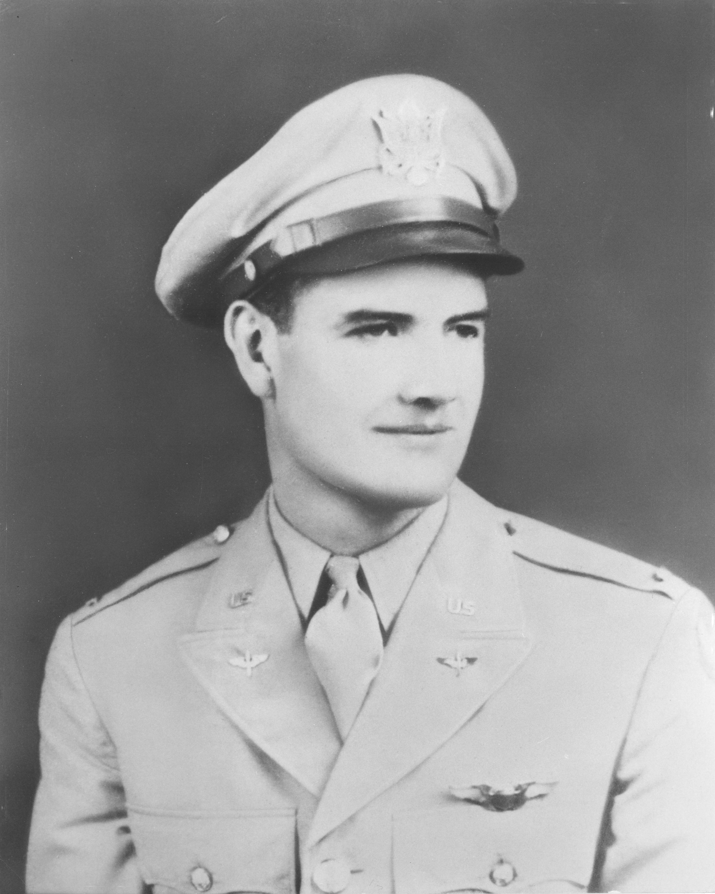

Slide 7
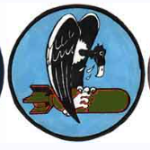
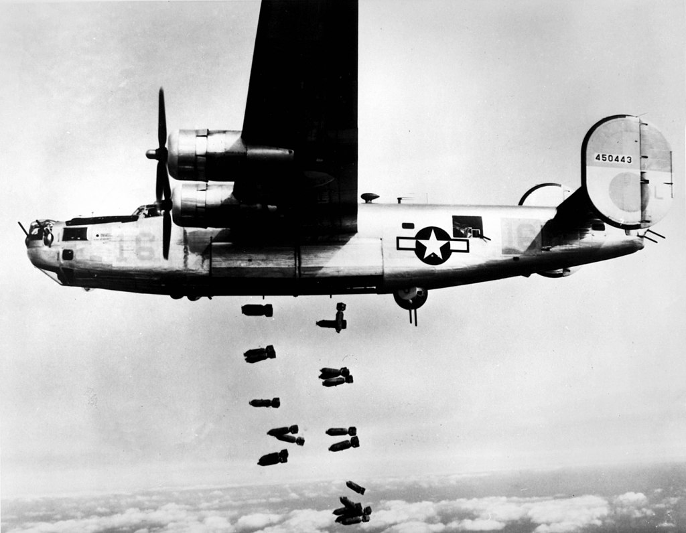
741st Bomb Squadron
Troop ship to Italy in September 1944
Joined the 741st at San Giovanni Airfield
First mission on November 11, 1944
Flew on 35 credited missions
All his bombers were called the “Dakota Queen” after his wife
#
#

Slide 8
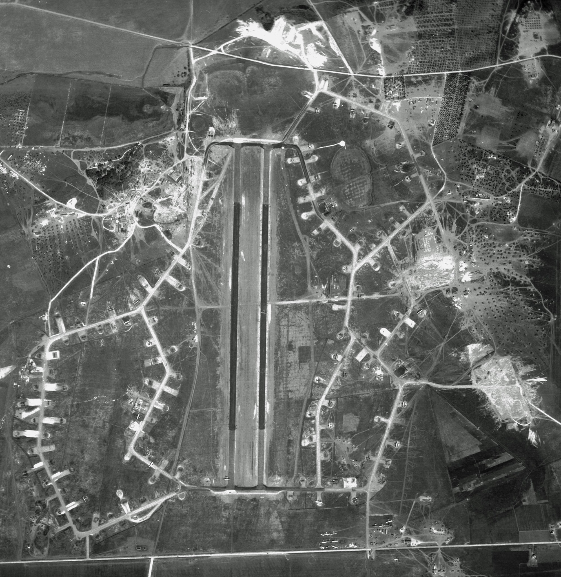

# San Giovanni airfield – home of the 455th

Slide 9
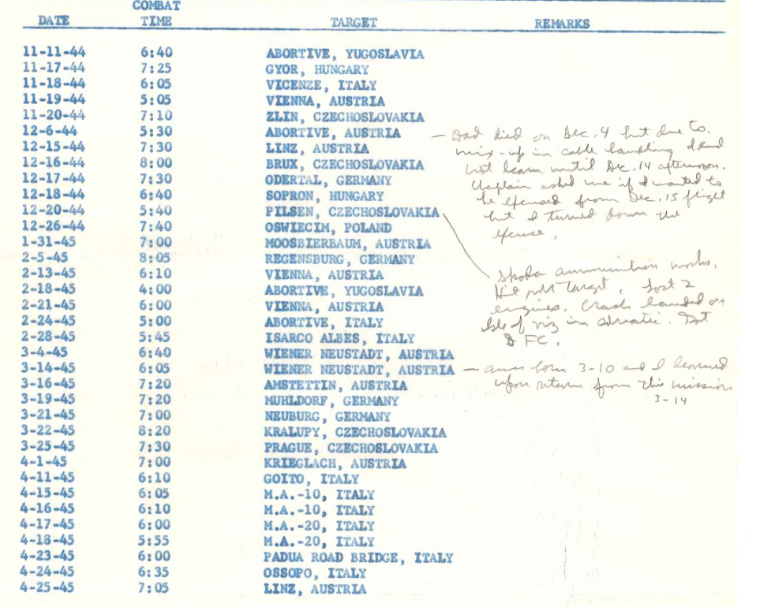
McGovern’s Missions – with his notes

Slide 10
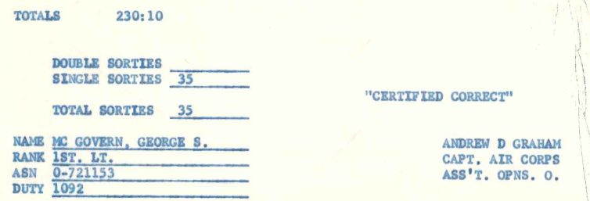

Slide 11
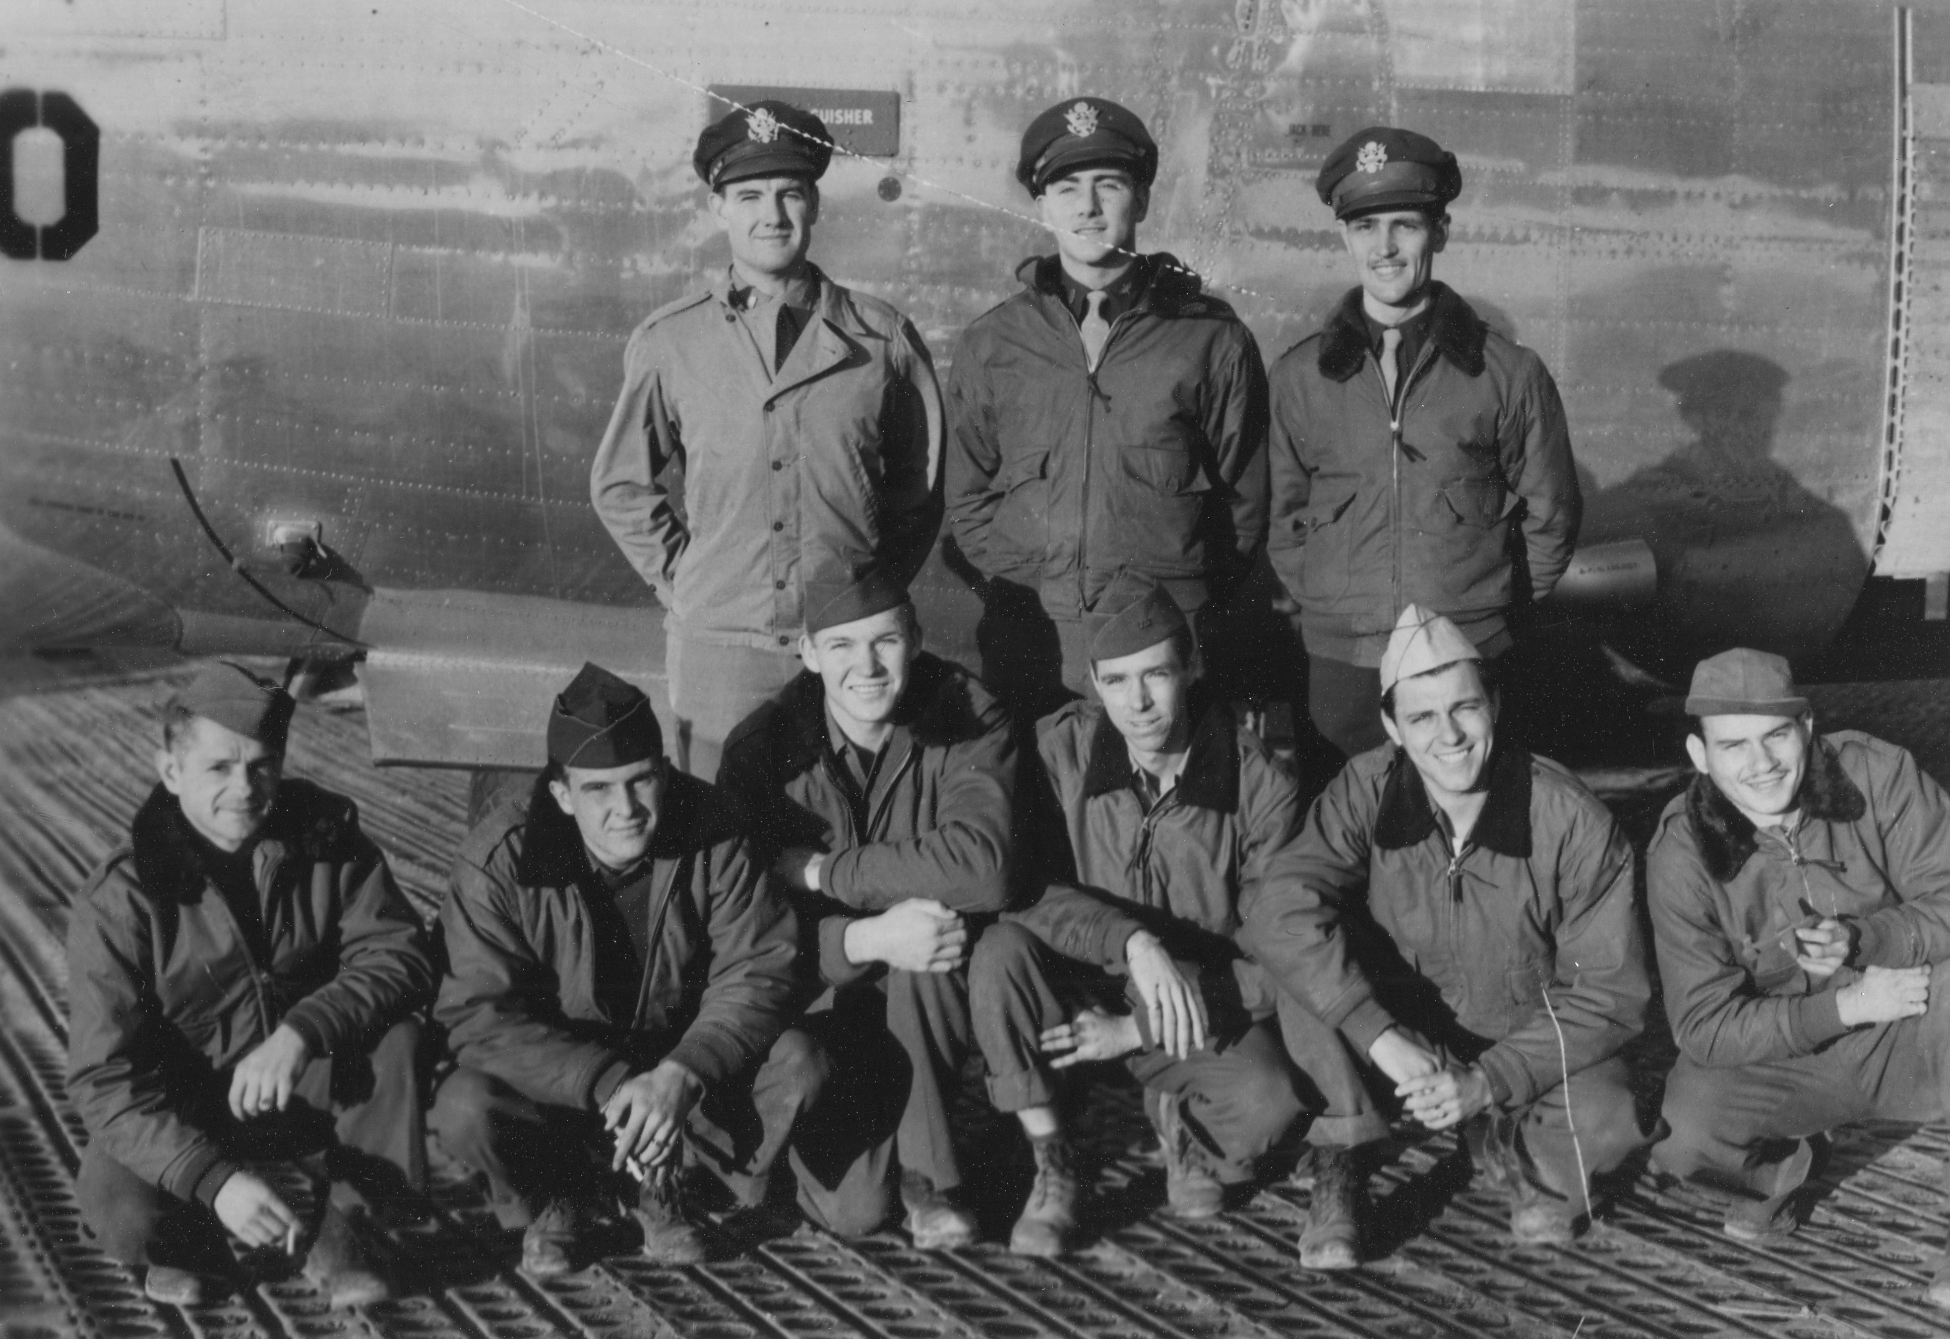
McGovern: “You just dropped those damn bombs where you could and got the hell out of there before they shot your ass off!”
McGovern crew on base with “Dakota Queen” November1944.
Top. Lt. McGovern, pilot, Lt. Bill Rounds, co-pilot, Lt. Sam Adams. Navigator/Bombardier.
Kneeling: Sgt. Mike Valko, engineer, Sgt. Bill McAfee, ball turret gunner, Sgt. Bill Ashlock, waist gunner,
Sgt. Ken Higgins, radio operator, Sgt. Robert O’Connell, nose gunner and Sgt. Isadore Siegel, tail gunner

Slide 12
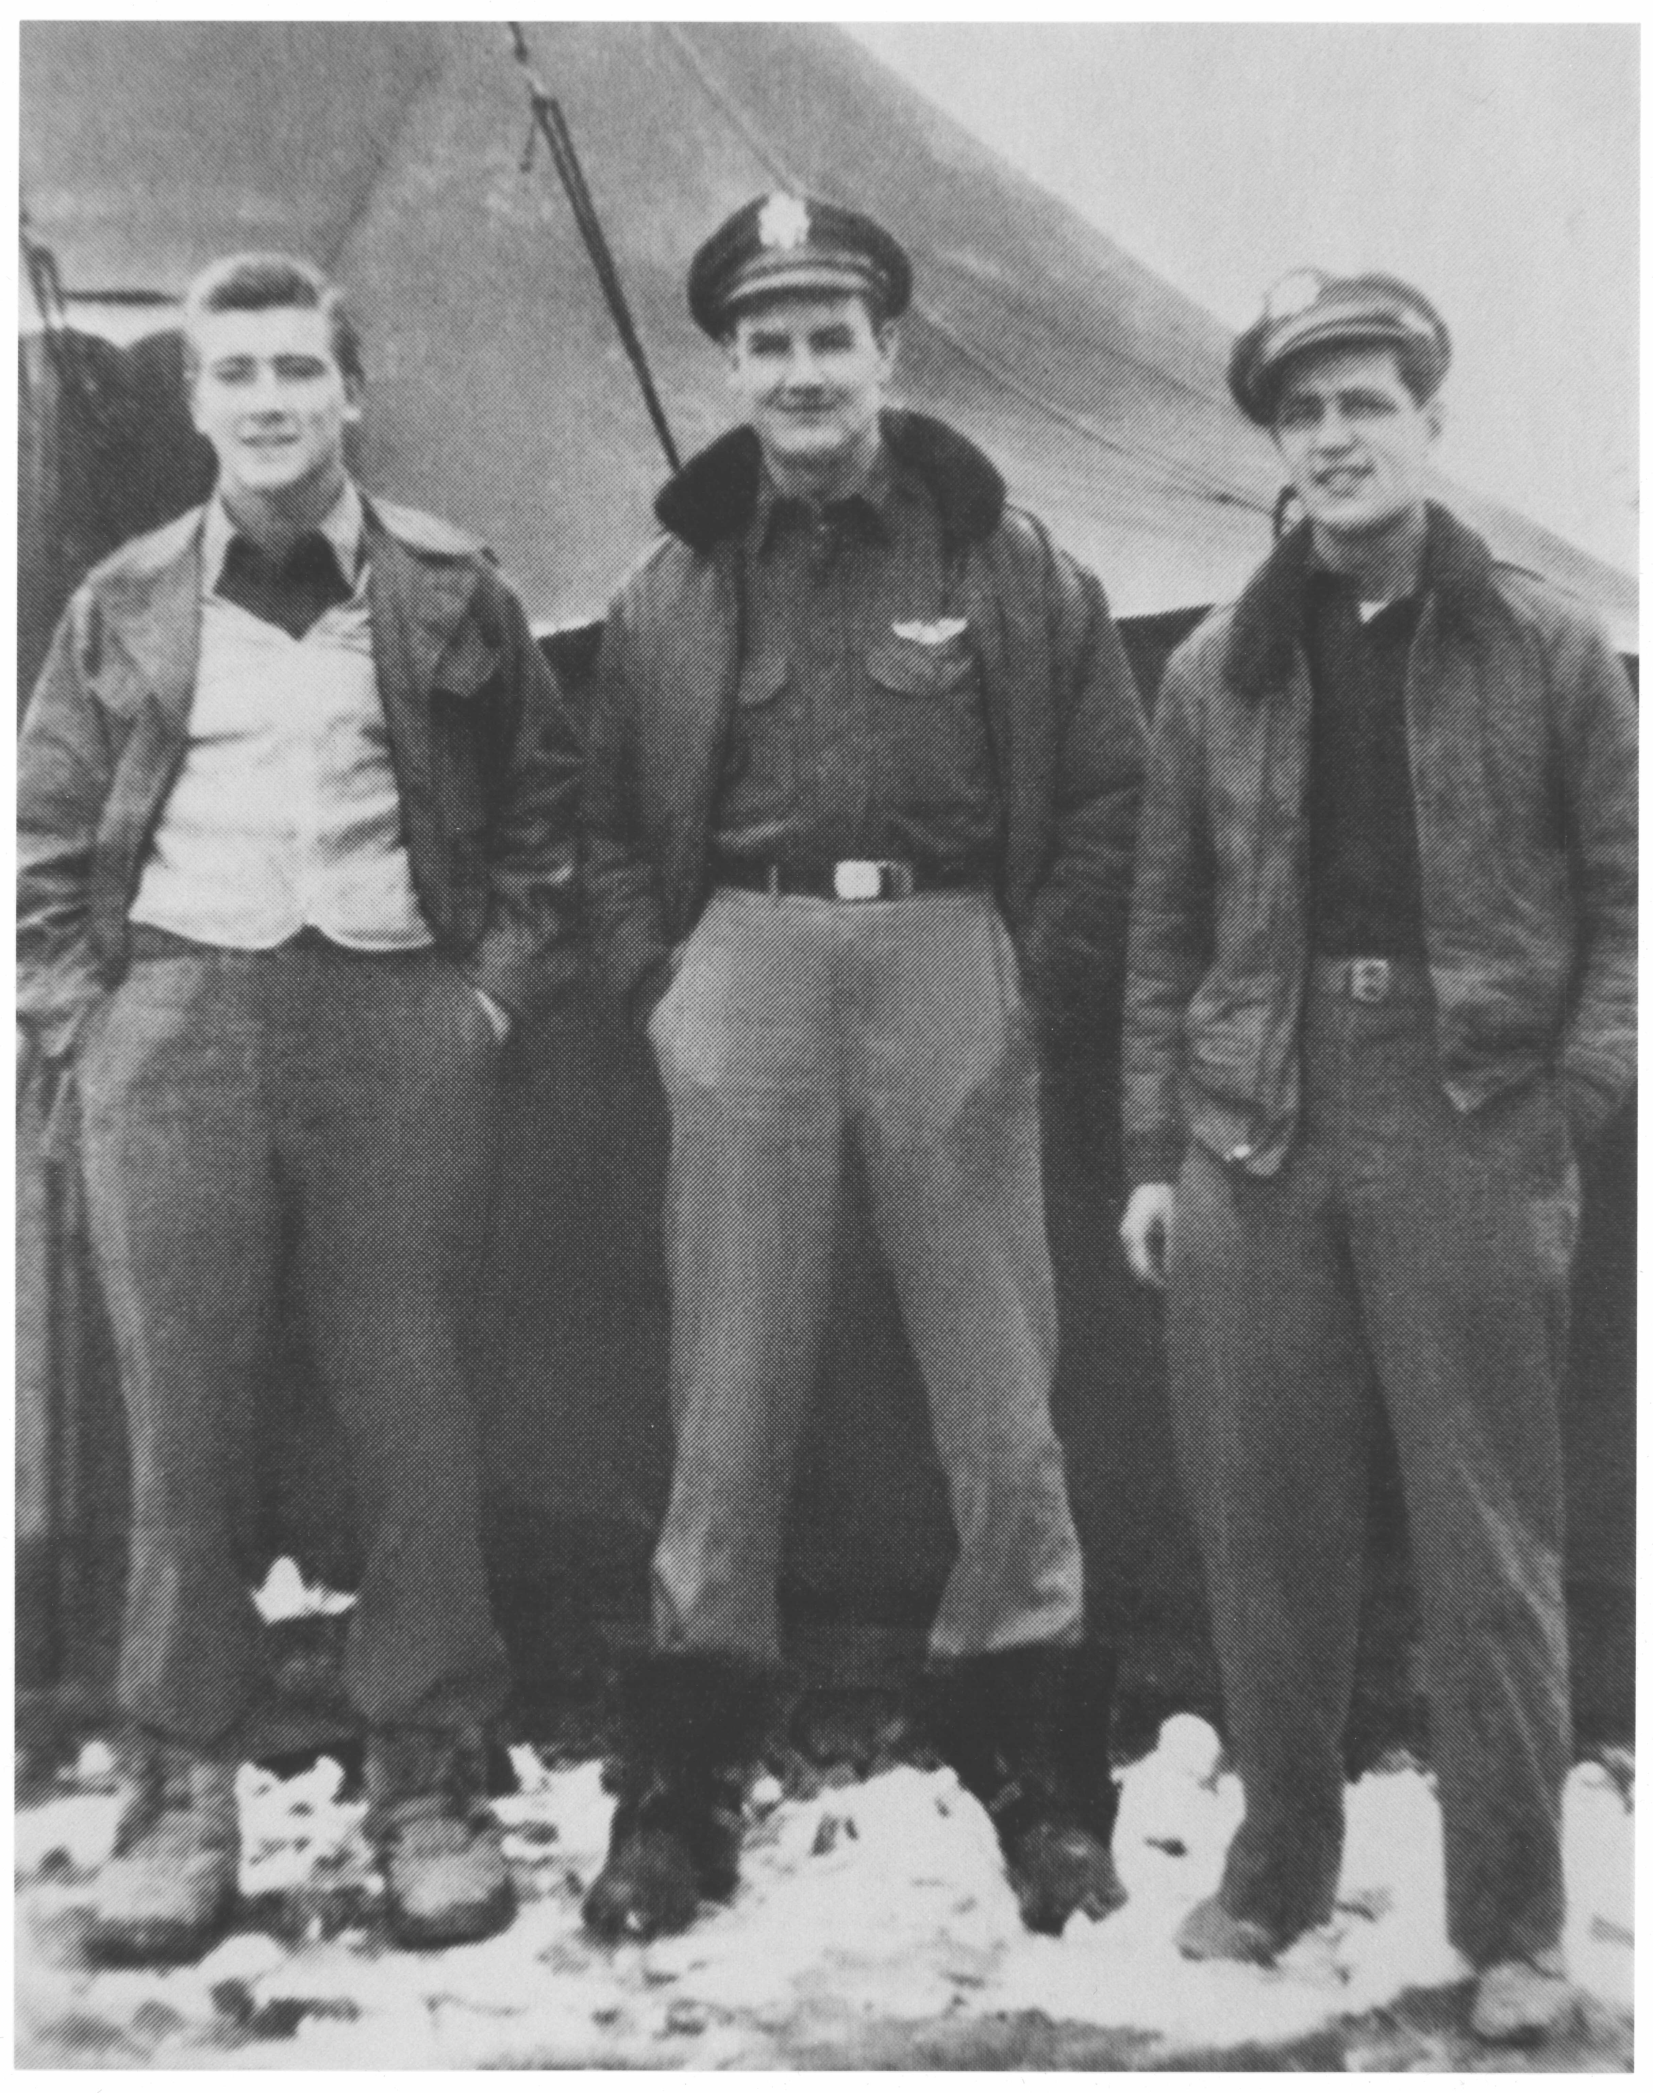
LT McGovern with co-pilot LT Bill Rounds (left) and navigator LT Sam Adams at San Giovanni

Slide 13
December 20, 1944 – 11th Mission
Bombing mission to Skoda Ammunition Works in Pilsen, Czechoslovakia
400 bombers from 15th AF, 35 from 455th BG
No. 2 engine quit an hour before the target, then No. 3 after bombs away
Steadily lost altitude on return to base
Navigator Adams plotted course east along Yugoslavian coast
Forced to land on Vis- threw out everything they could – landed at very end
#

Slide 14
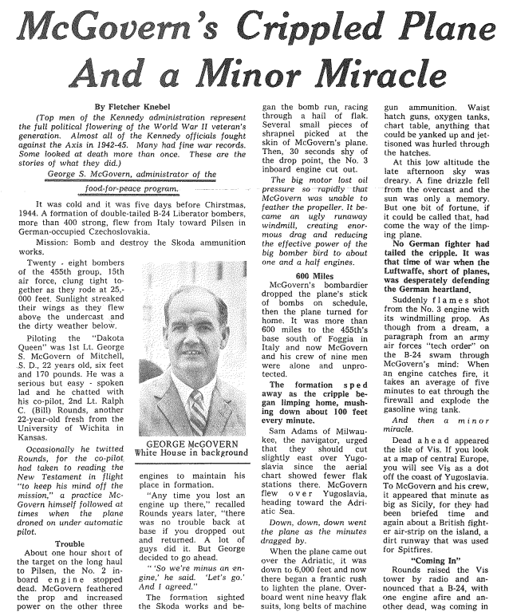
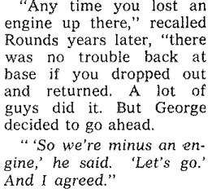
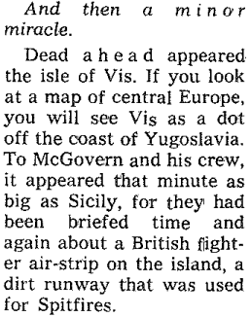

Slide 15
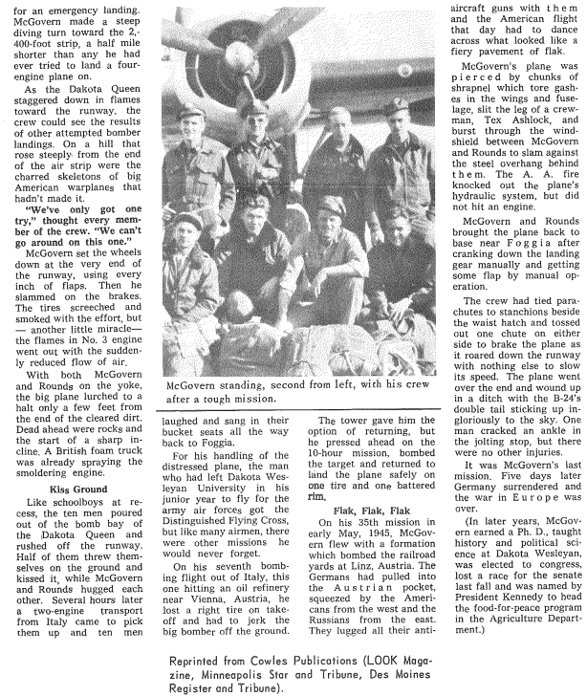

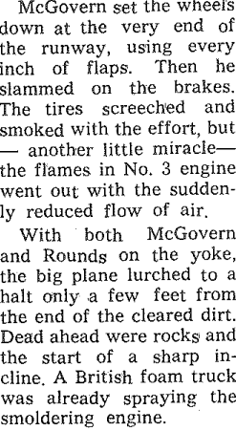

Slide 16
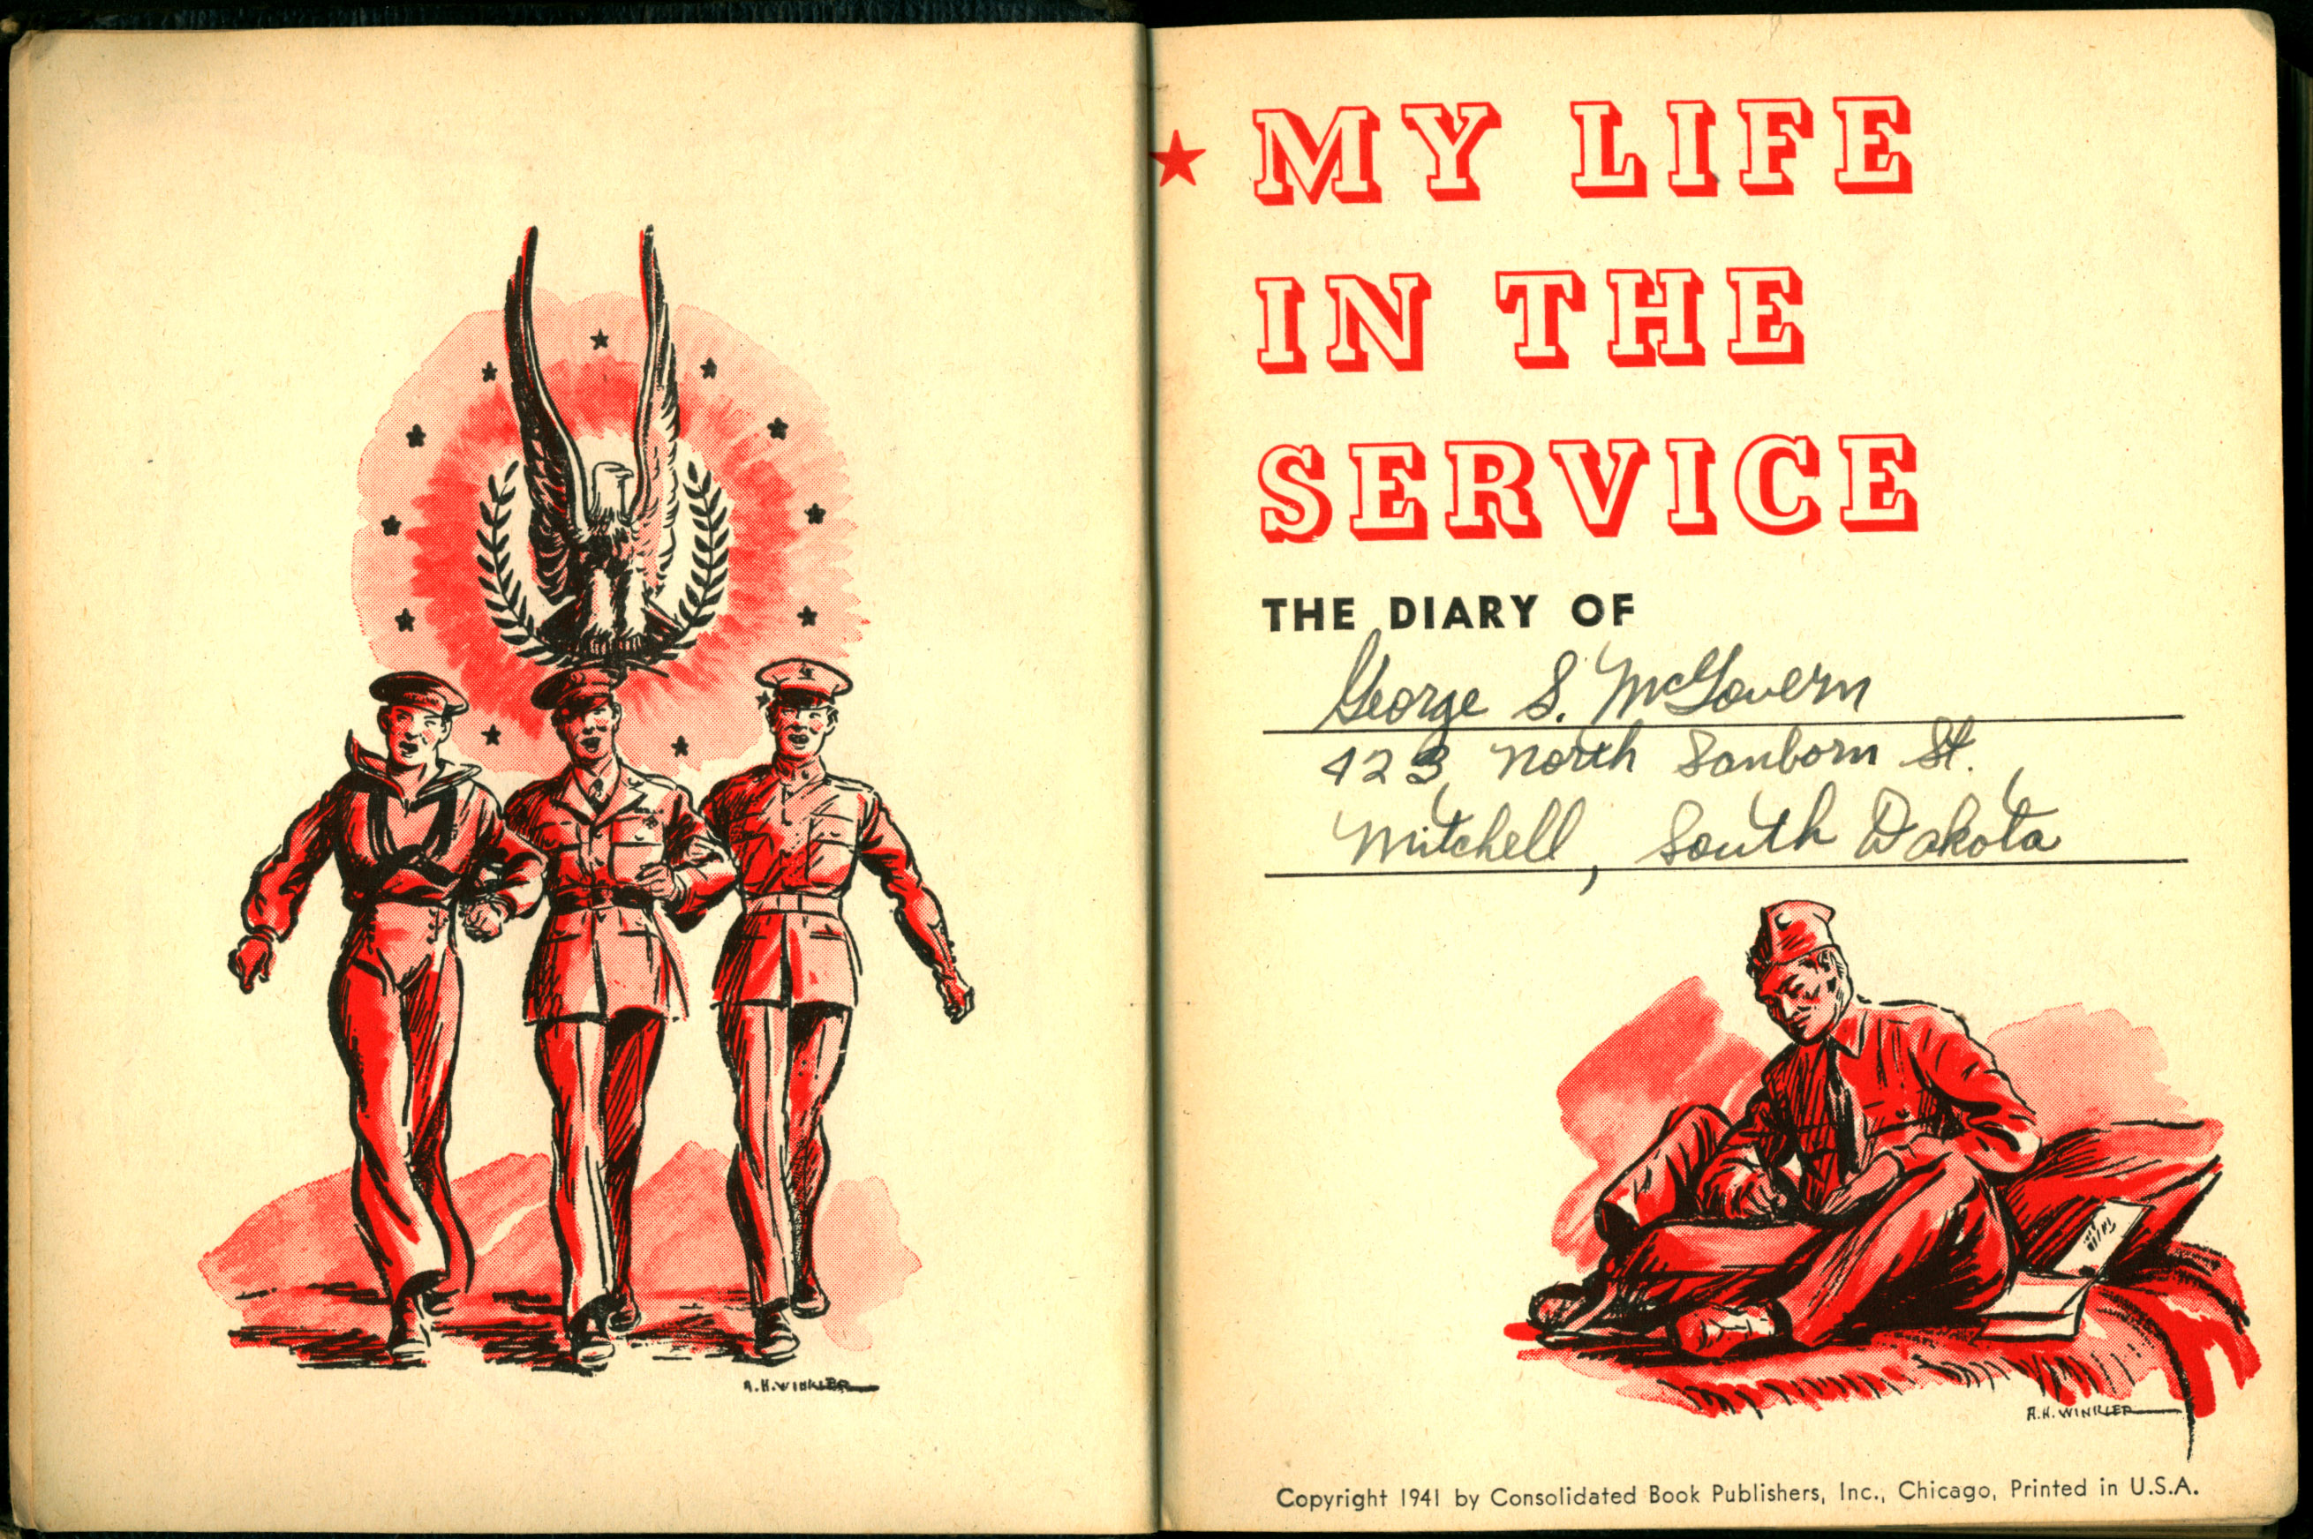
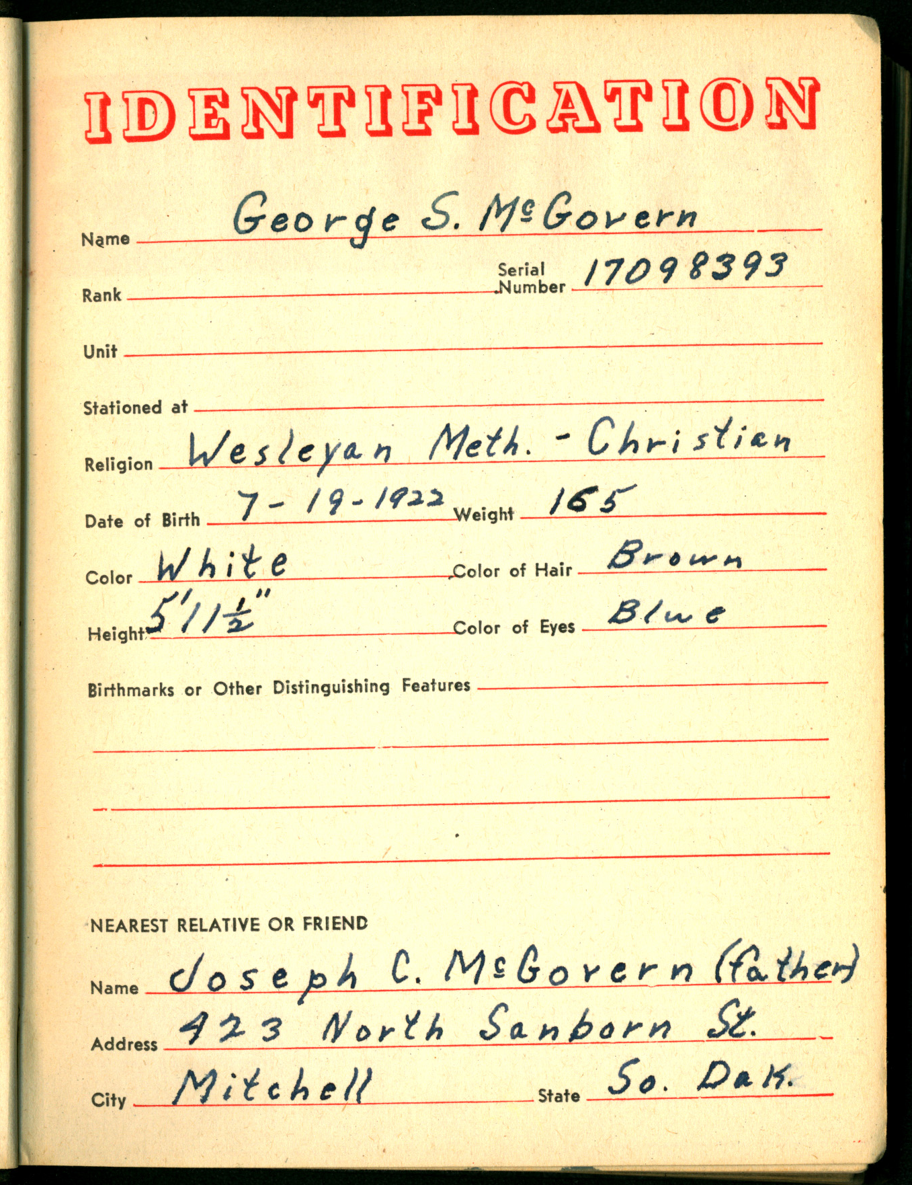
In his own words- McGovern’s Diary

Slide 17
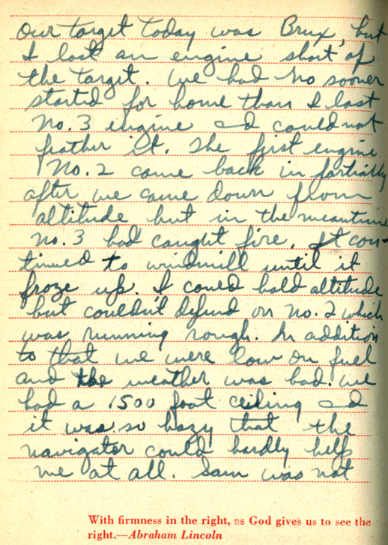
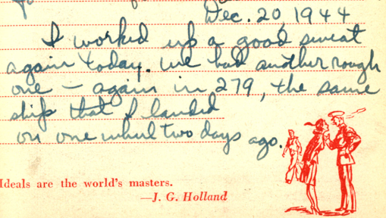
Note: the original target was Brux, but it
was changed to the alternate at Pilsen

Slide 18
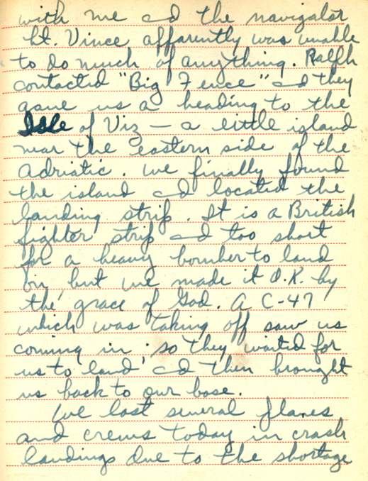
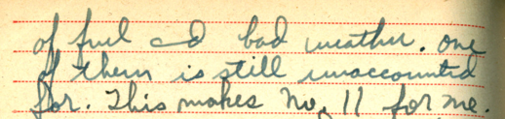
Note- There is some conflict as to who the navigator was. This diary says Lt Vince, but most other accounts say Lt. Adams. Both may have been on board as Adams was also a bombardier.

Slide 19

George McGovern audio recording Recorded in 2006*
CLICK on the arrow below the
symbol above to listen
George McGovern recorded by Stephen P. Hall for the Split Rock Studios as part of their
2006 creation of the McGovern Legacy Museum at Dakota Wesleyan University

Slide 20
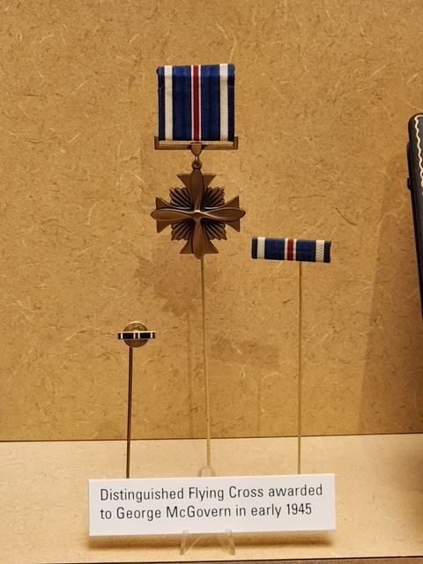
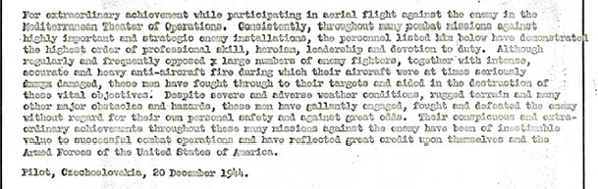
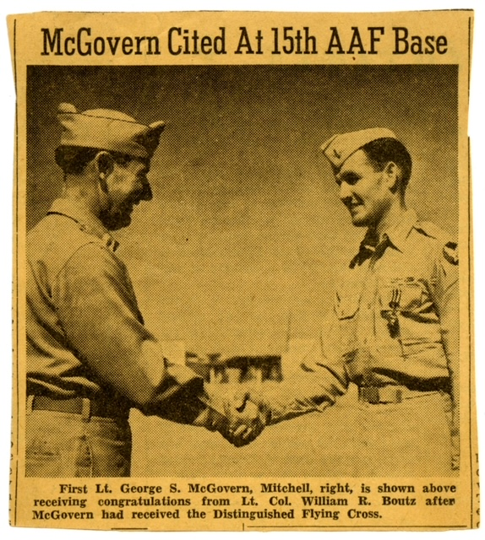
Awarded the Distinguished Flying Cross on May 7, 1945

Slide 21
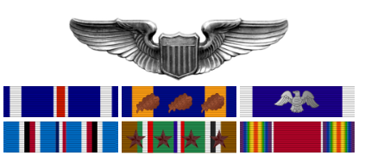
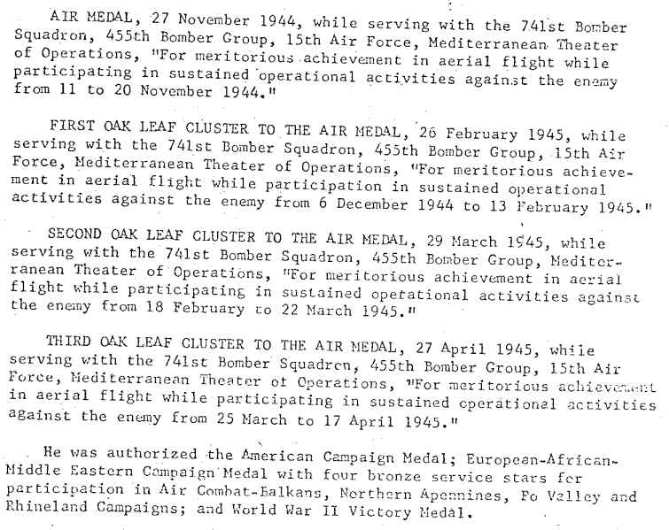
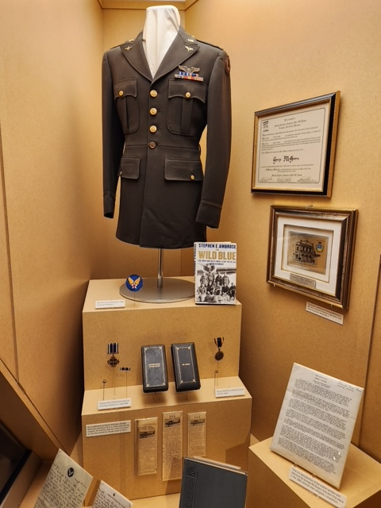
Other medals

Slide 22
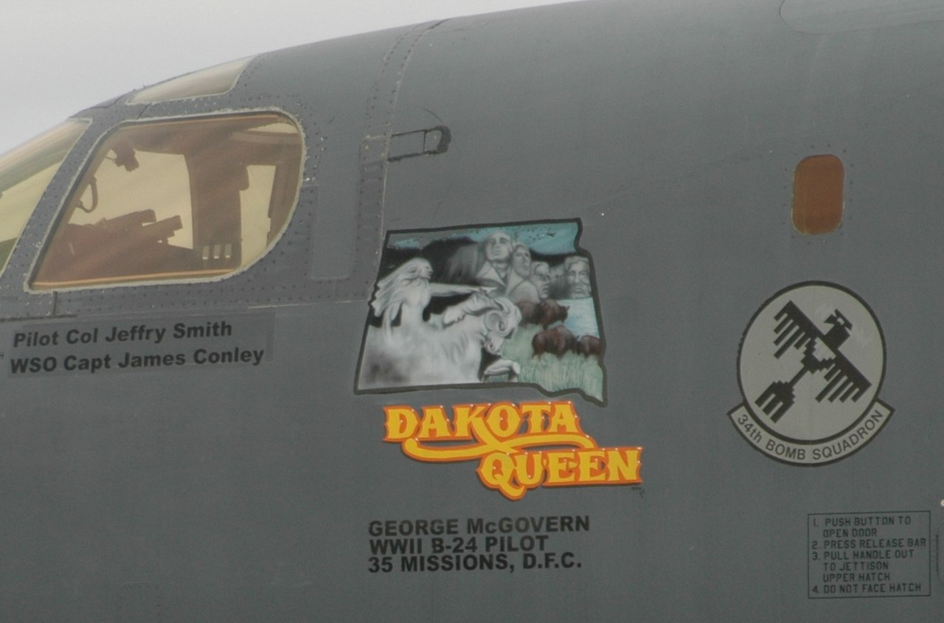
Nose art on B-1 Lancer in 2007 commemorating McGovern’s service

Slide 23
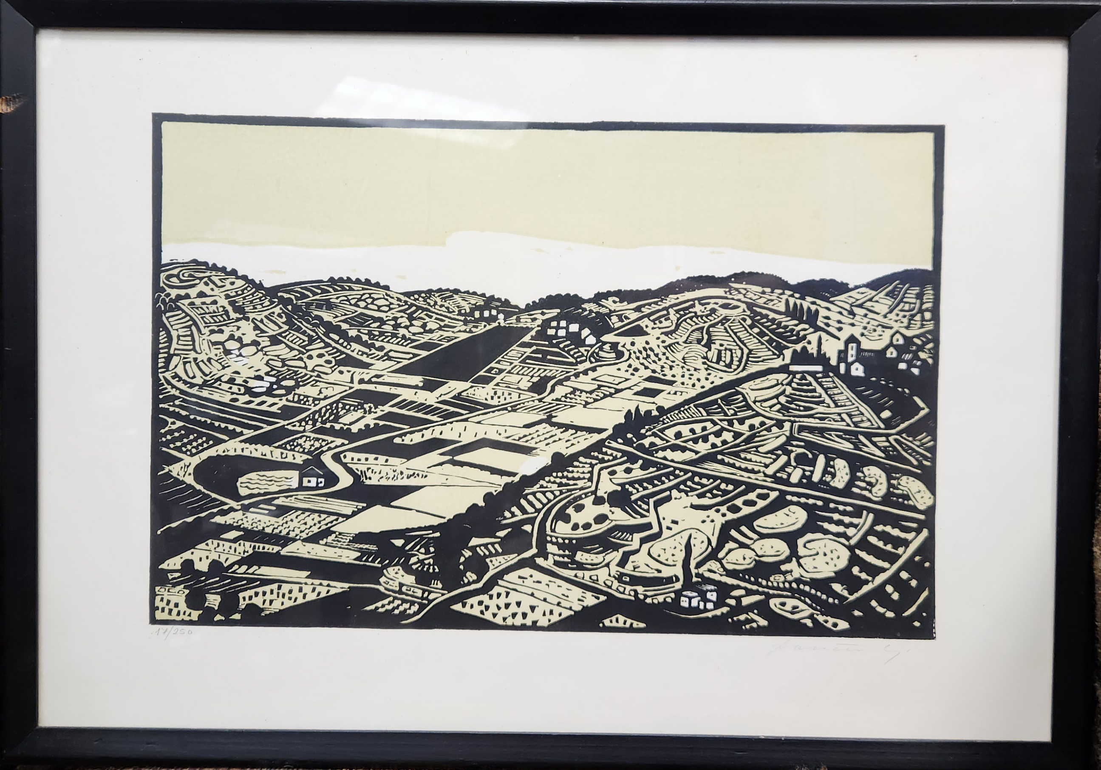
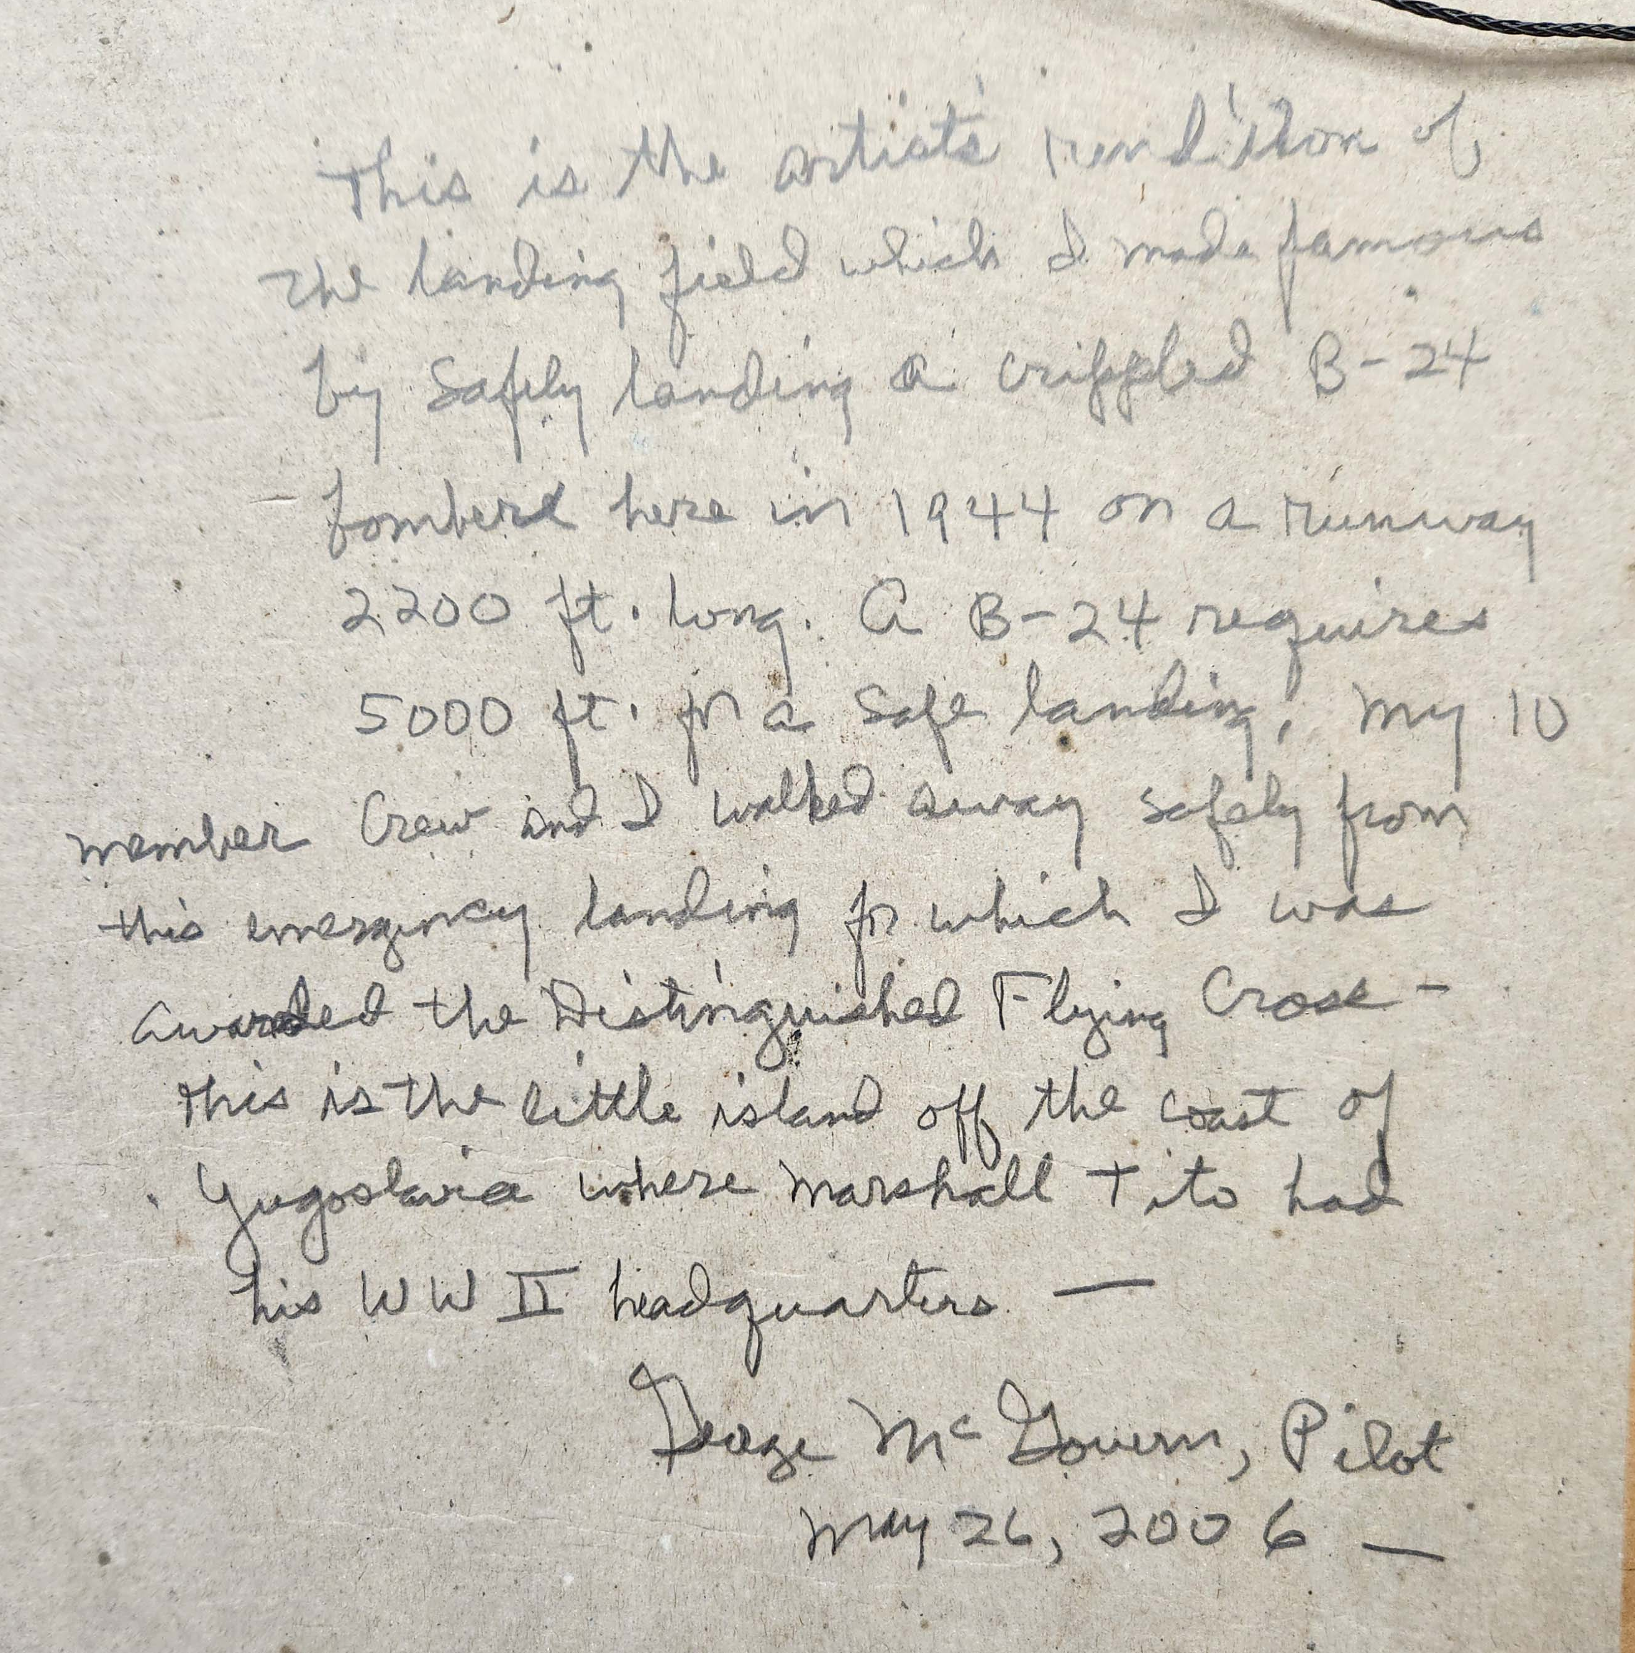
Framed print of Vis Airstrip artist’s signature illegible

Slide 24
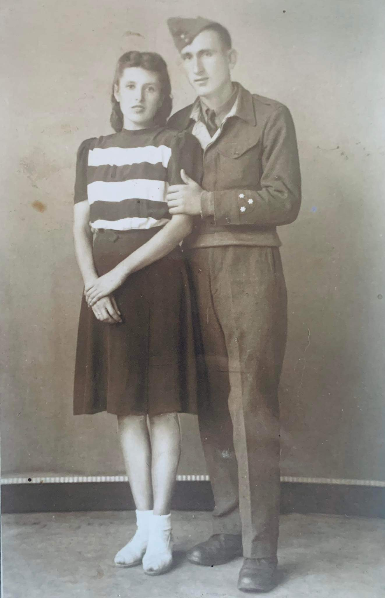
RAF Sgt Anton Sever*
Born in Gorizia, Austrian Littoral annexed by Italy after WWI
Italian subject of Slovene ethnicity
Conscripted into Italian AF in 1942
Deserted and taken POW then joined the NOVJ in 1944
Assigned to 351st Squadron of the RAF – to Vis October 18, 1944
* All material on Anton Sever courtesy of Niall Brannigan
#

Slide 25
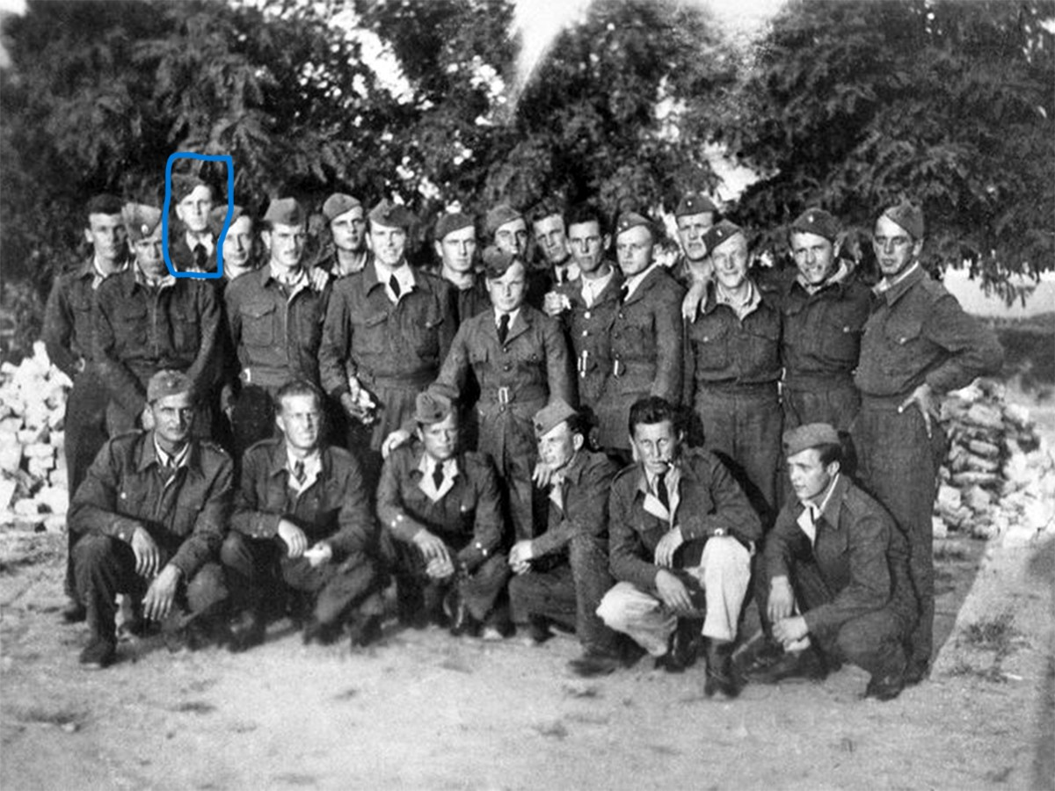
# 22 year-old Anton Sever with RAF comrades on Vis, c 1944

Slide 26
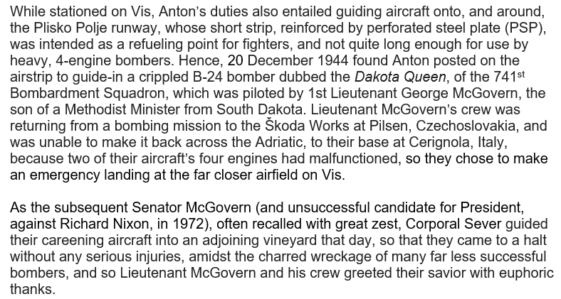


Slide 27
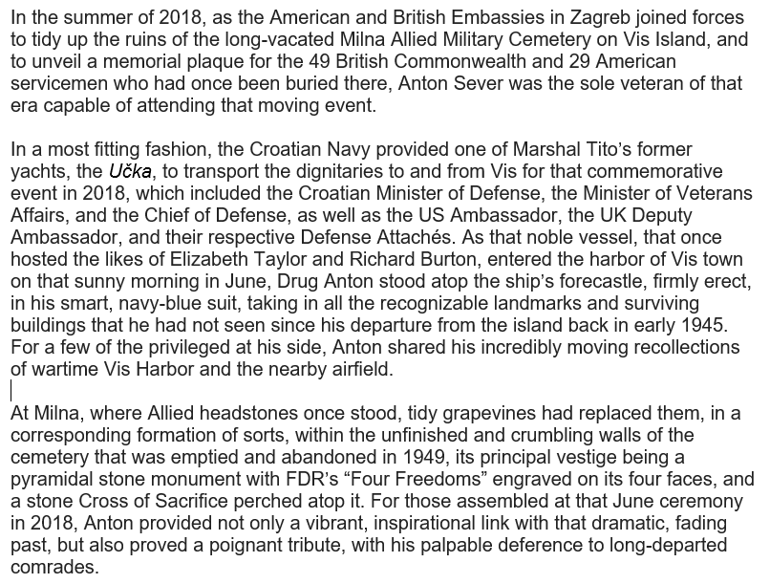
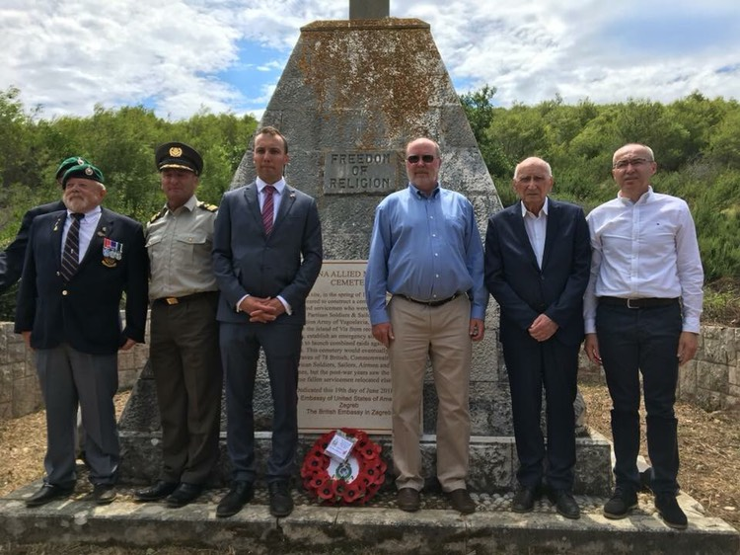
# Anton at Milne Cemetery with dignitaries
2nd from right on June 19, 2018

Slide 28
George McGovern - Post War
Flew food & supply relief flights in May 7 June 1945
Discharged July 1945
Graduated magna cum laude from Dakota Wesleyan
Briefly studied as a Methodist minister, then a history professor
PHD Northwestern 1953
Went into Democratic Party politics in 1953

Slide 29
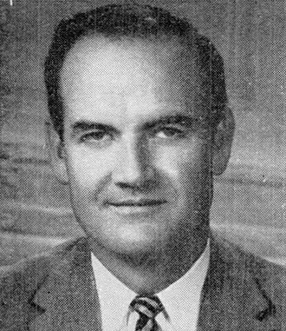
Political Career 1956-1981
Elected US house of representatives from South Dakota in 1956- served 4 years
Kennedy administration as Director of Food for Peace 1961-2
Distinguished US Senator 1963-1981
Strongly opposed the Viet Nam War
Ran for President against Richard Nixon in 1972 but was soundly beaten
Freshman Representative 1957

Slide 30
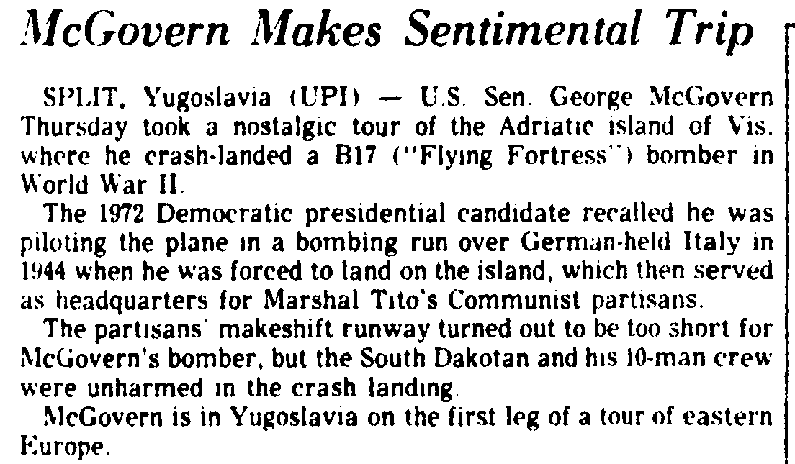
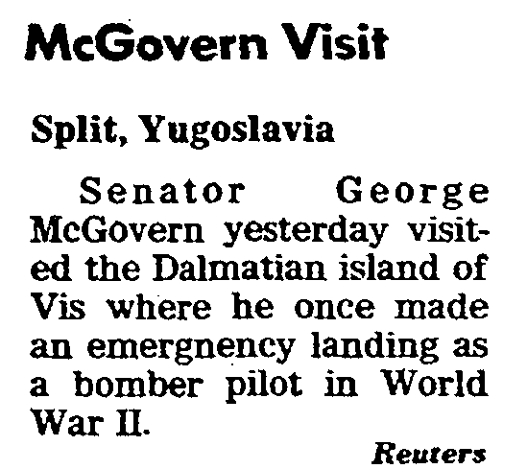
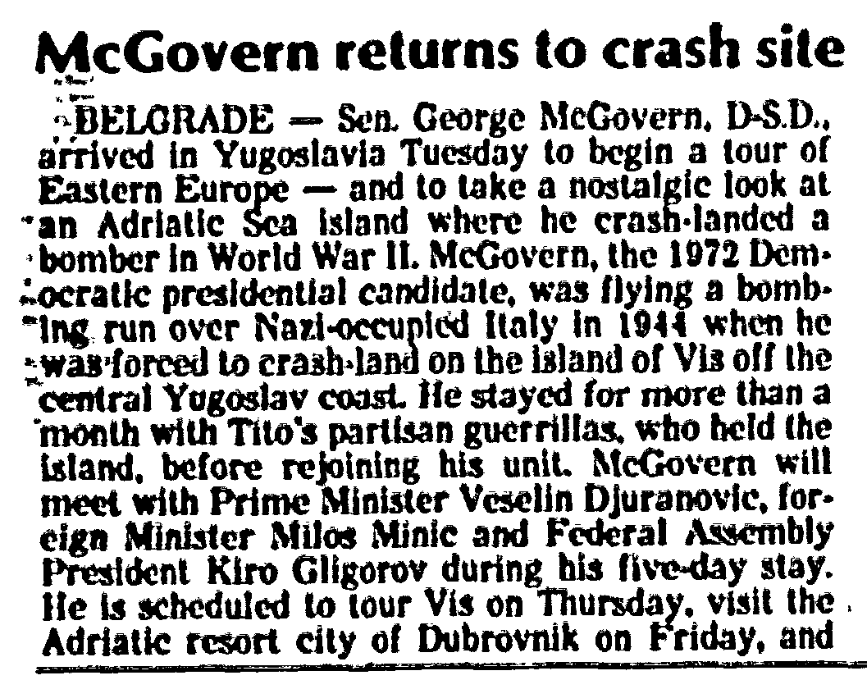
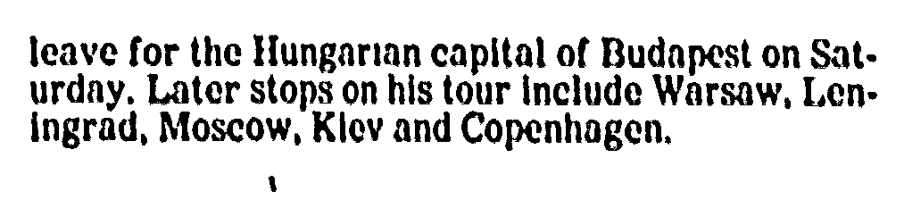
Visit to Vis on August 11, 1977
Notes: His bomber was a B-24, not a B-17
He left Vis after the crash the next day
and didn’t stay a month with the partisans

Slide 31
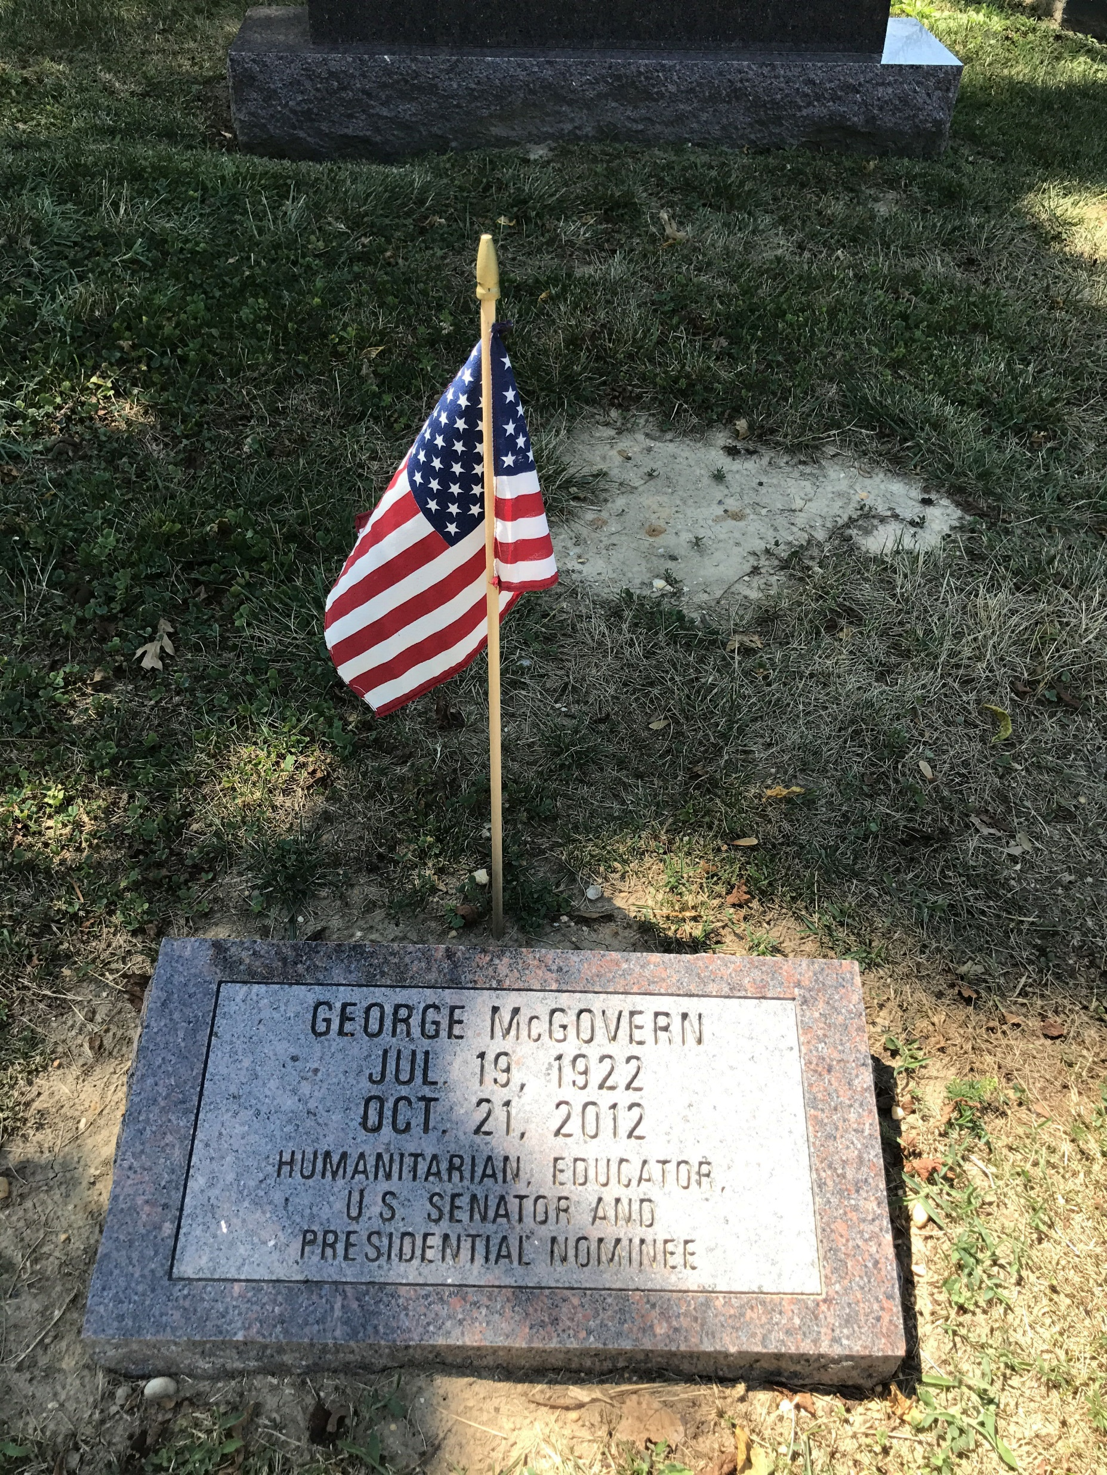
Rest in Peace
Lecturer and professor most of the rest of his life
Many positions on world hunger including for the U.N. & Clinton administration
Presidential Medal of Freedom in 2000 for his service in the effort to eradicate world hunger
Died at age 90 in 2012
#

Slide 32
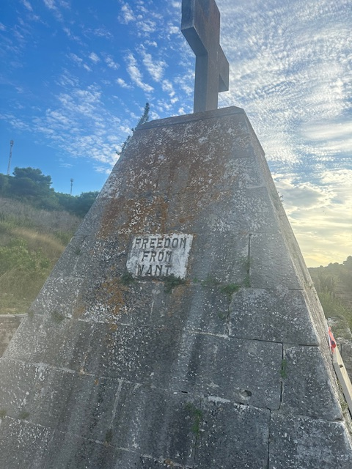
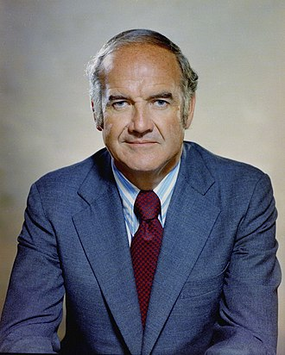
War Hero –dedicated to eliminating world hunger
Milne Cemetery on Vis – one of Roosevelt’s Four Freedoms
inscribed on the monument there
McGovern’s book “The Third Freedom” proposed
a plan whereby chronic world hunger could be
eliminated within thirty years

