Slide 1
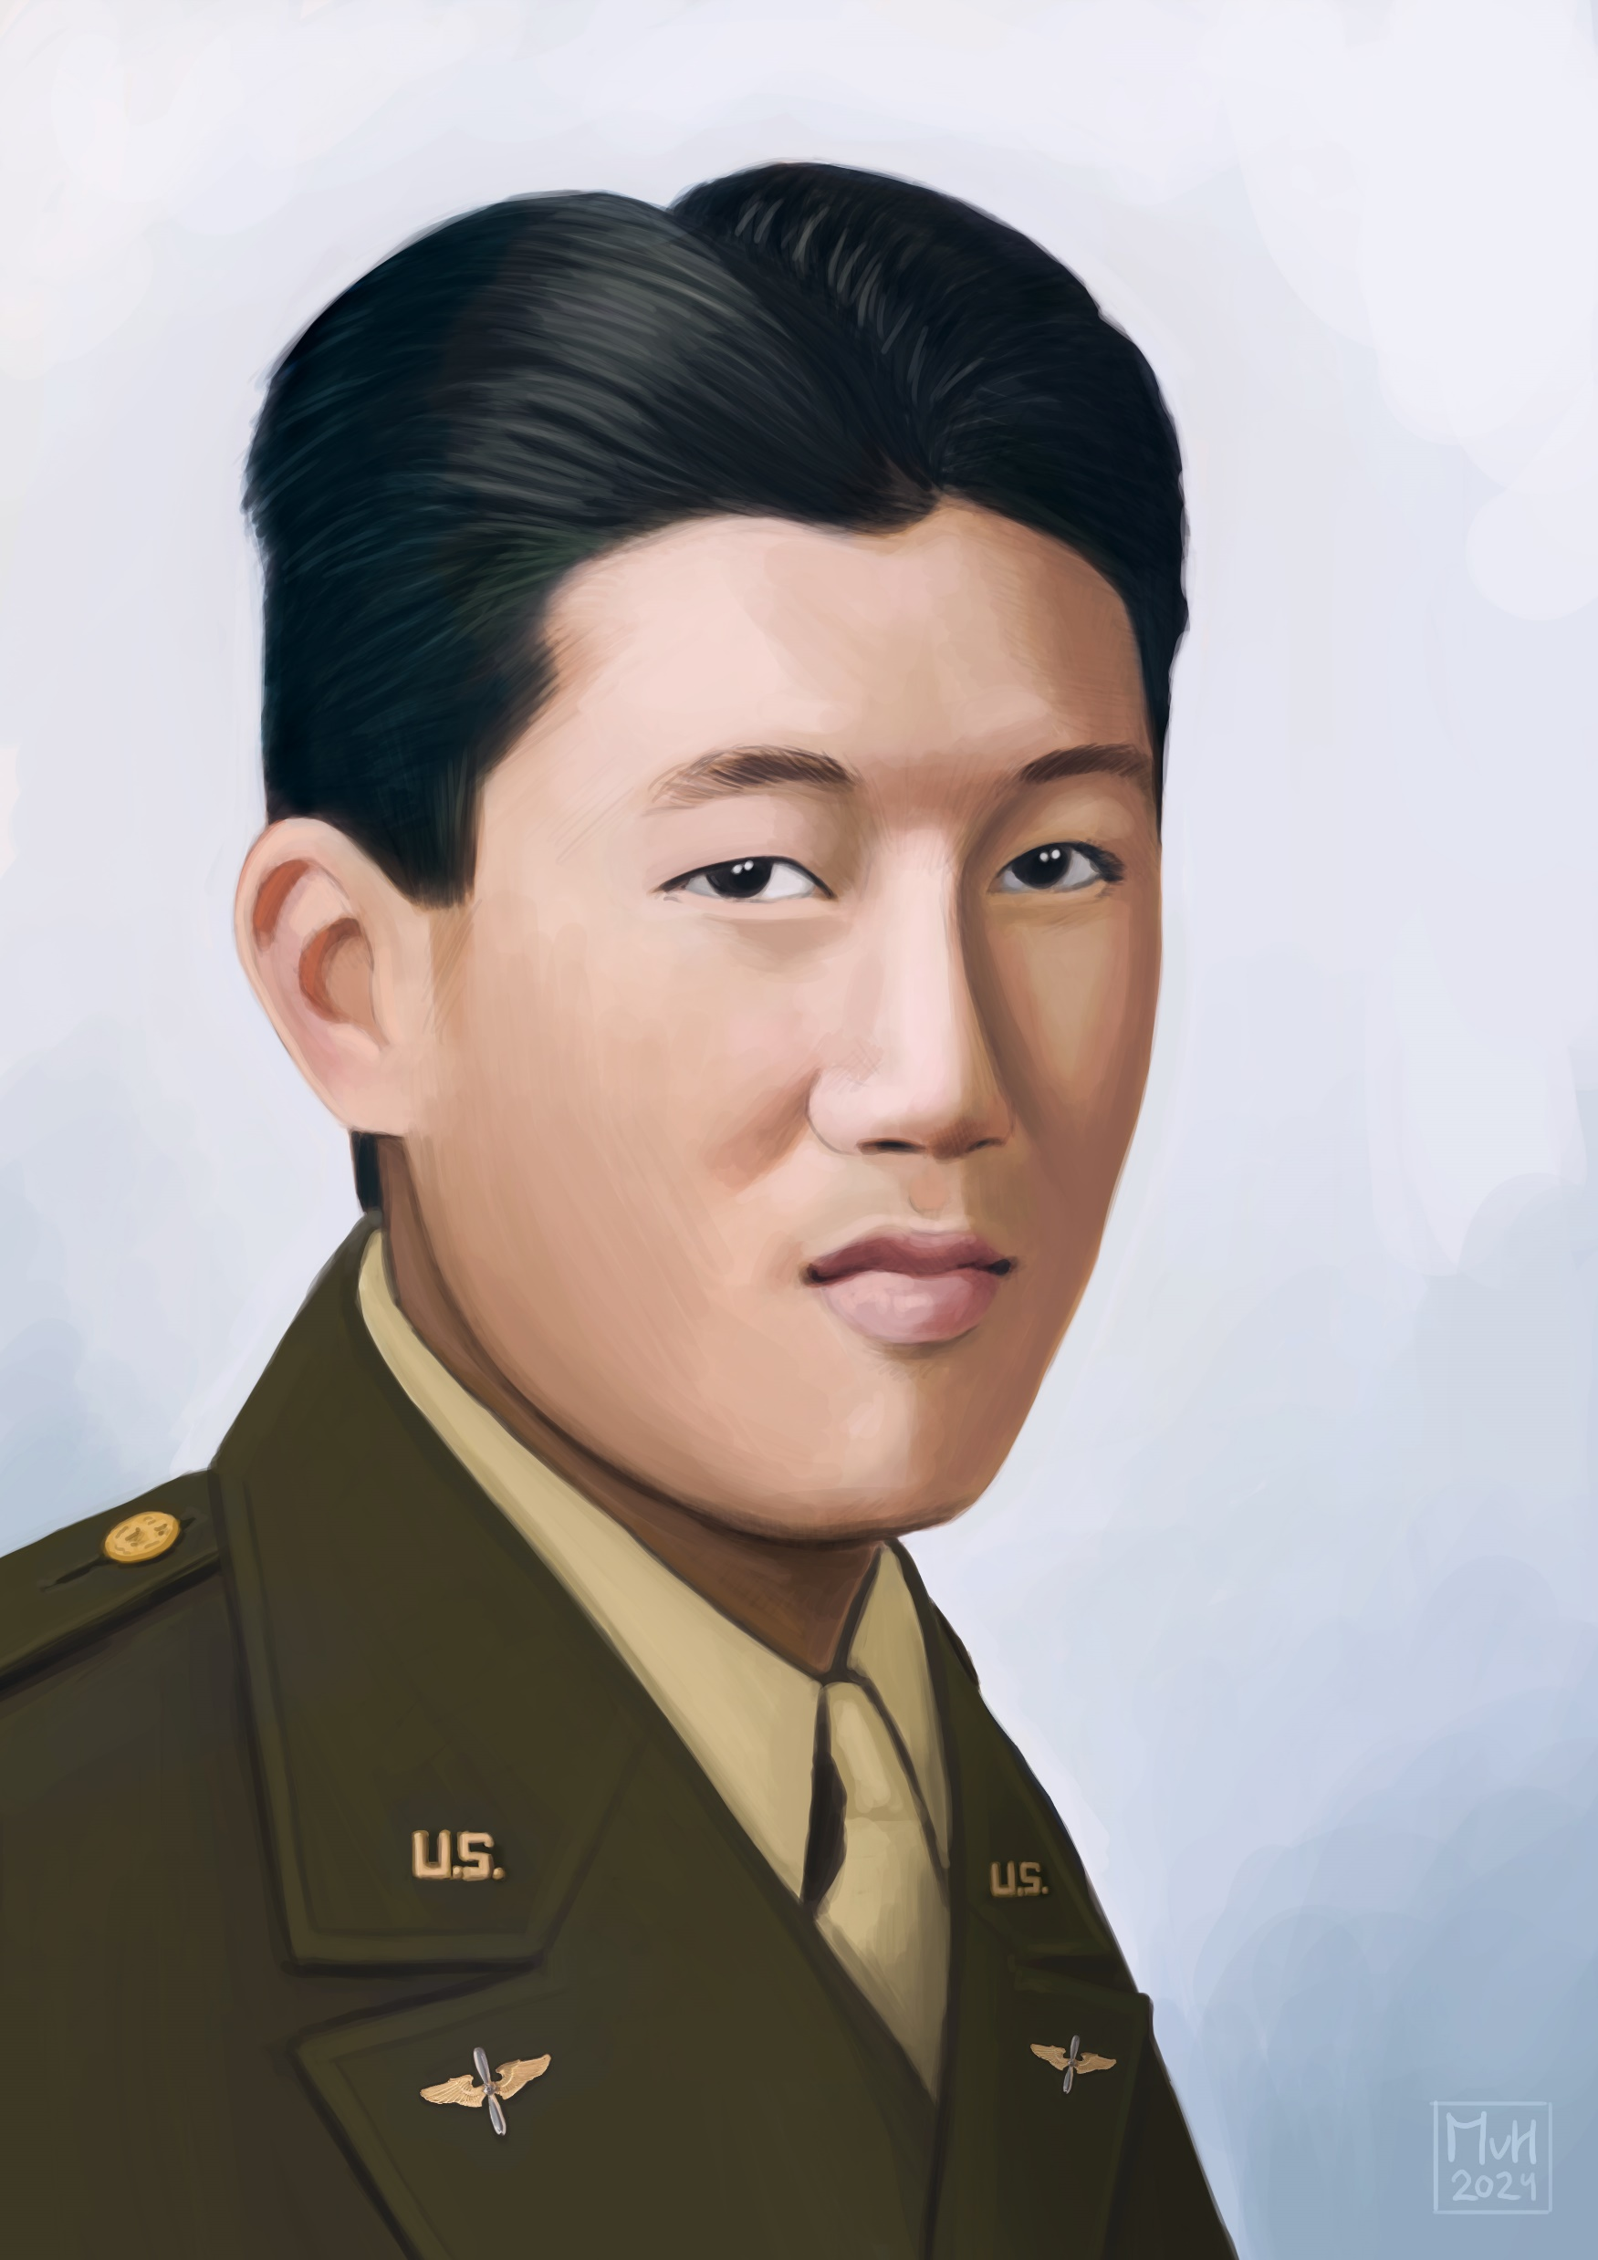
STORY #1A SYNOPSIS
2d LT John J. K. C. Kim- DOW* APRIL 12, 1944
27th FS, 1st FG
P-38 Lightning Fighter
Fighter Pilot
Returning from escorting bombers to Bad Voslau, Austria
Forced to land at Vis for fuel & repairs
Upon take-off, engine failed & had to land
Crashed short of runway, pulled from burning plane
Died two days later on April 14th
First American airman to die on Vis in WWII
Born- Honolulu, Hawaii 25 Years Old
*Died of Wounds Received in Action

Slide 2
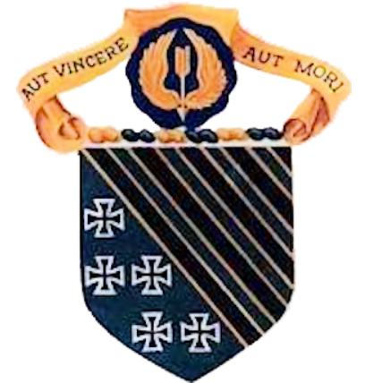
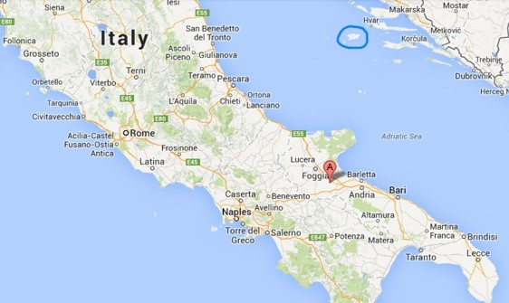
1st Fighter Group
VIS
Salsola
Salsola, Italy - January 1944- May 1945
Three fighter squadrons: 27th, 71st & 94th
Primary mission- escorting bombers attacking targets in Italy, France, Germany, Czechoslovakia, Austria, Hungary, Bulgaria, Rumania, Yugoslavia and Greece
Flew P-38 Lightning aircraft
Flew 1,045 combat missions in WWII

Slide 3
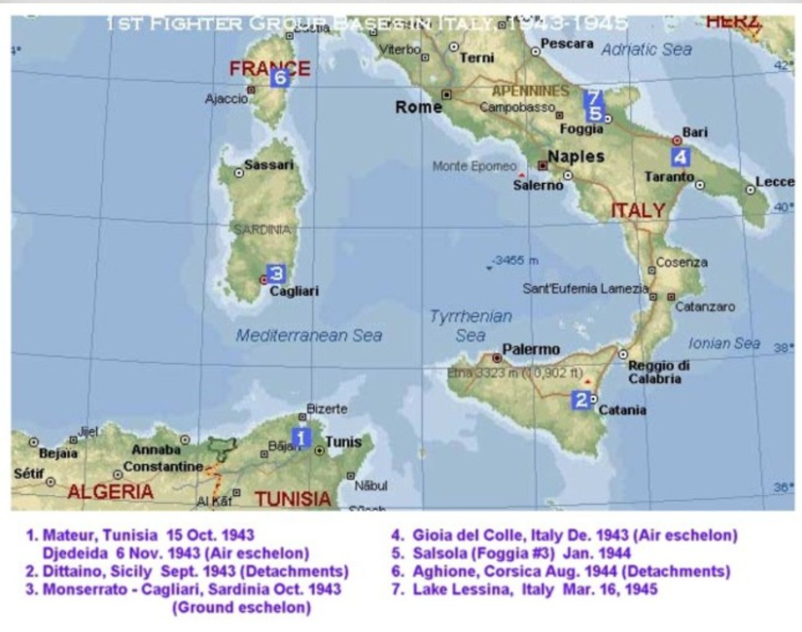

Slide 4
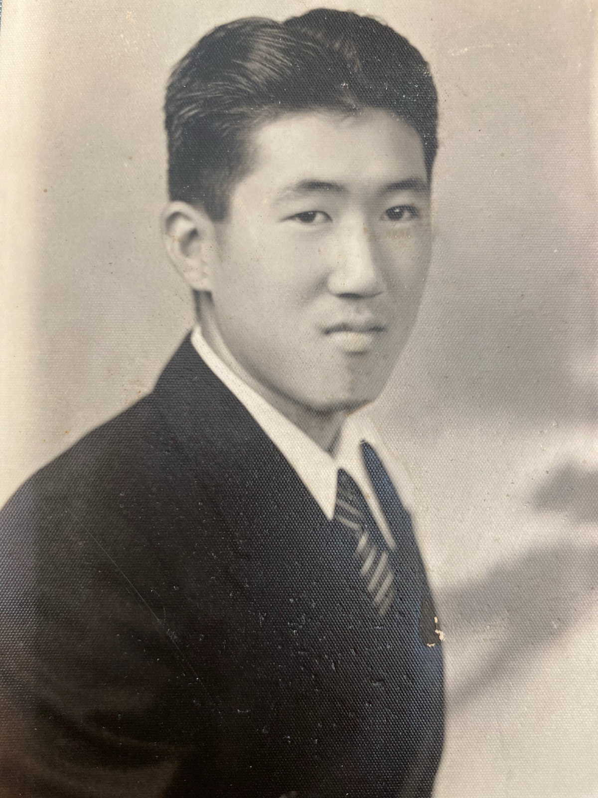
John Jay Ki Chon Kim
Born on March 3, 1919 in Honolulu, Hawaii & grew up there and in California
Hawaii was a U.S. Territory, became a state in 1959
Son of Korean immigrants Hyung Kak (aka Chang Wha) Kim & Sung Gin Hahn
Three brothers & two sisters
Attended Delano CA schools, Bakersfield College & the University of California at Berkeley where he got an Engineering degree

Slide 5
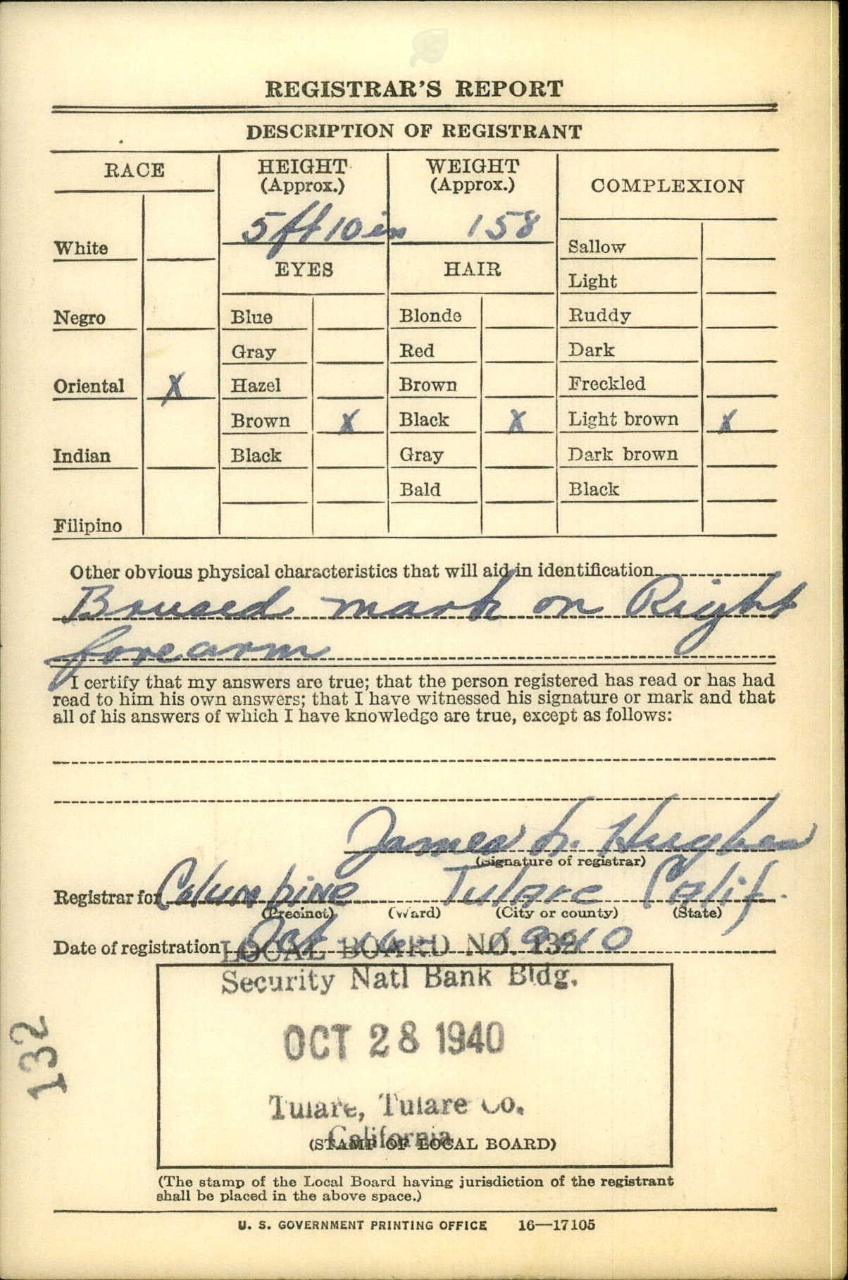
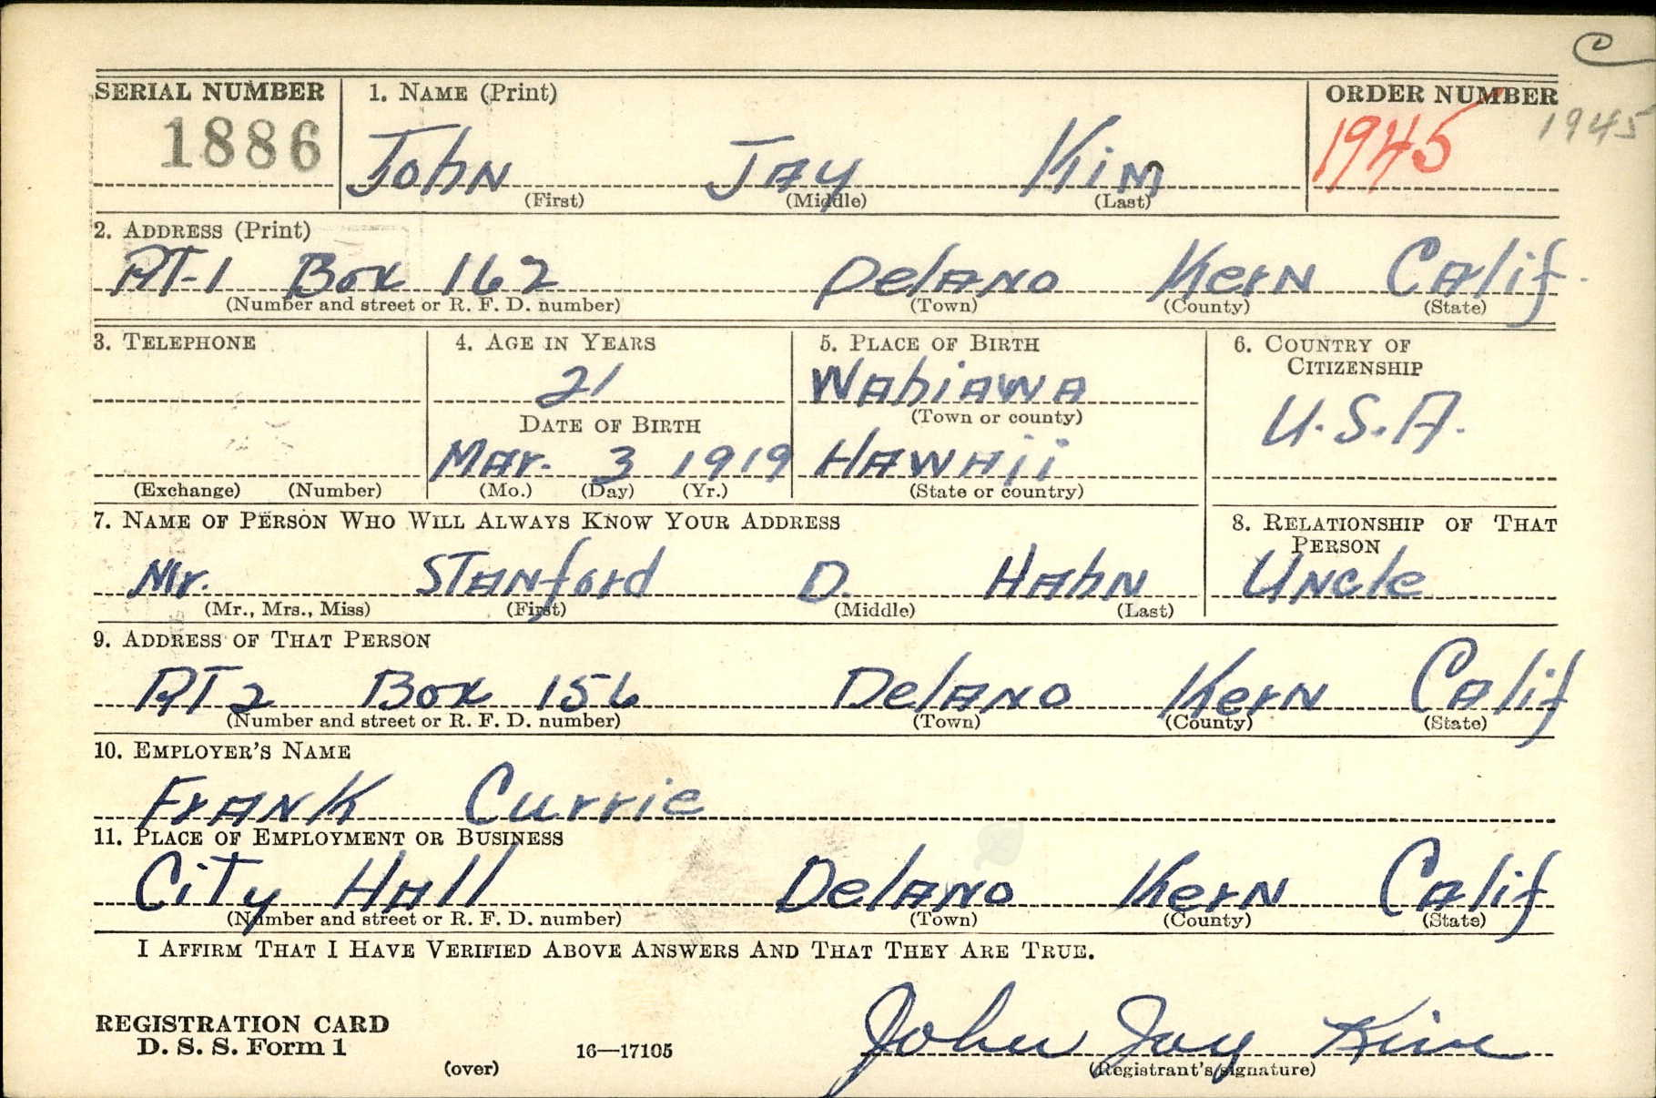
Draft Registration Card – Oct. 28, 1940

Slide 6
2d LT Kim in WWII
Moved to Hawaii and worked in Honolulu as a draftsman at the U.S. Engineering Department- 1941-2
Lived at 929 Green St., Honolulu
Was there on December 7, 1941, “Pearl Harbor Day”
Met & married Victoria Sunghye Chai on October 17, 1942
Enlisted in the Army Air Corps on October 31, 1942
Trained at Gardner Field, California and Luke Field, Arizona- became a pilot

Slide 7
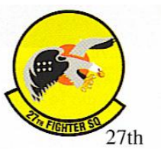
27th Fighter Squadron
2d LT Kim joined the 27th at Salsola on March 31, 1944
May have seen previous action in Africa
New P-38Js arrived about this time

Slide 8
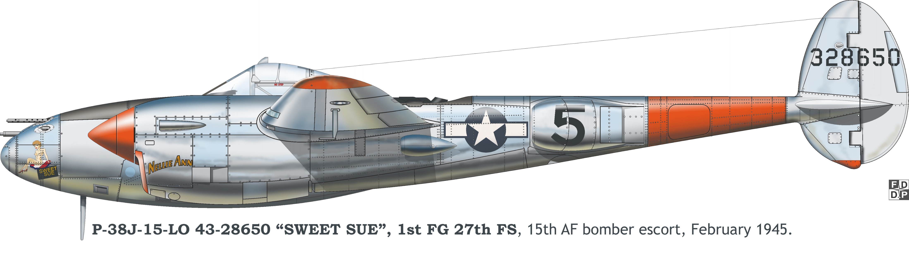
P-38J similar to 2d LT Kim’s
Source: “Vis-the Last Hope” page 389

Slide 9
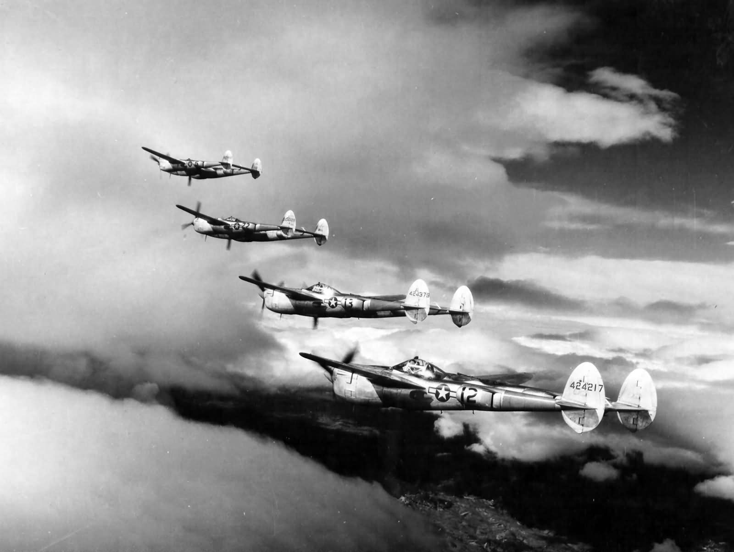
(702) P-38 formation flight POFAS 2013 - YouTube

Slide 10
April 12, 1944
Mission to Bad Voslau, Austria, Messerschmitt assembly plant & aerodrome
Escorting 140 B-24 bombers
Only Kim’s second combat mission- considered an “unusually good” pilot
16 P-38 Lightnings from the 27th FS led by 1LT Francis Lawson
Successful mission – extensive damage to the plant & aerodrome
On return to base, 2d LT Kim forced to land on Vis to refuel
Vis airstrip became operational for fighters only a day before

Slide 11
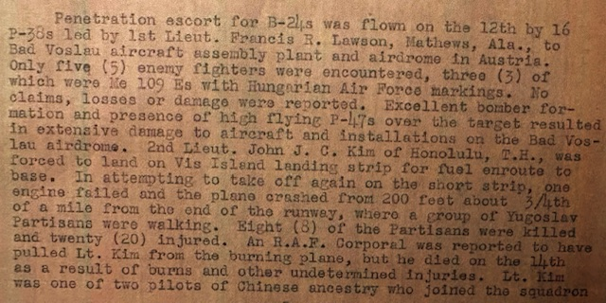
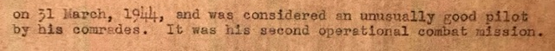
27th FS Mission Report

Slide 12
“Vis-The Last Hope” page 104
April 12, 1944-
In a large-scale offensive on industrial targets around Vienna, 172 B-17 Flying Fortresses bombed an aircraft parts factory in the town of Fischamend Markt, 140 B-24 Liberator bombers attacked a Messerschmitt factory in the small town of Bad Voslau, and additional 134 B-24s bombed an aircraft factory in the town of Wiener Neustadt. One B-17 bomber and six B-24s were lost. The bombers were escorted by more than 200 P-38 Lightning and P-47 Thunderbolt fighters whose pilots reported downing 17 German fighters.*
At 14.30, one P-38 Lightning fighter of the 1st FG 27th FS force landed on Vis’ small strip. It belonged to the group of 10 American aircraft led by 1st Lt. Francis Lawson which had escorted B-24 bombers on a bombing mission of an aircraft factory near Bad Voslau in Austria. The fighters were intercepted by only 5 enemy fighters, three of which were Bf-109s with Hungarian markings. No losses were suffered. The perfect bomber formation carried out its mission undisturbed, leaving the aircraft factory and nearby airfield in ruins. Owing to fuel shortage, 2nd Lt. John J.C. Kim (from Honolulu, Hawaii, but of Korean origin) crash landed on the Vis airstrip.
After refueling he went to takeoff, but immediately on takeoff one engine cut out. The aircraft lost altitude and crashed on the Vis-Komiža road, a couple of meters from an ammunition dump and Partisan positions. An explosion and fire burst out. Seven Partisans were killed and five injured, as well as one British commando. Even though the ammunition kept exploding, a British soldier dragged the burnt pilot (Lt. Kim) clear and he was immediately taken to hospital. Lt. Kim was one of the two pilots of Korean origin in the squadron which he had joined less than two weeks earlier (March 31) and was esteemed as an excellent pilot. It was only his second combat mission.
* Eric Hammel “Air War Europa, Chronology 1942-1945”, Pacifica Press, USA 1994.

Slide 13
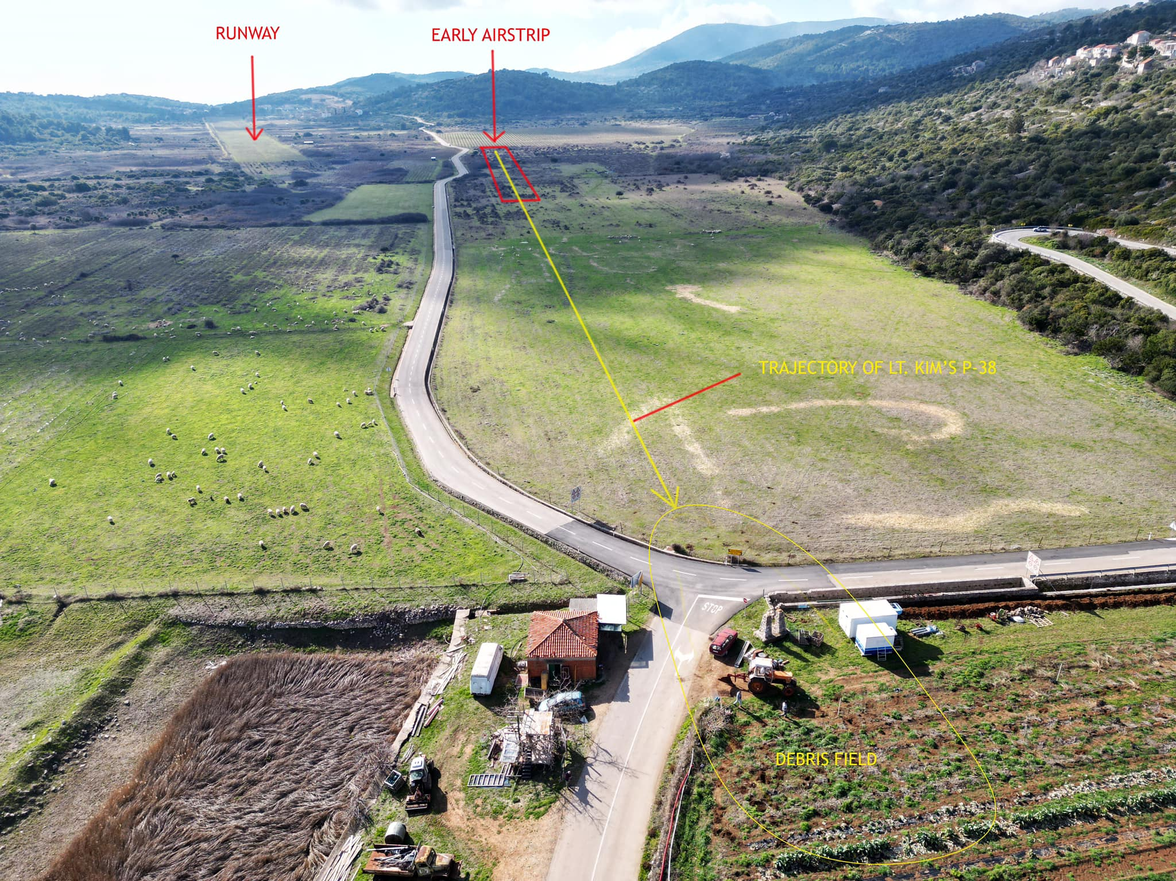
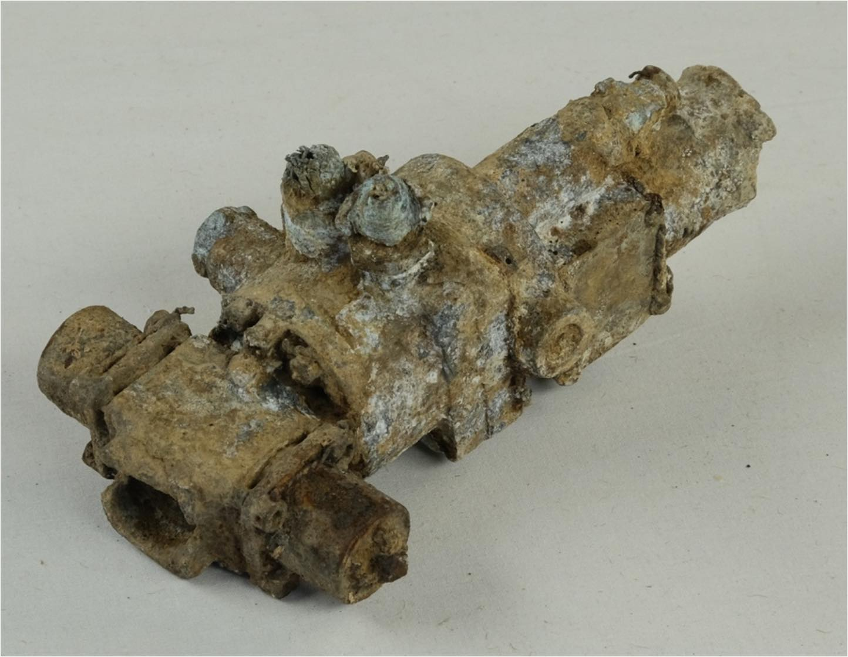
P-38 parts recently found by the Croatian Society of Military History (HDVP) at crash site- February 2024
Parts found include hundreds of small pieces of
broken, melted aluminum, plexiglass, stainless steel, bushings etc. including 3 pieces that un-
doubtedly are from that type of aircraft.
Only one aircraft crashed there per “Vis-the Last Hope”
The part above is the P-38 coolant temperature control valve found.

Slide 14
Death of 2d LT Kim
Treated by British Major Dr. James Rickett at Podhumlje Hospital on Vis
The field hospital was in the converted house of a priest
He died of his injuries there 2 days later on April 14th
He was 25 years old

Slide 15
11 Partisans killed on that fateful day
The Mission Report is accurate: 8 Partisans were initially killed, but no RAF soldiers
20 Partisans were injured- 3 died later
The names of the deceased Partisans are shown on the next page
The name of the RAF corporal who pulled Kim from the burning plane is not known

Slide 16
Partisan casualties of the April 12th crash Rest in Peace
Members of the 1st Dalmatian Brigade, most 2nd Battalion:
1. Bohorović Petar, age 44, born in Kaštela - Split,
2. Bukurović Petar, born in Knin,
3. Cular M. Niko. age 31, 1913. born in Danilo – Kraljica - Šibenik
4. Grgantov I. Spiro, age 32, born in Kaštel Lukšić — Split
5. Grigori Pelajnog — Alpolzijev, born in Armenia- USSR
6. Jukić A. Ivan, age 29, born in Kaštel Štafilić -Split
7. Kalebić M. Slavko age 34, born on island Šolta,
8. Klarić P. Vinko, born in Draga Voda —island Brač
9. Kokeza L. Ivan, age, born in Ogorje — Split,
10. Mladìneo P. Pavao, age 20, born in Borovik-island Vis
11. Skorić I. Ivan, age 37, born in Primošten – Šibenik
Note: An elderly resident of Višan told Velimir Mratinic that at least two partisans saved themselves by throwing themselves into a 7-foot deep ditch. One of them was his father Ivan Cvitanović and his comrade called “Mote Mecak” Also, the owner of the neighboring vineyard Ivan Murušić testified in 2015 that a piece of landing gear was sticking out of the ground

Slide 17
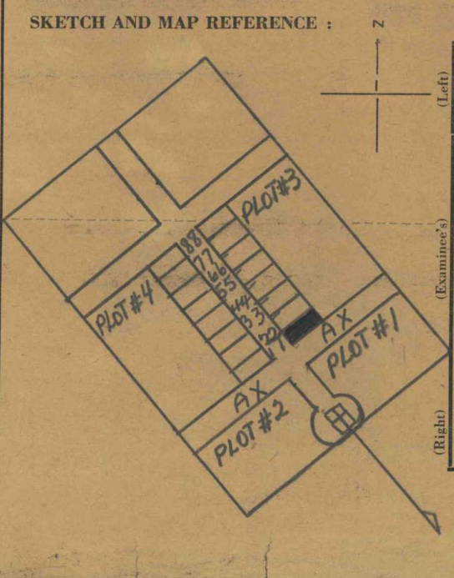
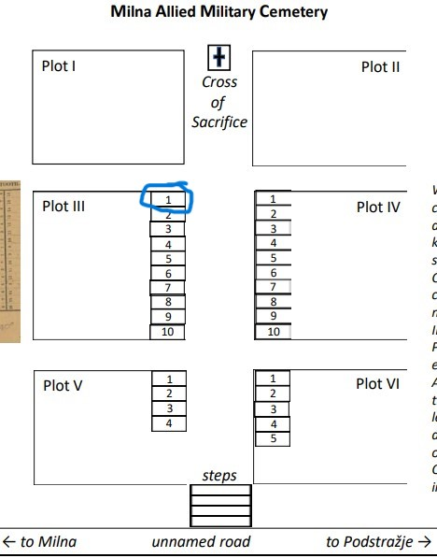

2d LT Kim’s Grave at Milne Cemetery

Slide 18

Awarded the Distinguished Flying Cross on June 4, 1944 (10 other Medals subsequently including the Purple Heart)

Slide 19
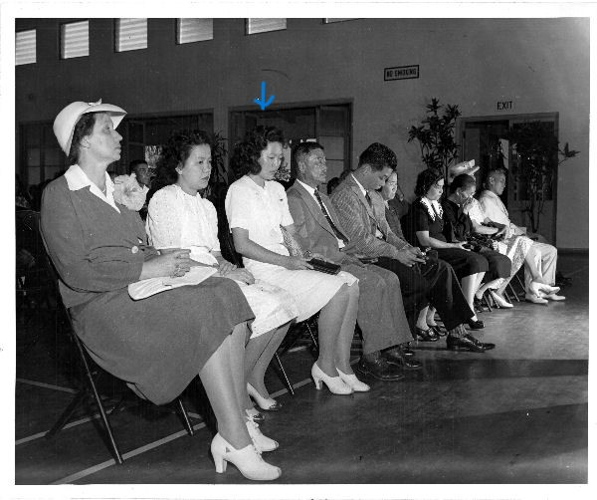
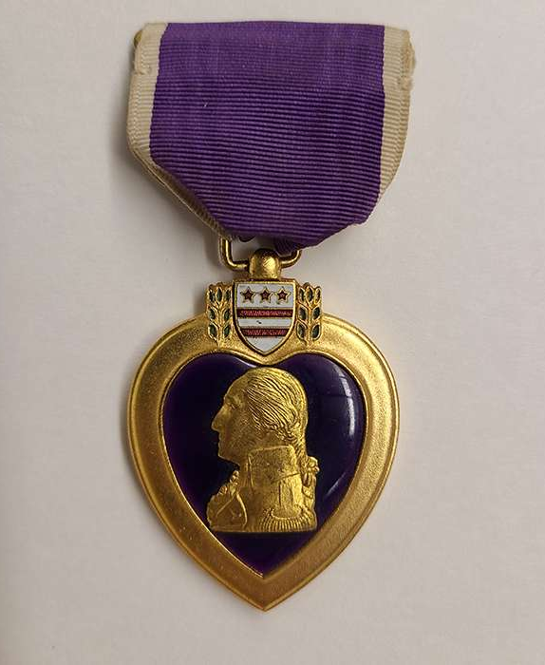
His wife Victoria received his Purple Heart in Honolulu on September 14, 1944

Slide 20
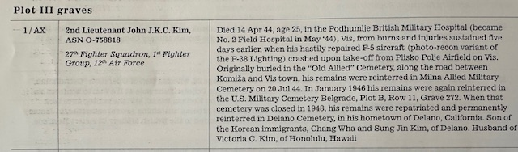
He was reinterred three times before being repatriated to his hometown
Corrections: 1. He died 2 days after crashing
2. His fighter was a P-38 Lightning- not an F-5 variant

Slide 21
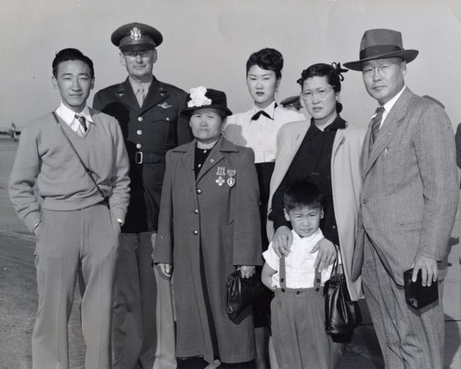
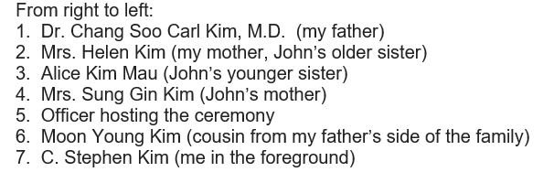
In 1948, Kim’s mother Sung Gin received all his medals at Hamilton Air Station, CA
Courtesy of nephew C. Stephen Kim:
Mrs. Kim is wearing his D.F.C & Purple Heart

Slide 22
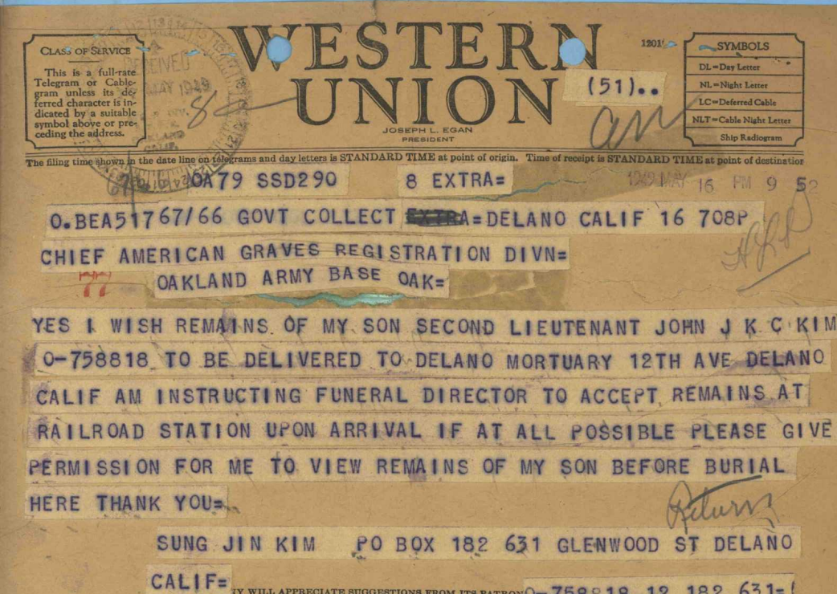
In 1948, Mrs. Kim requested return of her son’s remains

Slide 23
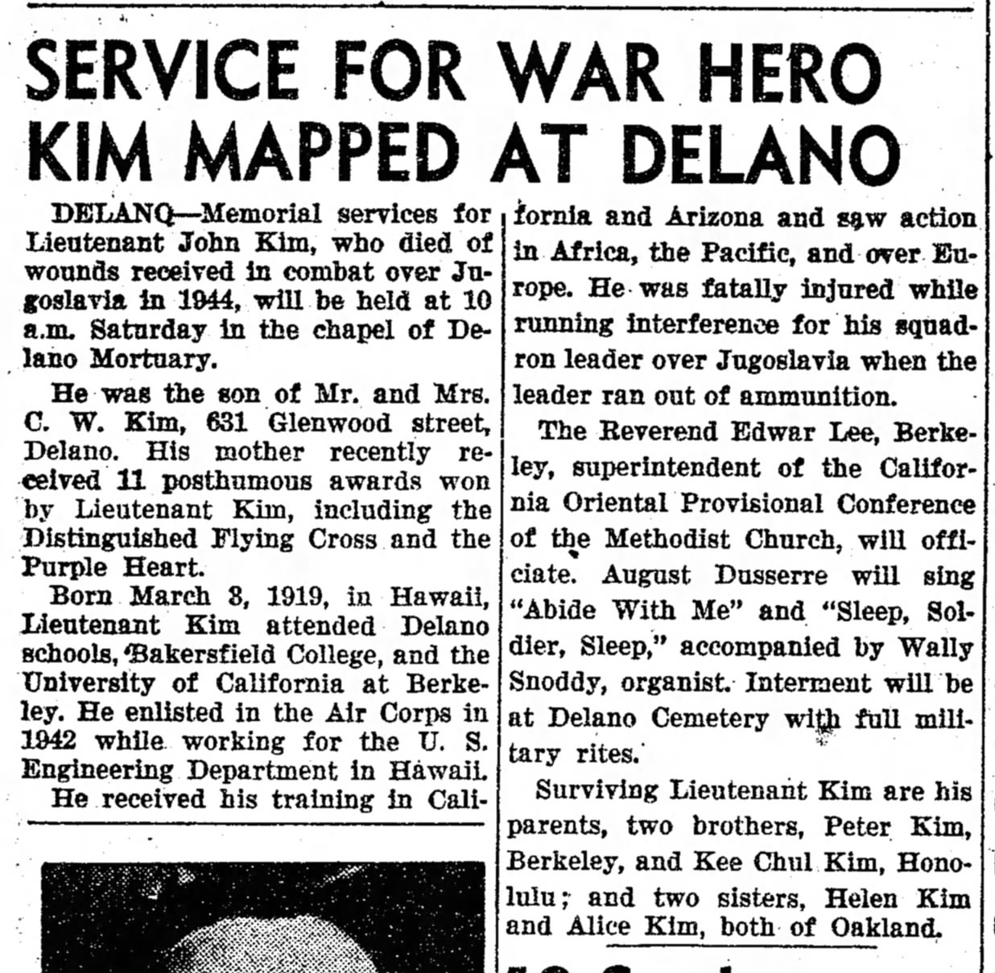
His remains finally arrived on June 24, 1949 A memorial service was held on June 25
Note: he wasn’t likely stationed in the Pacific & the account of his death is not accurate

Slide 24
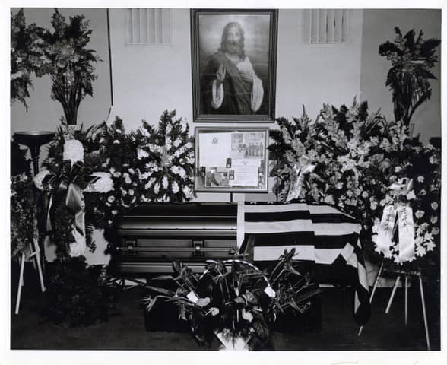
Lt. Kim’s coffin with his medals
Nephew Stephen Kim: “The framed picture on the casket was always prominently displayed by his mother.
I remember my grandmother waking up every morning sighing in recollection of her lost son. “

Slide 25
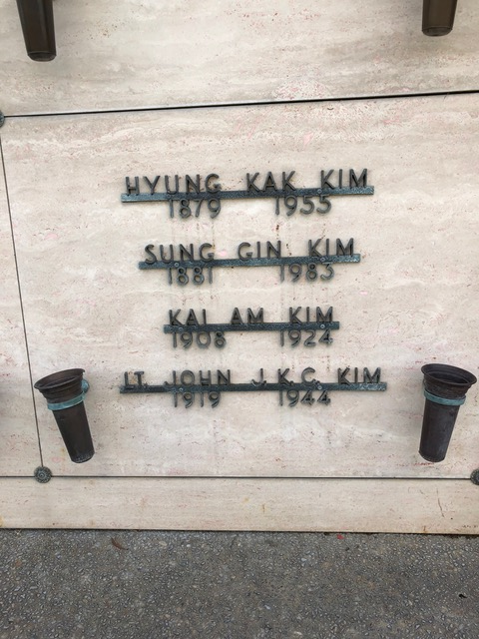
In 1983. Lt. Kim’s remains were cremated and reinterred in the family crypt at Los Gatos Memorial Park in San Jose

Slide 26
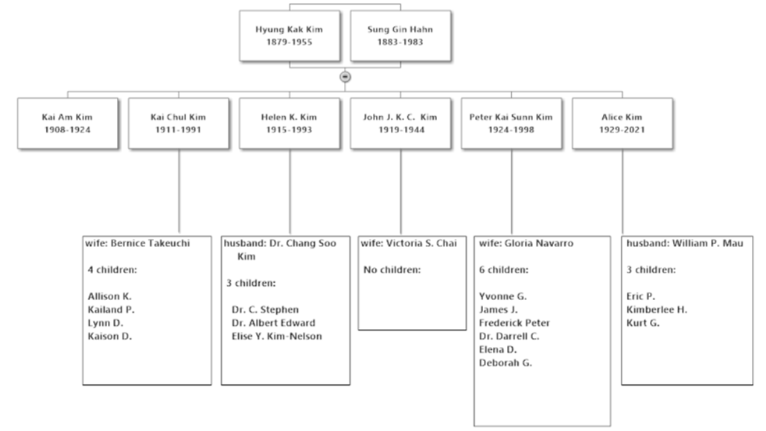
Kim Family Tree - 16 Nephews & Nieces

Slide 27
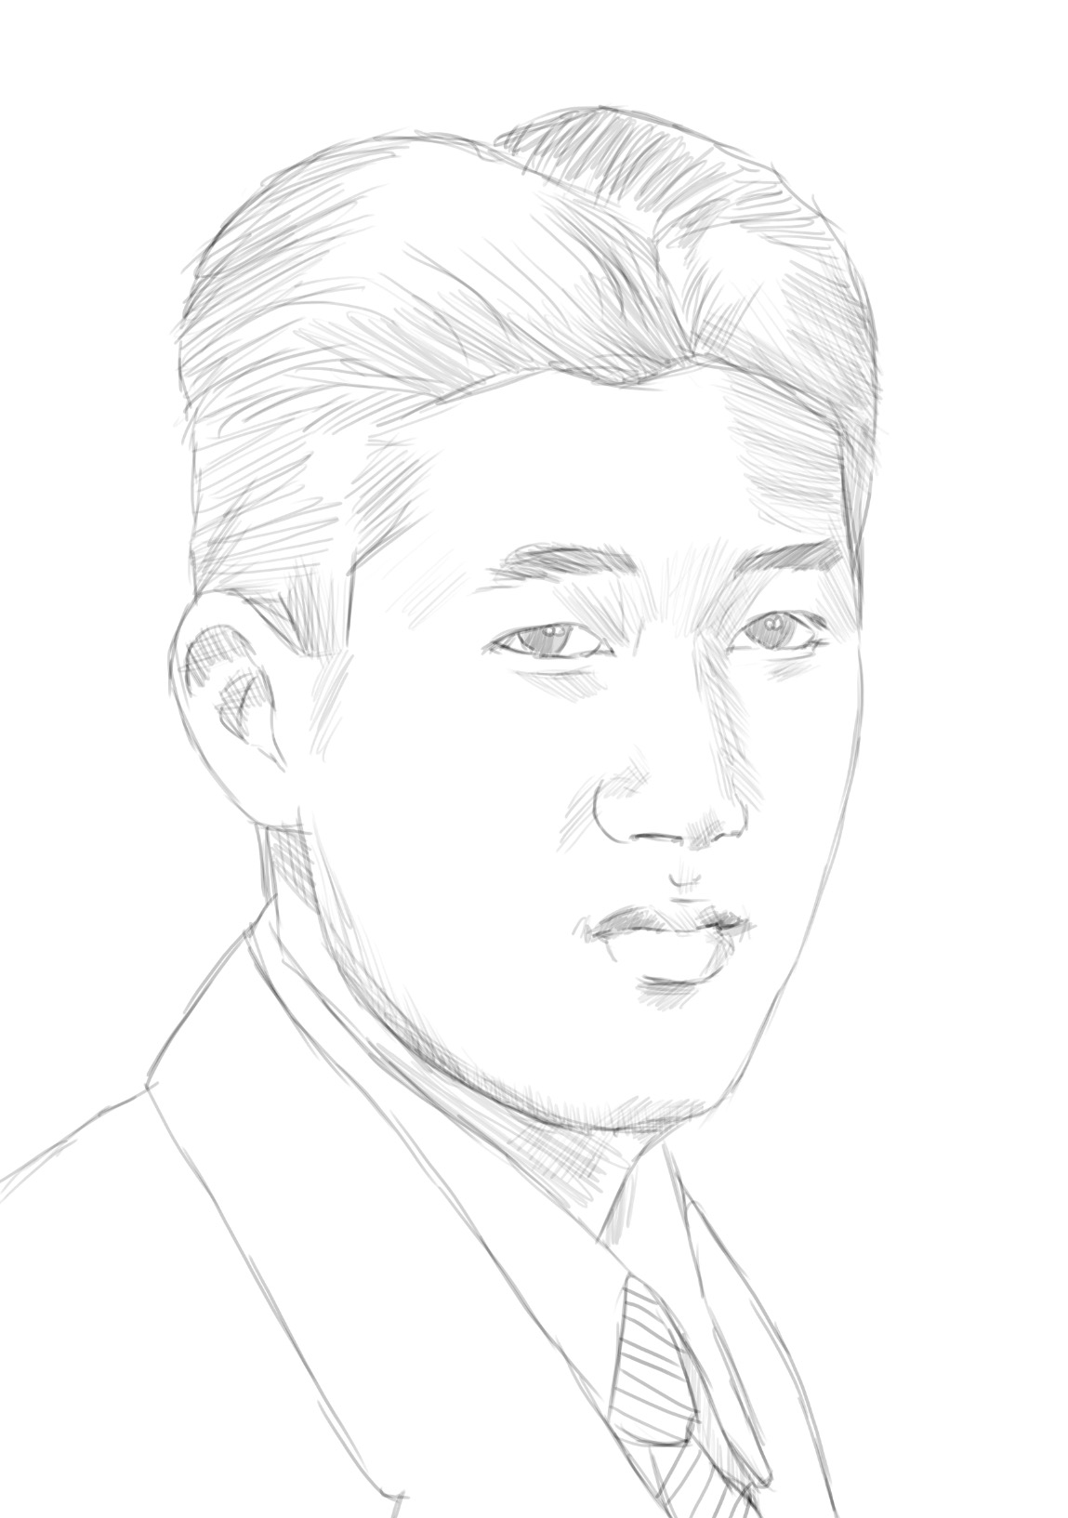
Rest in Peace

