Slide 1
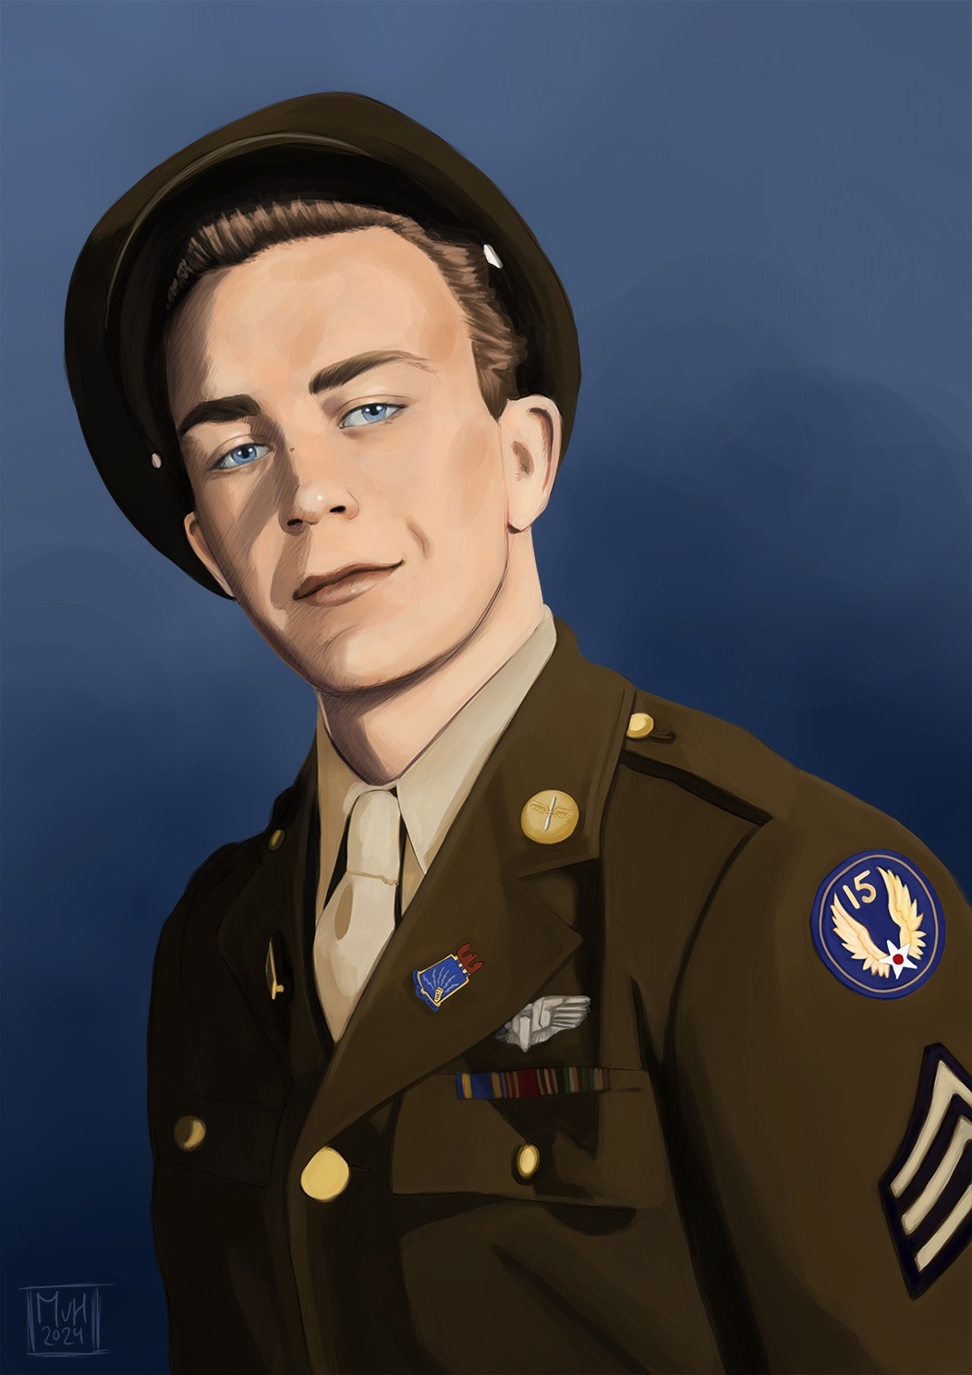
STORY #2A SYNOPSIS
Sgt Morris C. Peck- MIA/KIA OCTOBER 7, 1944
744TH BS, 456TH BG
B-24J Liberator bomber
Radio Operator & Waist Gunner
Returning from bombing mission to Vienna, Austria
Three engines damaged by flack & running out of fuel
Runway blocked by mired bomber- forced to bail out
Seven crew landed on Vis, three in the Adriatic
Sgt. Dicranian drowned in bay, body recovered
Sgts. Peck and Garr landed in sea and bodies never recovered
Born- Middlebury, VT 20 Years Old

Slide 2
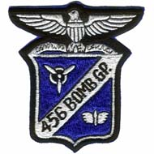
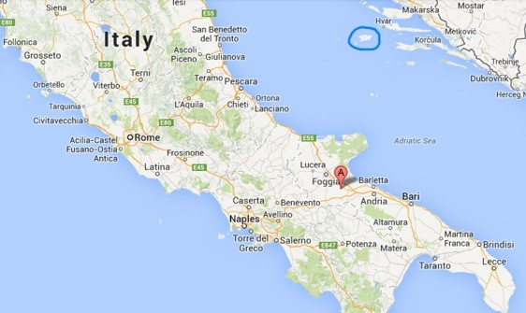
456th Bomb Group
VIS
Stornara
Stornara, Italy - December 1943-April 1945
Steed’s Flying Colts
Four bomb squadrons: 744th, 745th, 746th & 747th
B-24 Liberator heavy bombers with 10-man crews: pilot, co-pilot, navigator, bombardier, radio operator/waist gunner, engineer/waist gunner, nose gunner, tail gunner, ball turret gunner, and top gunner
Ten Browning 50 cal. machine guns
Flew 249 missions & dropped 14,000 tons of bombs – 91 B-24s lost in combat

Slide 3
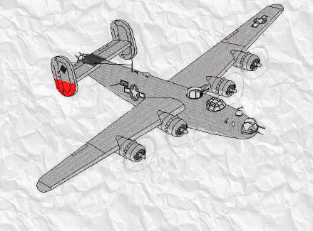
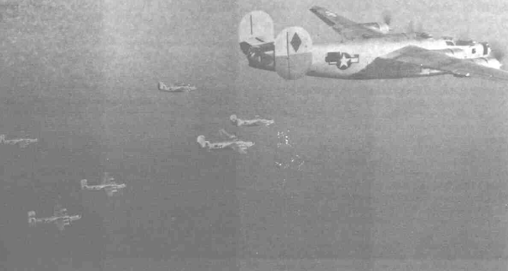
LEFT: B-24 Liberator Bomber with tail marking of the 744th BS. 4 guns can be seen: nose, top turret, right waist (behind the star) and tail. Left waist Gun (other side) and ball turret gun (under the plane, not shown)
RIGHT: B-24s in formation on a bombing mission.

Slide 4
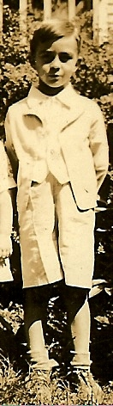
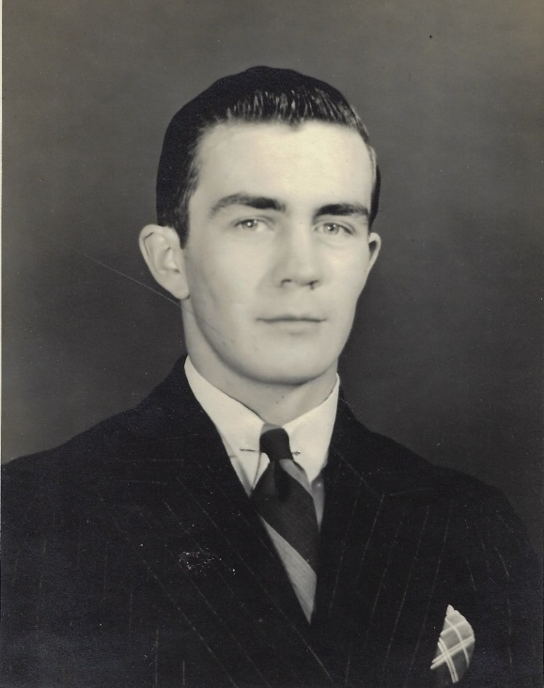
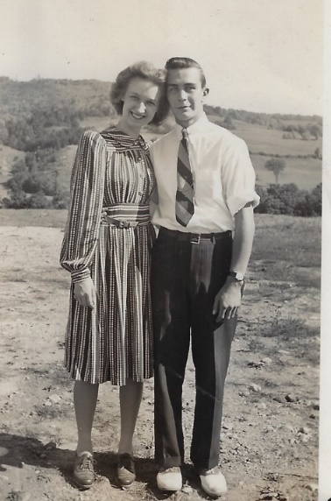
Morris Colby Peck
Born on April 11, 1924 & grew up in Middlebury, Vermont (100th birthday in 2024)
His father, George Warren Peck, was a WWI veteran in France
Loved hunting, fishing, repairing cars and maple syrup

Slide 5
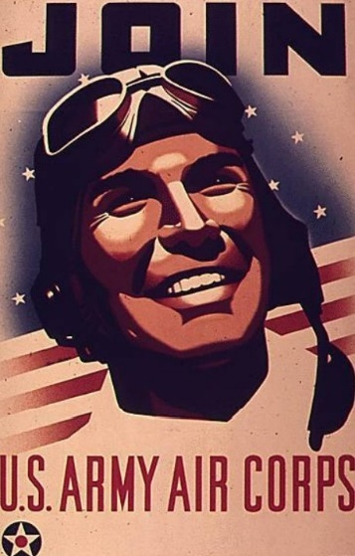
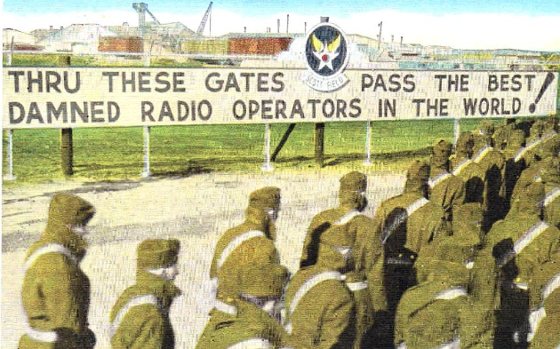
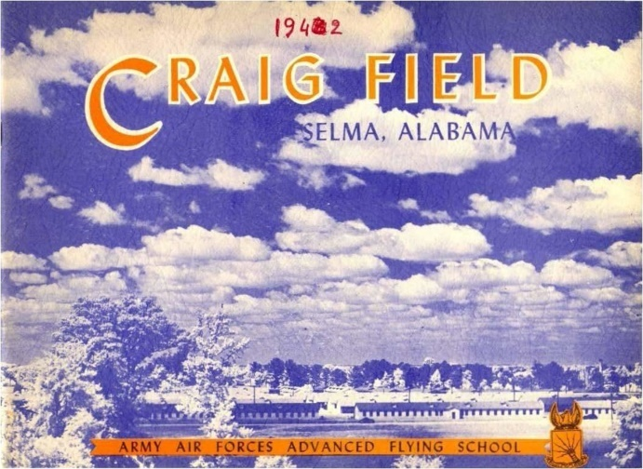
Training
Enlisted in AAF on September 18, 1942
Trained as a gunner and radio operator at US bases throughout 1942-1943 and through July 1944

Slide 6
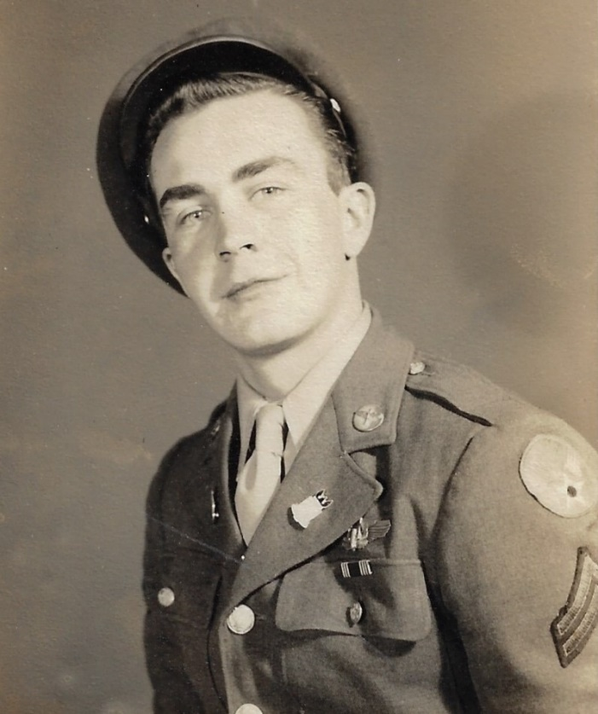
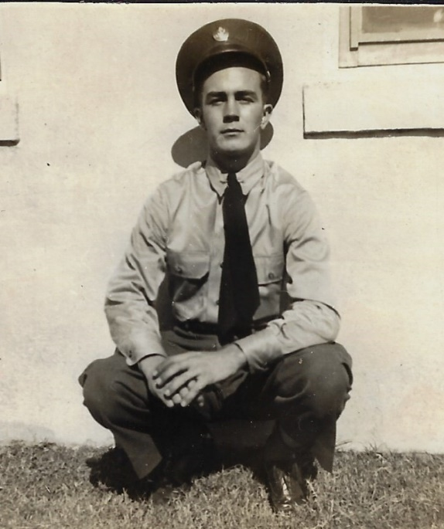

Slide 7

744th Bomb Squadron
Flew with crew in B-24 to Stornara, Italy from July 20th to August 4th 1944
From 1 to 40 planes went on each mission, with an average of about 15 to 24.
Sgt. Morris Peck’s first mission was on August 10th
Earlier in the war, the requirement was 25 total missions, but now it was 50
Morris would fly on 30 credited missions

Slide 8
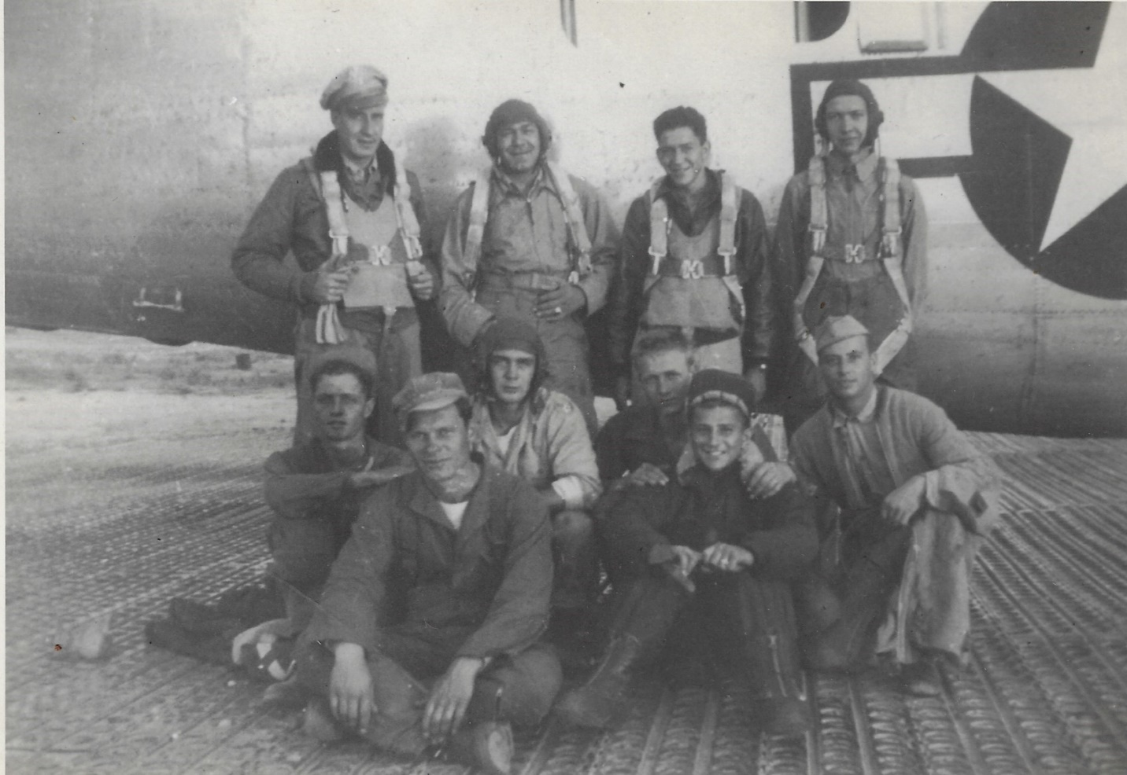
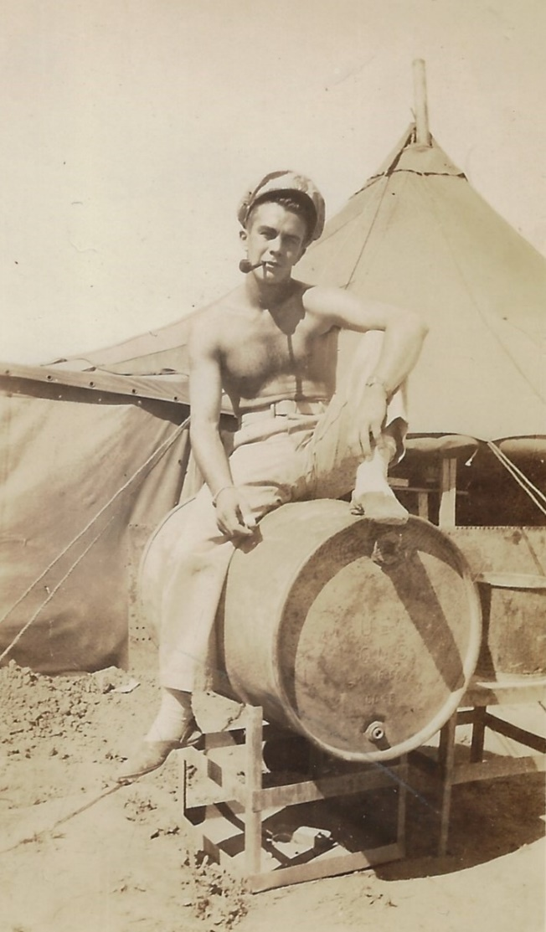
August 10th: “Well, today I went on my first mission and now have 49 to go.”
On base before take-off, September 1944.
Top. Lt. Vogel, pilot, Lt. Collins, bombardier, Lt. Wolf, co-pilot, Lt. Driver. Navigator.
Sitting Middle: Sgt. Hall, Cpl. Peck, Cpl. Garr, Sgt. Moore.
Sitting Front: Sgt. Thompson, Sgt. Dicranian
Morris relaxing

Slide 9
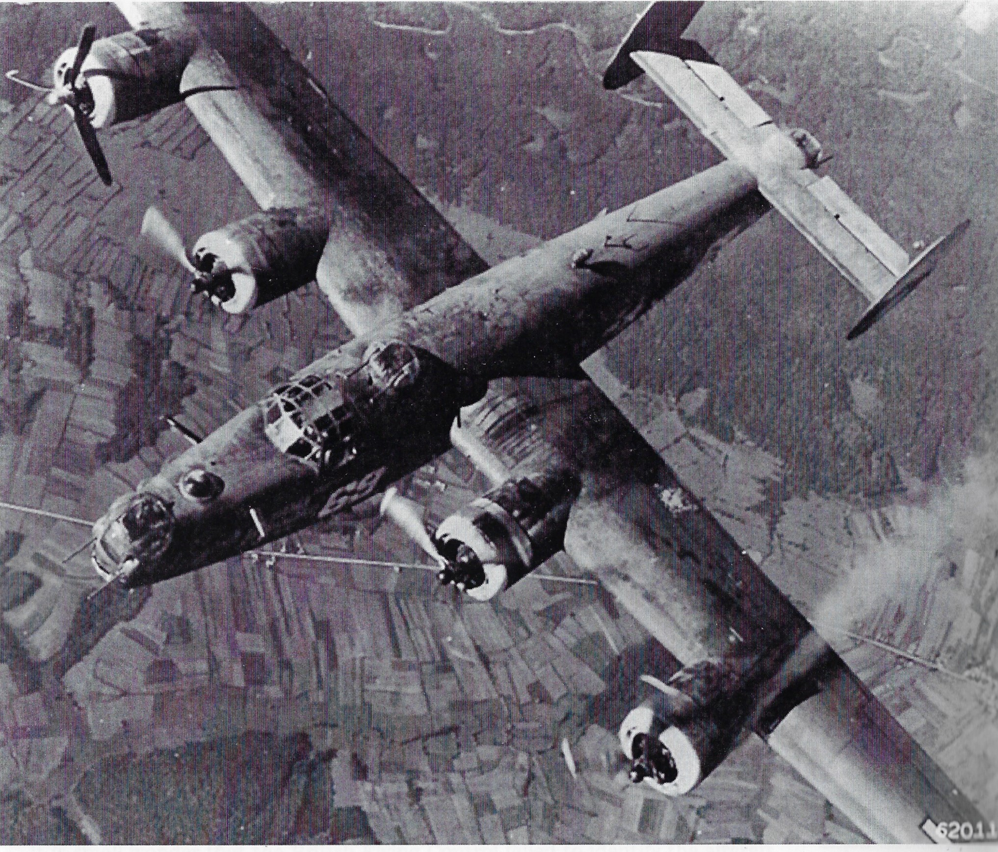
October 7, 1944
Mission to Vienna- Winterhafen Oil Depot
After bombs away, hit by flak knocking out two engines
Third engine ran out of fuel on way back.
Radioed tower at Vis island emergency airstrip –runway blocked by a B-24
Pilot Vogel gave “bail out” command as he flew over the airstrip

Slide 10
Navigator Lt Daniel Driver
“We called Vis Tower and asked if we could land. They would not let us land as there was a plane stuck in the mud on the runway. They gave us the choice of bailing out over the island or going back to the coast of Italy [about 120 miles] and landing there. We elected to try and make the Italian coast. When we were approximately five minutes from the island of Vis at approximately 43N-16E, #3 engine ran out of gasoline. We then headed back to the island of Vis running all three engines off #4 fuel cell. When over the island of Vis, we bailed out at 4,000 feet. The coordinates when we bailed out were 43/02N-16/12E at approximately 1615 hours.
See MACR #9040

Slide 11
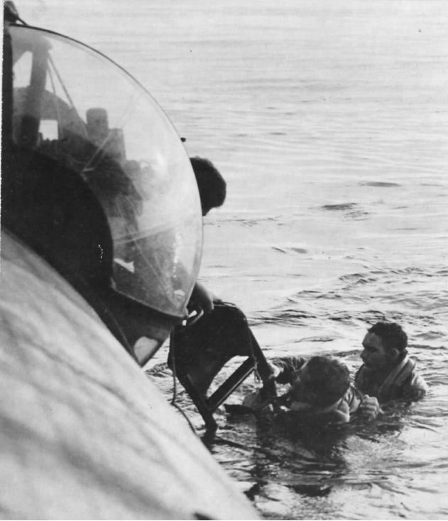

From “Vis-The Last Hope”, pages 218-219
October 7, 1944:
US 15th Air Force launched massive attack in the Vienna area with heavy bombers. Four damaged B-24 Liberator heavy bombers force landed in a row and caused confusion on the landing strip. This made the crews of another three Liberators which circled waiting for the landing strip to be cleared to bail out in the vicinity of the island. Very strong wind (Sirocco) prevailed with choppy seas. One Catalina seaplane, HSL 2537 (F/Lt. Watson) and two naval launches were dispatched to the area. One naval launch rescued one American airman, but despite of immediate medical measures, the survivor succumbed on arrival to port of Komiža. HSL 2537 took two survivors from a Partisan fishing ship which also contained one dead airman. The majority of the airmen who bailed out safely landed at the island. The combined rescue mission resulted with 23 rescued, three dead and four missing American airmen. ASR vessels continued the search until one hour after darkness, but with no results.
Note: Only one of the 4 B-24s that force landed has been identified. It was piloted by 2d Lt. Warren Maust of 721st BS, 450th BG. See recording and story on slide 24.

Slide 12
“Vis-The Last Hope” continued
One of the three B-24s where the crew bailed out over Vis was B-24J S/N 42-78319 (pilot 1st Lt. Edward C Vogel) of 456th BG 744th BS. Immediately after dropping bombs on Winterhafen oil refinery near Vienna, it was hit by German flak in the bomb bay. Splintered shards pierced fuel tanks 1, 2 and 3 and the fuel started leaking into the bomb bay. When they were over the Adriatic, engine No. 1 ran out of fuel and stopped. The pilot had no choice but to turn back to Vis. But the Flying Control on Vis did not give permission for landing since another B-24 was stuck in the middle of the strip, so they decided to proceed to Stornara base in Italy. Soon after, engine No. 3 stopped too, and they decided to turn back to Vis, where the crew bailed out at position 43.02 N and 16.12 E. According to the records obtained, the crew bailed out over the southeast part of the island, i.e. west of Rukavac. It is highly possible that the aircraft crashed into the sea, which was confirmed by testimonies from other crews.

Slide 13
“Vis-The Last Hope” continued
The second B-24J, S/N 42-51848 (pilot 1st Lt. Louis McClumsey) of 450th BG 722nd BS, was also returning from the bombing mission of Winterhafen oil refinery to Manduria base in Italy. It was damaged, and due to fuel loss asked for permission to land on Vis. Since Flying Control refused permission owing to the B-24 stuck on the landing strip, the pilot activated the autopilot and the whole crew bailed out. Four airmen landed on the island, while the remaining six were carried over the sea by strong winds at Rukavac. Rescue launches picked up two, found two bodies, and the remaining two went missing.
The third B-24 (serial number unknown) of 450th BG, damaged as well, managed to reach Vis where the crew bailed out. All landed safely, although some were slightly injured. Even this plane, whose S/N remains unknown, probably crashed into the sea.
One of the Liberators which, despite the partly blocked landing strip, surprisingly managed to land on Vis Airfield was B-24H-15-DT S/N 41-28861 #69 Burma Bound of 451st BG 724th BS flown by 1st Lt. George Tudor (SEE STORY #4A).

Slide 14
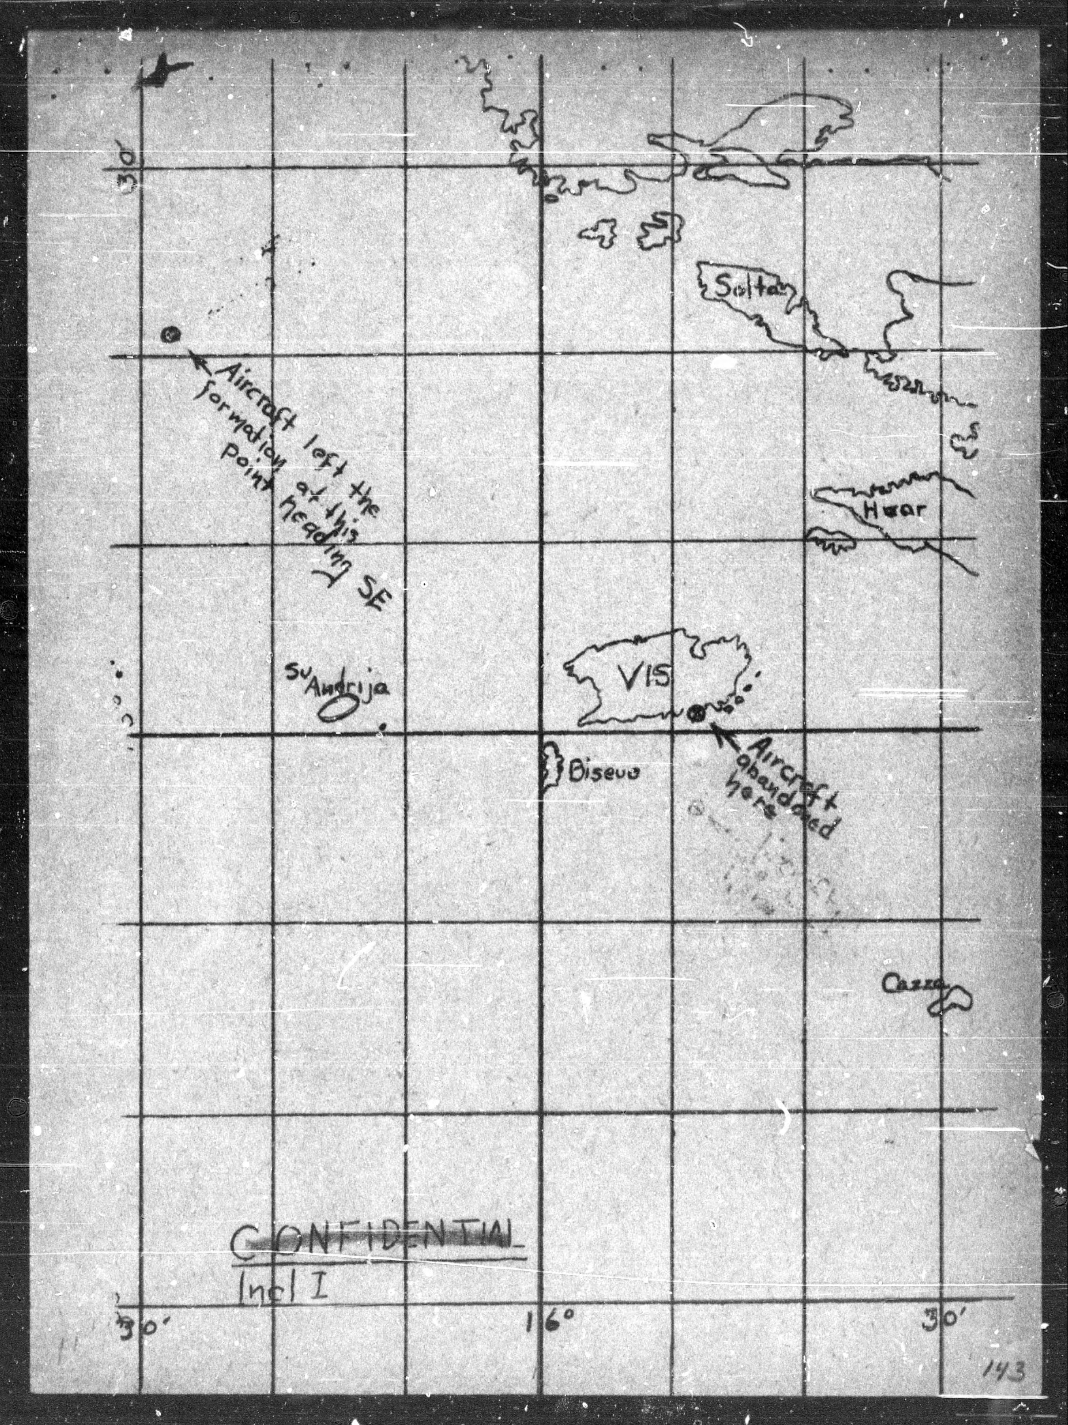
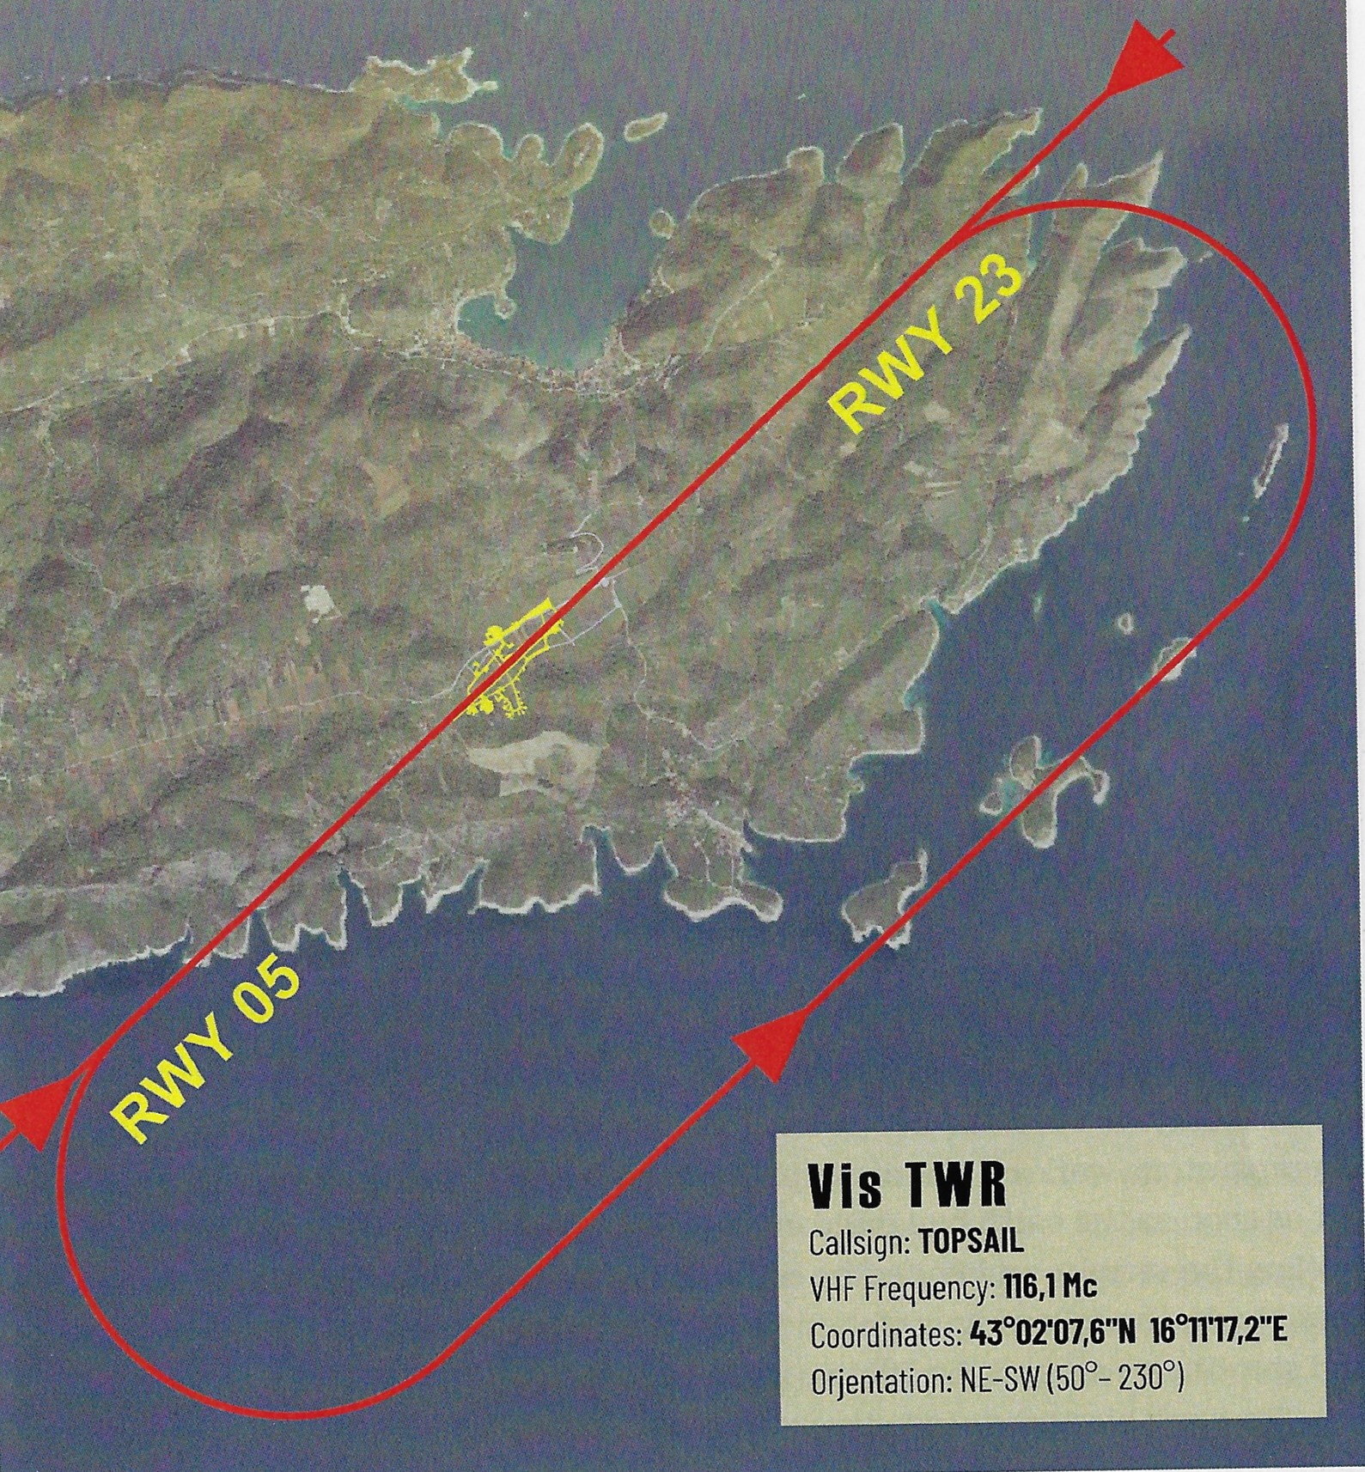
VIS- The Last Hope – never captured by the Germans

Slide 15
Lt. Edward Vogel - Pilot
“Shortly after [the order to bail out] Morris called me over the interphone and said the waist was clear, wished me luck and said he was bailing out. The men then started jumping out of the bomb bay. I remained at the controls until the rest of the men had jumped. As I left the ship, the two remaining engines stopped from lack of fuel.
“[Morris] did a wonderful job all the way back until we decided to leave the ship. We were in contact by radio at all times and it was he who supervised the jumping from that part of the ship. He called me just before he jumped and said he was the last one to leave the waist. I had more confidence in Morris than anyone on the crew, yet I had to marvel at his coolness in handling things. Even his last words were cheerful and showed no evidence of fear. He said ‘Good luck Ed, see you downstairs.’ That was the first time he had called me ‘Ed’.”

Slide 16

Seven bailed out over island & landed successfully
Three went into the Adriatic Sea due to strong gale winds -Sgt Johnny Dicranian drowned in bay - Sgts. Morris Peck and Louis Garr bodies never recovered
Searched for 6 months- officially designated KIA in 1948

Slide 17
Bomber Crew- B-24G SN 42-78319
# | Crew Position | Name | Rank | Service # | Age | M/S? | Home Town | Birth | Death | Age | Fate
1 | Pilot | Edward C. VOGEL | 1LT | 0-820859 | 28 | M | San Francisco, CA | 3/31/1916 | 8/21/1973 | 57 | RTD
2 | Co-Pilot | Milton WOLF | 2LT | 0--1692840 | 21 | S | Brooklyn, NY | 10/19/1922 | 11/12/1997 | 75 | RTD
3 | Navigator | Daniel DRIVER | 2LT | 0-717401 | 20 | M | Berkley, CA | 5/8/1924 | 7/24/2017 | 97 | RTD
4 | Bombardier | Robert T. ALLER | 1LT | 0-703022 | 24 | S | Wappinger Falls, NY | 6/1/1920 | 6/16/1991 | 71 | RTD
5 | Engineer/LWG | Leon H. MORRELL | Cpl | 34054386 | 35 | S | Columbus, GA | 4/23/1909 | 6/27/1967 | 58 | RTD
6 | Radioman/RWG | Morris C. PECK | Sgt | 11084963 | 20 | S | Middlebury, VT | 4/11/1924 | 10/7/1944 | 20 | KIA
7 | Nose Turret Gunner | George J. THOMPSON | Sgt | 33702447 | 25 | M | East Carnegie, PA | 8/30/1919 | 2/16/1999 | 79 | RTD
8 | Upper Turret Gunner | Louis J. GARR | Sgt | 38508991 | 20 | M | Van Buren, AR | 8/11/1924 | 10/7/1944 | 20 | KIA
9 | Ball Turret Gunner | Rush I. MOORE, Jr. | SSgt | 14091135 | 23 | S | Birmingham, AL | 7/19/1921 | 6/3/2011 | 89 | RTD
10 | Tail Turret Gunner | Herant J. DICRANIAN | Sgt | 31339891 | 21 | S | Pittsfield, MA | 6/29/1923 | 10/7/1944 | 21 | KIA
Sick on 10/7:
11 | Bombardier | Arnold R.COLLINS | 2LT | 16004205 | 28 | M | Chicago, ILL | 12/9/1915 | 1/10/1982 | 66 | RTD
12 | Engineer/LWG | Marion HALL | Sgt | 33739727 | 22 | M | Abbeville, SC | 5/20/1922 | 8/29/1994 | 72 | RTD

Slide 18
Sgt. Morris Colby Peck- 20 years old
Reported KIA to parents until March 1, 1945
1952- Italian fishermen found the chute 7 ID tags of Sgt. Peck off the island of San Andrea – 25 miles west of Vis
Morris received the Purple Heart
His mother, Marie Premo Peck, became a “Gold Star Mother” for life
His parents- George & Marie – didn’t talk much about Morris

Slide 19
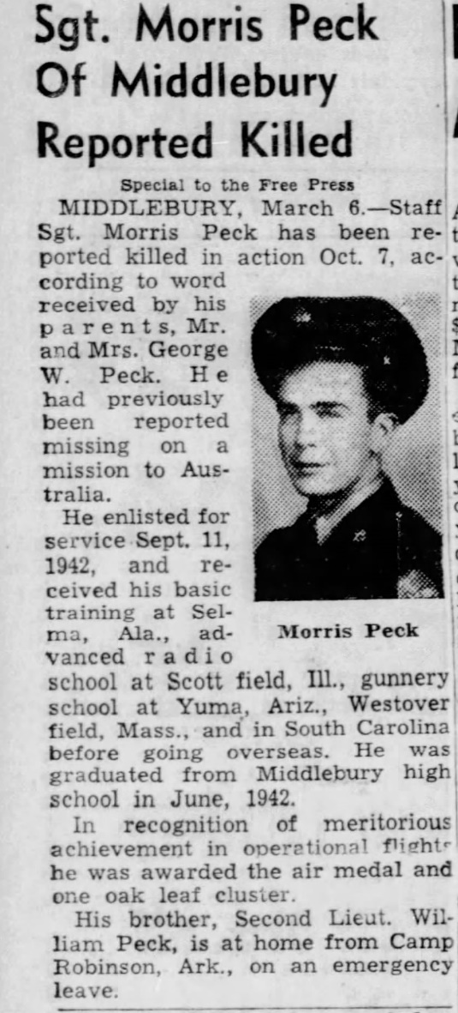
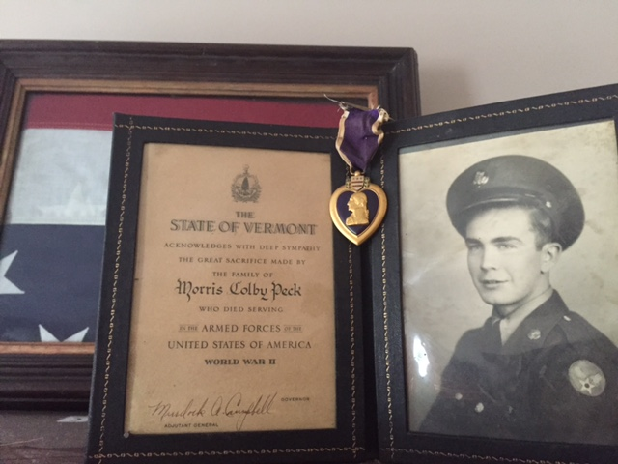
Memorial on his parent’s living room wall
Now on nephew Jeff Peck’s camp on Lake Dunmore in VT

Slide 20
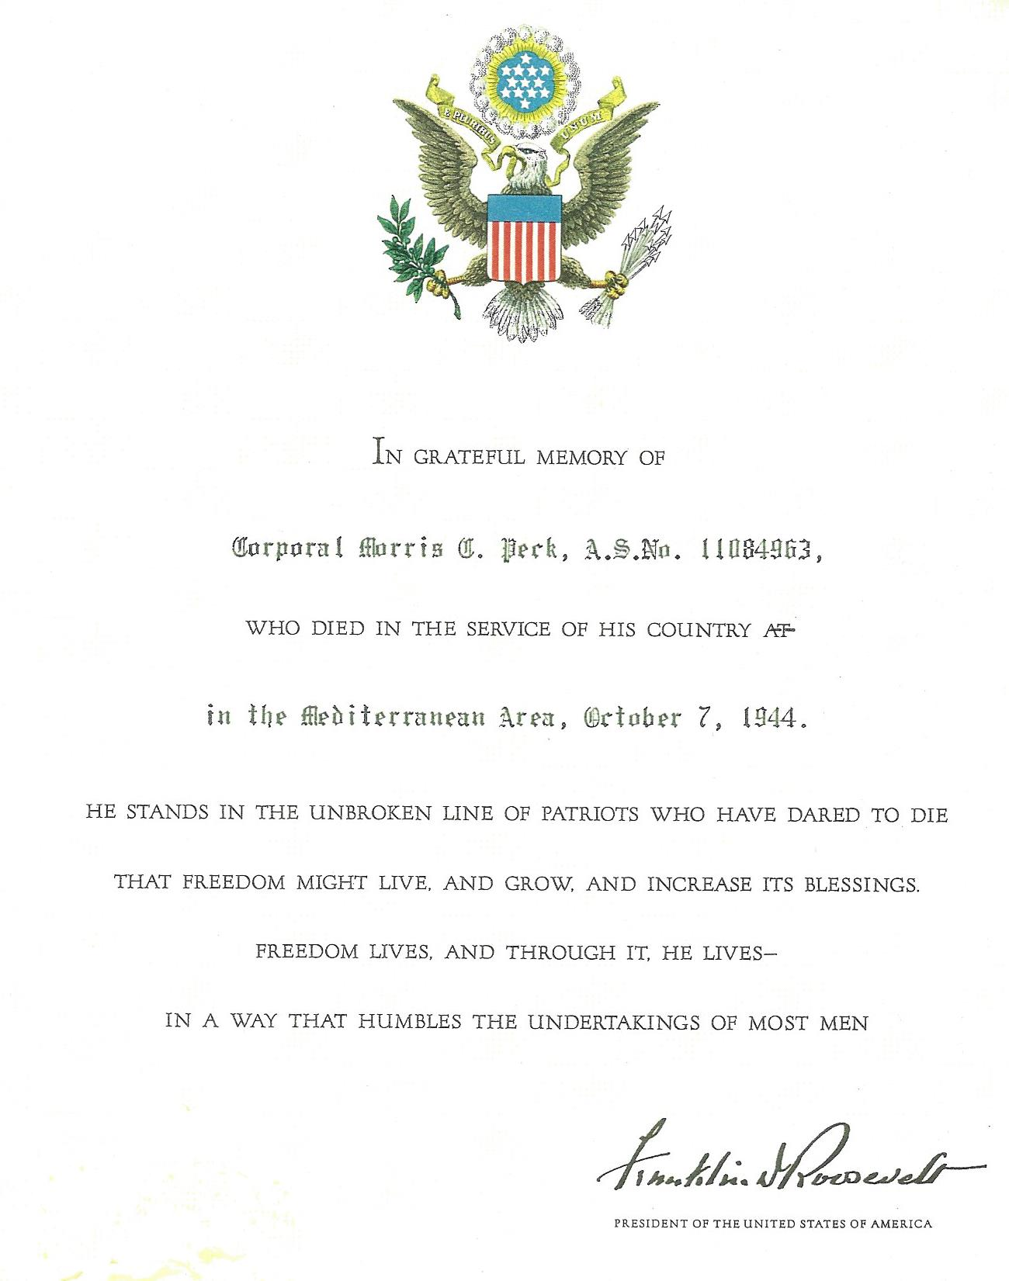
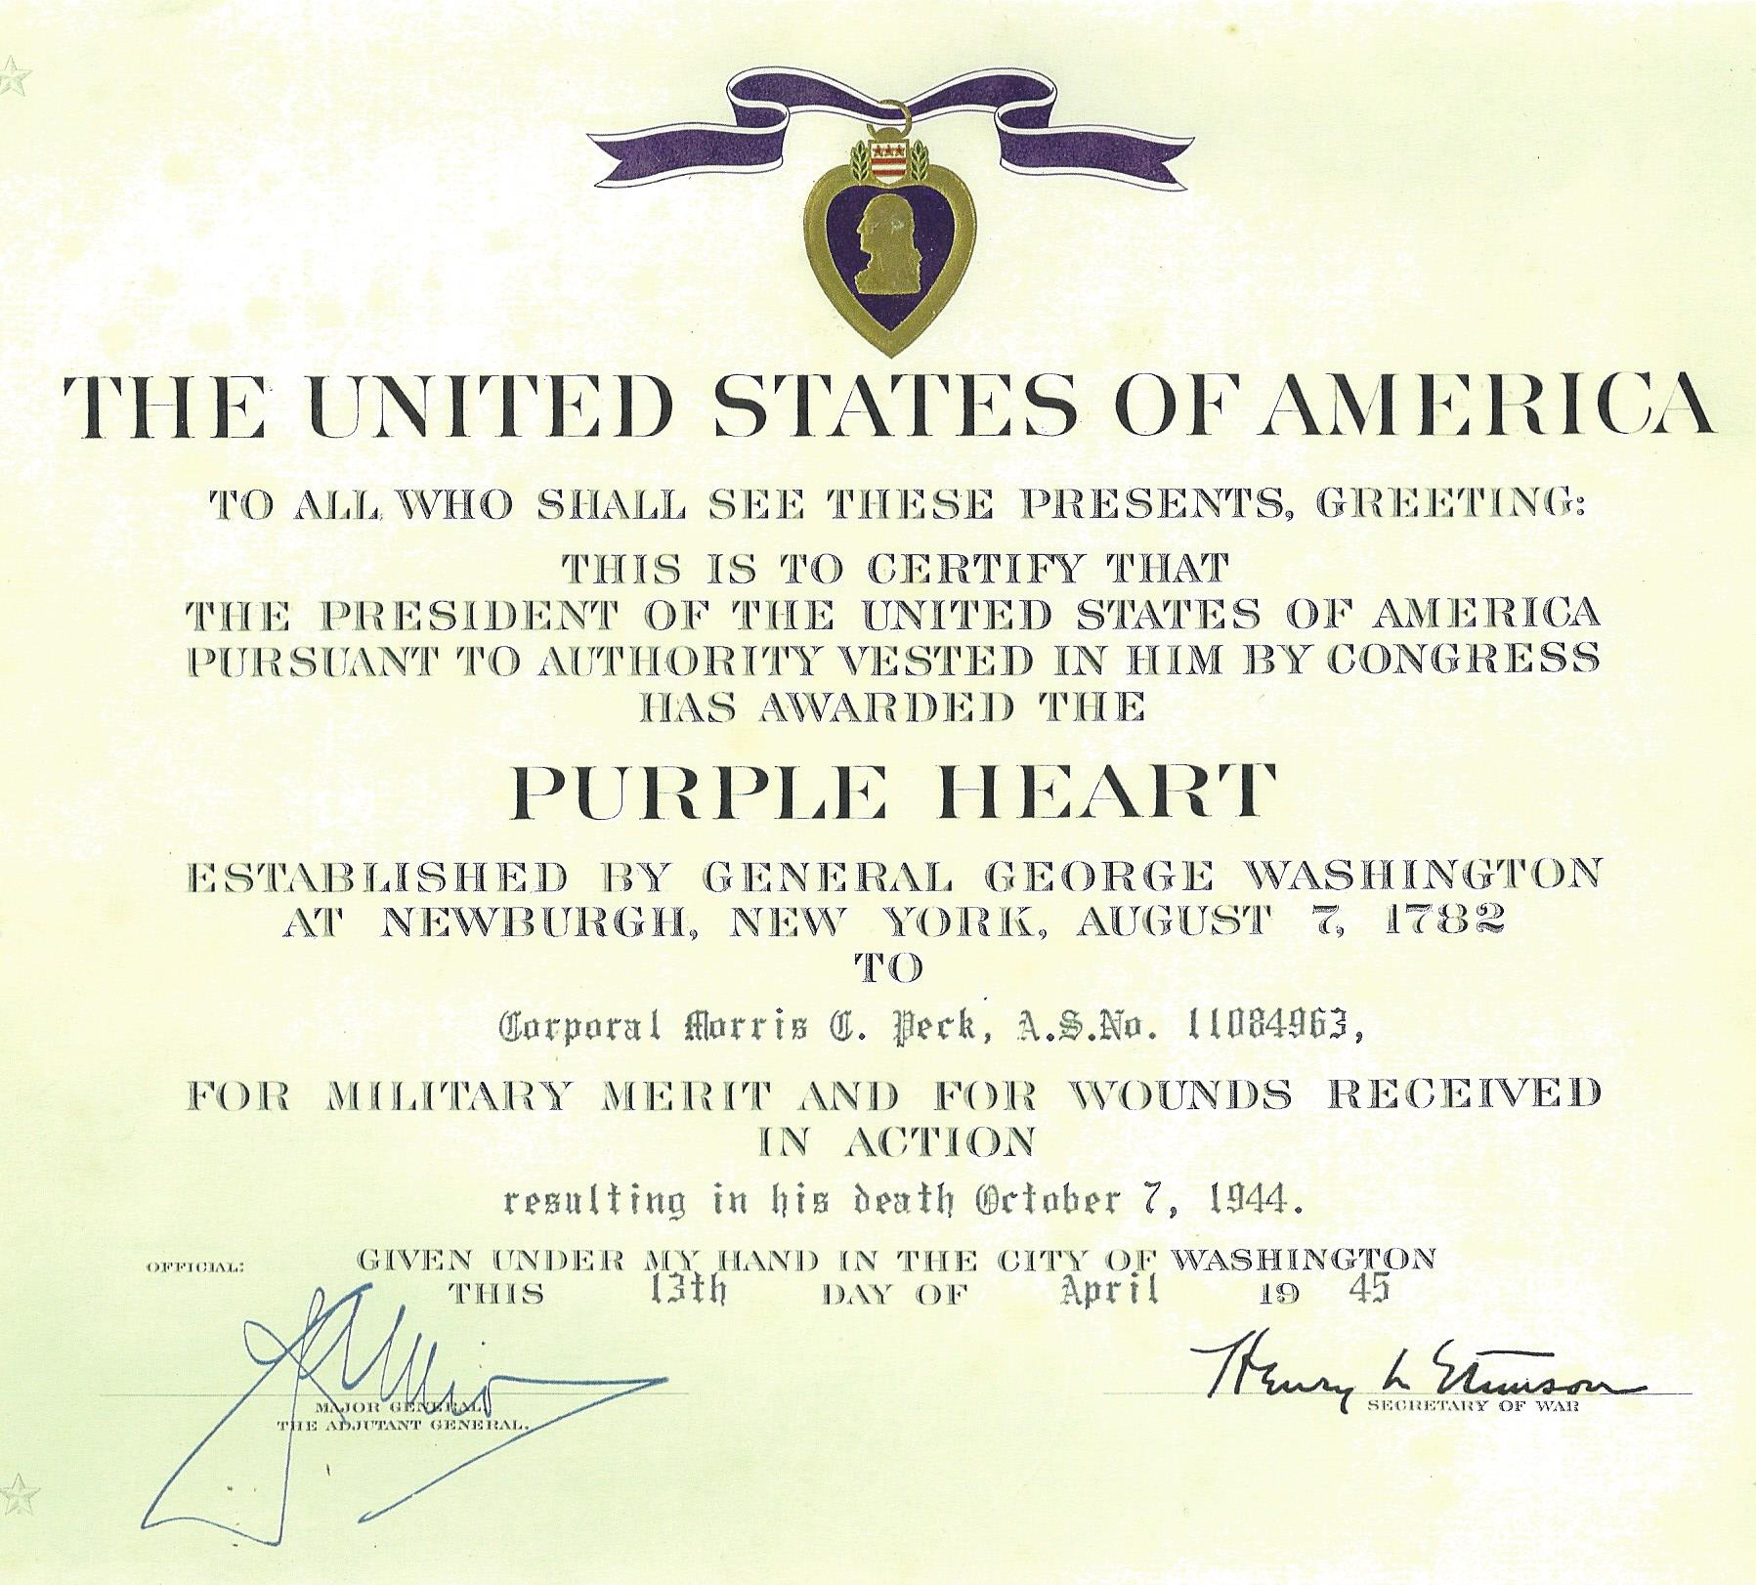

Slide 21
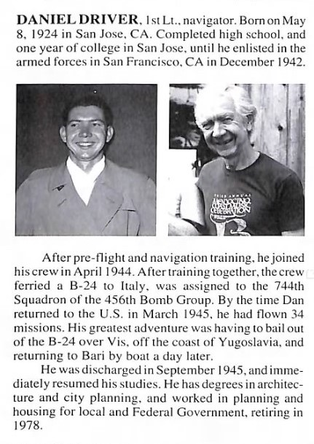

2011 Interview with Lt. Daniel Driver, the navigator on the October 7, 1944 event*
CLICK on the arrow below the
symbol above or click mouse to listen
Courtesy of Roger Davis, his son-in-law, Albion CA. 10 minutes, 30 seconds. Daniel Driver died at age 97 on July 24, 2017
Source of above- Fold3 456th BG Unit History, P 84, Turner Pub Co, 1994

Slide 22
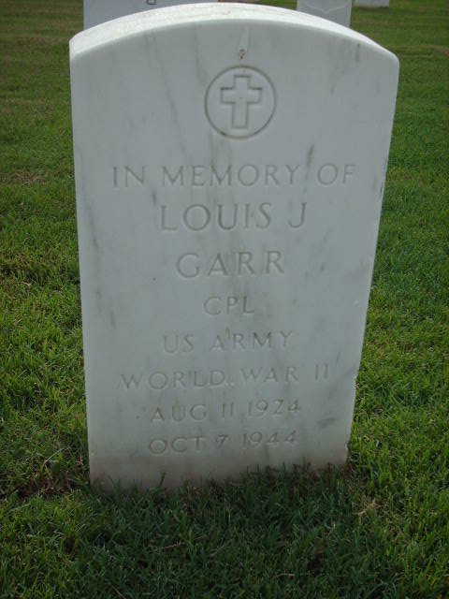
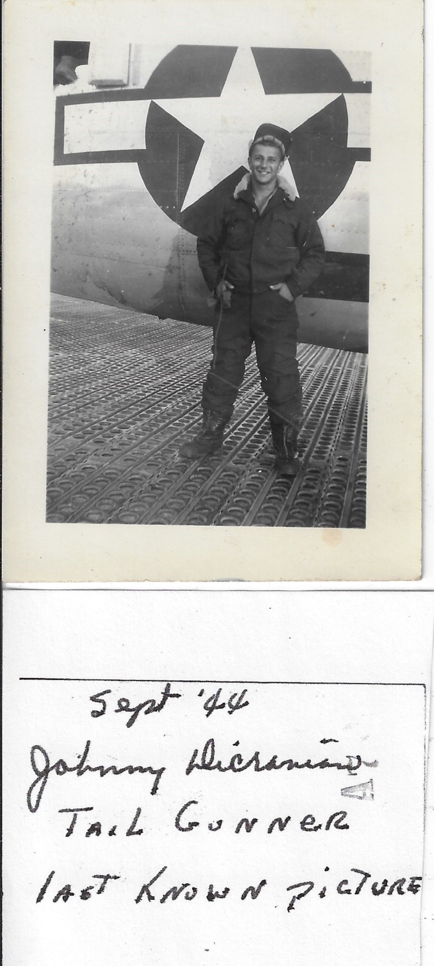
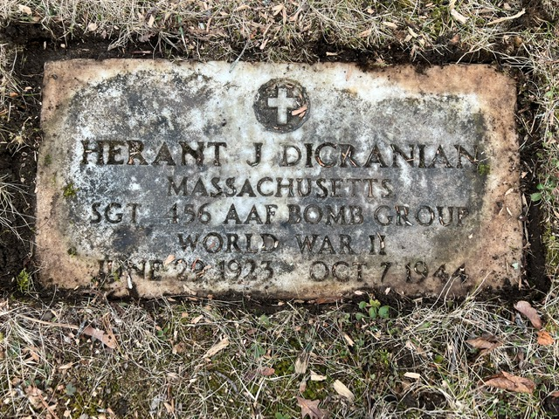
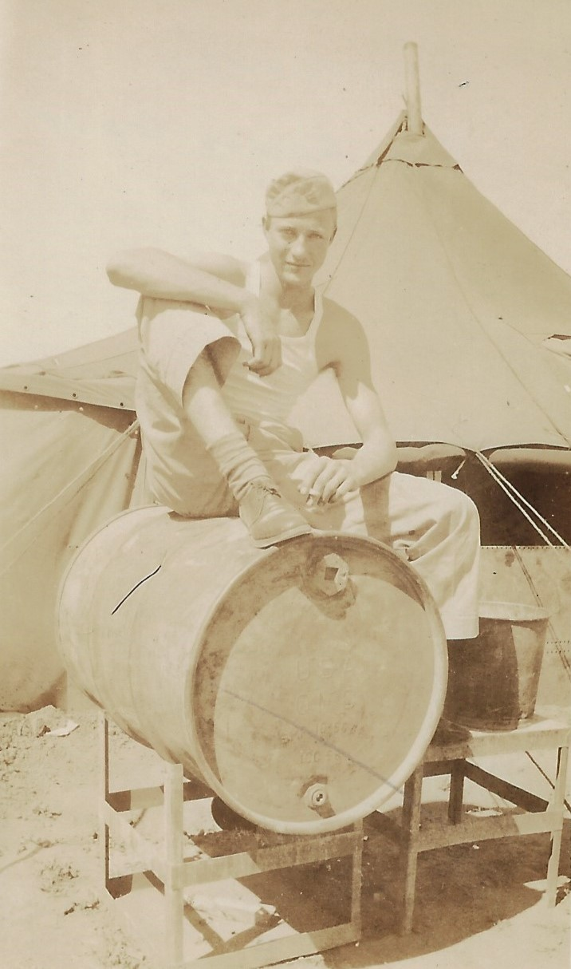
Rest in Peace Crew members KIA
Sgt. Johnny Dicranian
Tail Gunner
age 21
Cpl. Louis J. Garr
Upper Turret Gunner
age 20

Slide 23
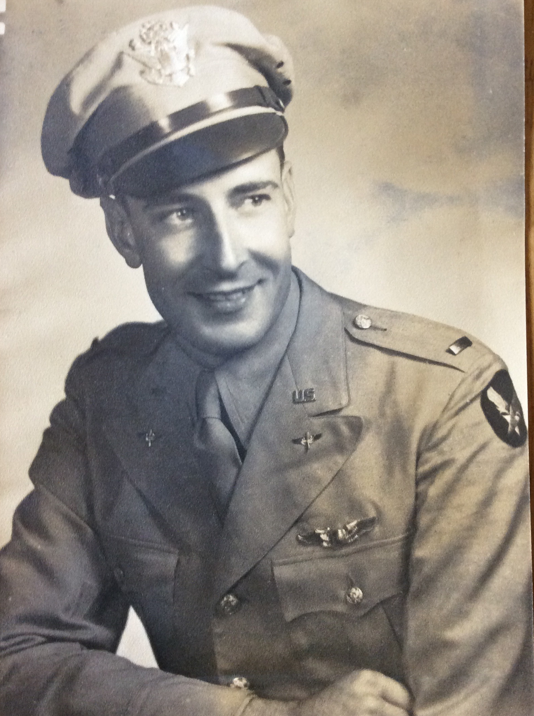
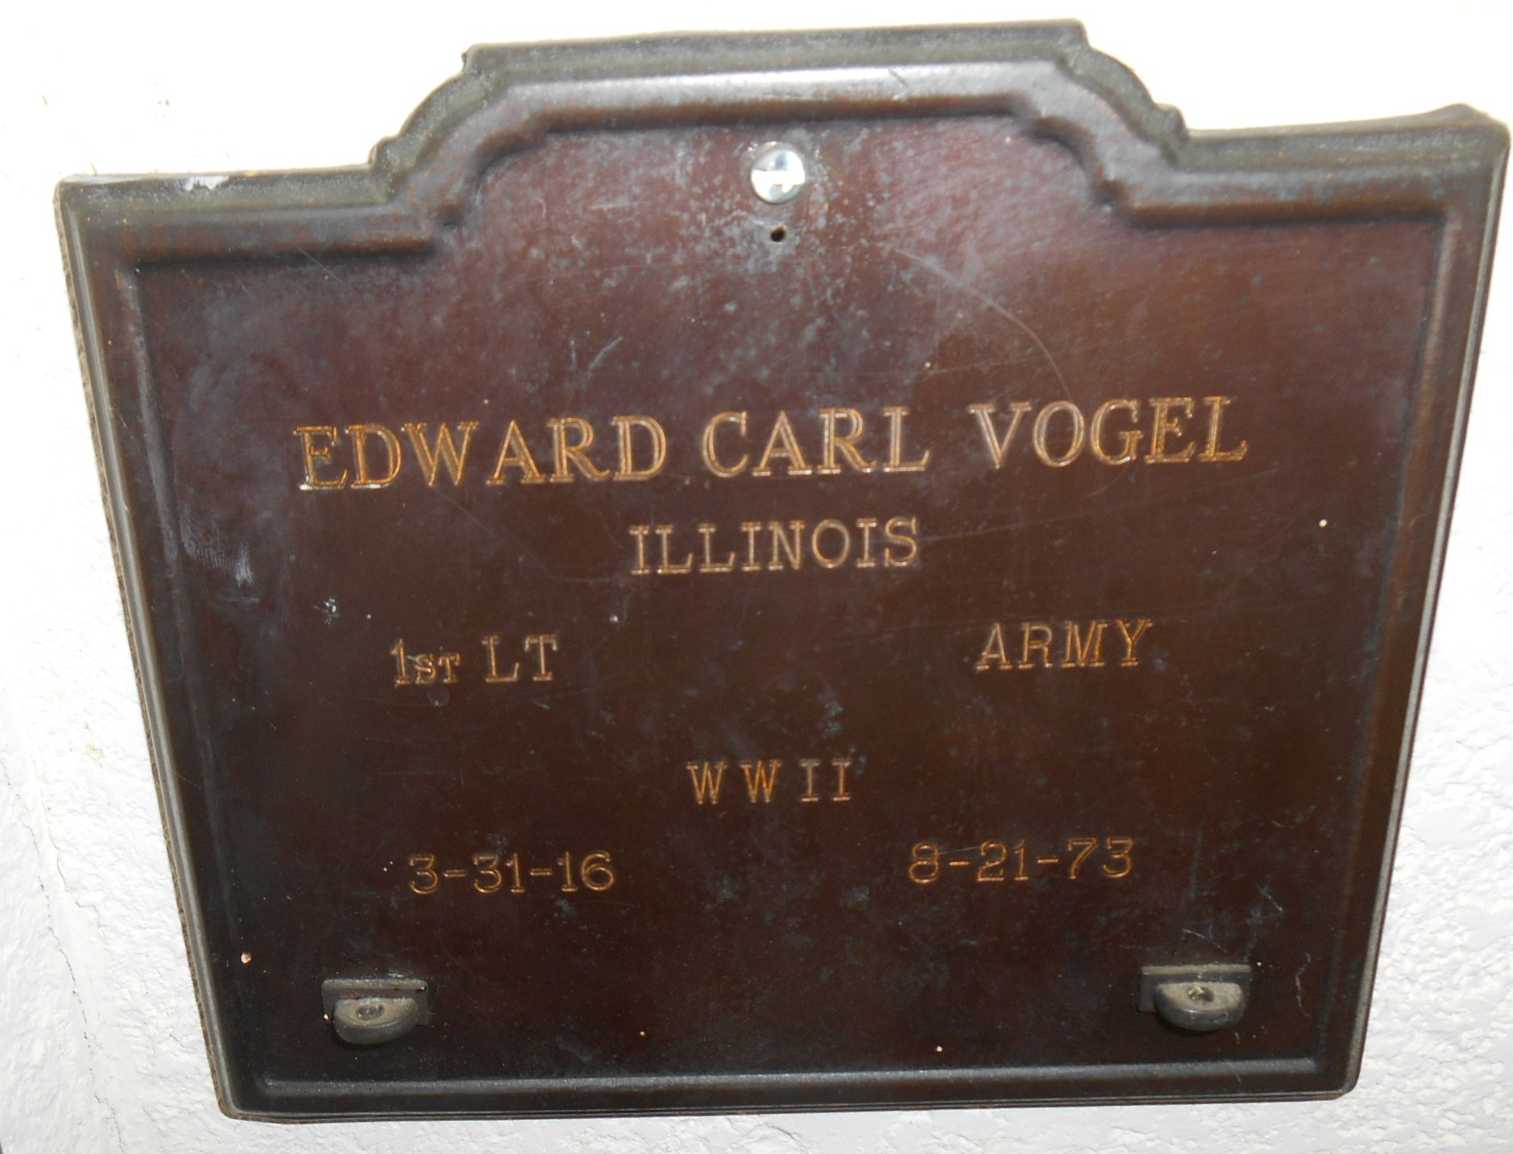
Pilot Edward Vogel (1916-1973)
December 1944 letter to the Peck family from Mrs. Vogel:
“Ed was mostly damaged by losing his three boys than anything else.
They had to dope him six nights so he could sleep. He felt as though
He should not have had them bail out. “

Slide 24
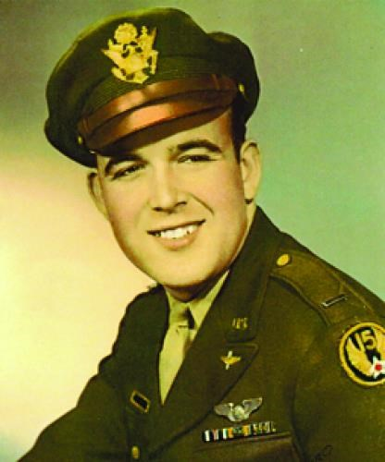
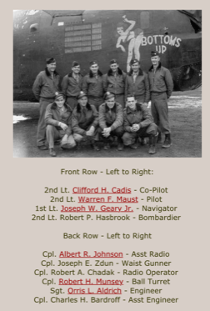
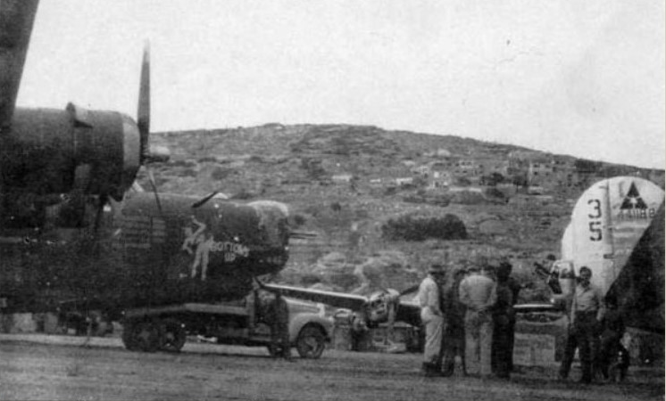
2014 recording from navigator of B-24 that landed on October 7th earlier (one of 4) 1Lt. Joseph Geary of 721st Bs 450th BG
1Lt Geary
Navigator
CLICK on the arrow below the
symbol above or click mouse to listen
Bottoms Up at Vis Airfield

Slide 25
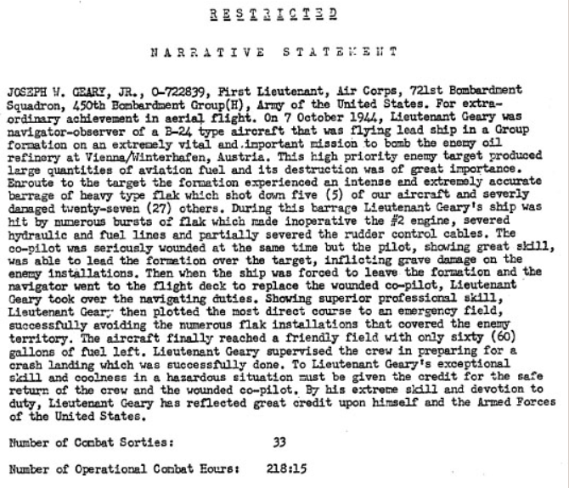
1st Lt Leary received the DFC for his actions on Oct 7th, 1944

Slide 26
Trip to Croatia – October 2-8, 2023
In search of traces of Morris – to see where he died and better write him into the Peck Family History
Jim and Jeff Peck, his nephews
Met three helpful men:
- Niall Brannigan- retired State Dept. MIA official & author of “Allied Presence on Vis” - Danijel Frka- diver & author of “Vis-The Last Hope”
- Velimir Mratinic – fig farmer & WWII museum owner (now Vis WWII Memorial Center)

Slide 27
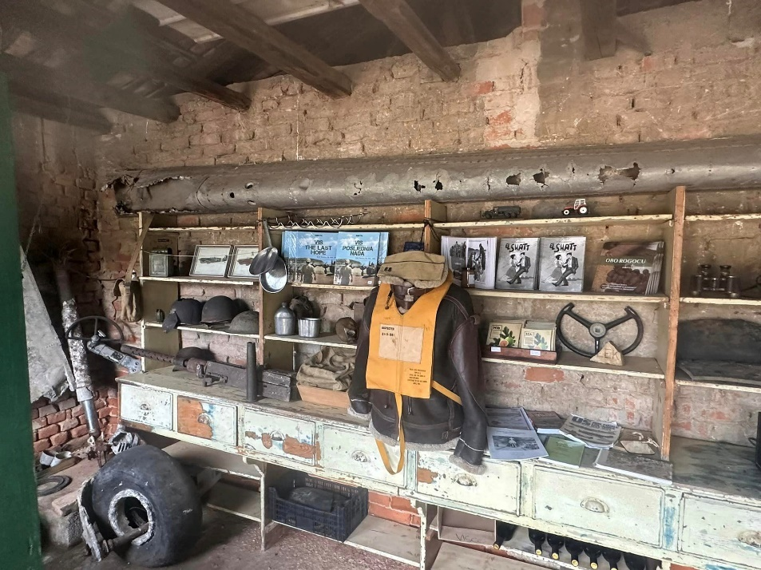
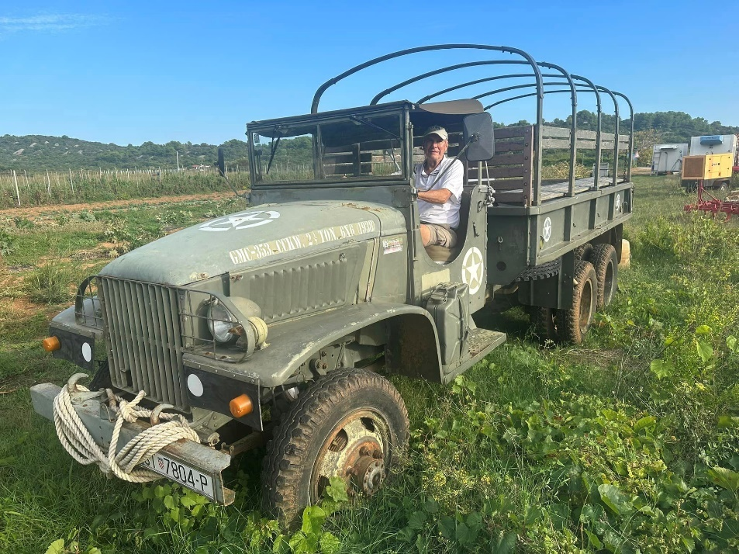
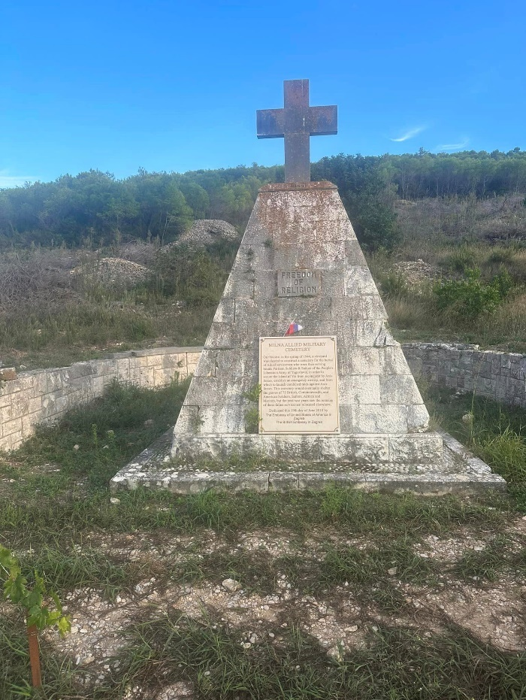
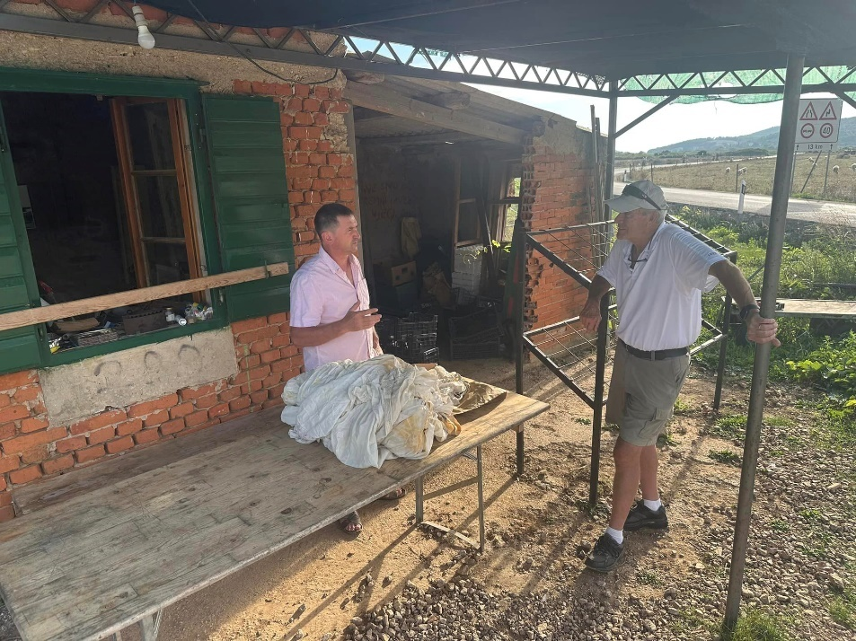
October 2024

Slide 28

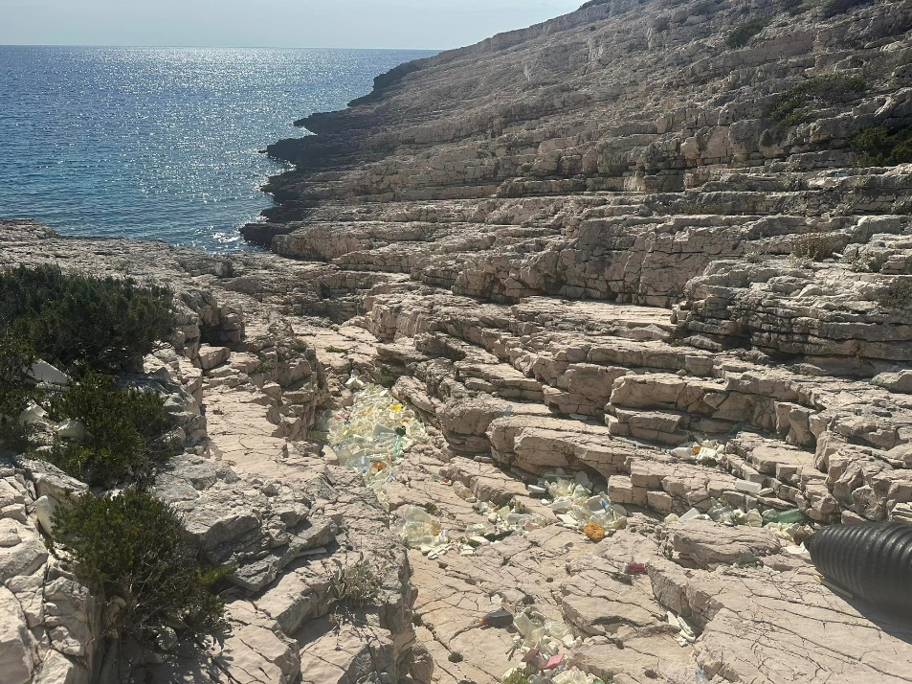
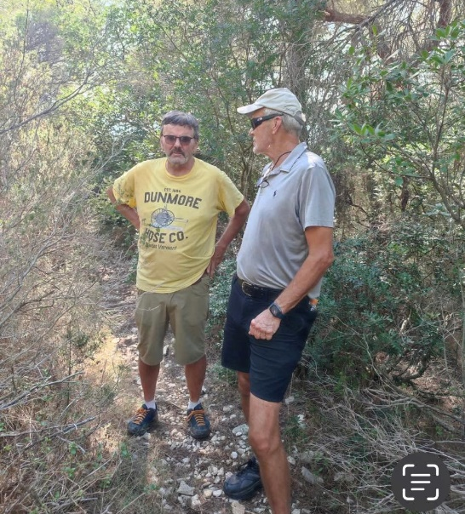

Slide 29
Vis WWII Memorial Center
Dream of Velimir Mratinic –expand his small museum
Working since November, 2023 on this- Advisory Group meeting via Zoom
Sponsored by the National Federation of Croatian Americans Cultural Foundation (NFCACF) with 90,000 members and the Croatian Military History Foundation (CMHF)
Supported by the US Embassy in Croatia
A new non-profit "Foundation for the Island of Vis History" will oversee the Center
Will memorialize the Allied airmen who landed or tried to land on the emergency airstrip on Vis in 1944-5, and the Partisans who ran the airstrip and assisted the Allies.
The lives of over 4,000 Allied airmen were saved by the airstrip and the actions of the RAF and Partisans there.

Slide 30
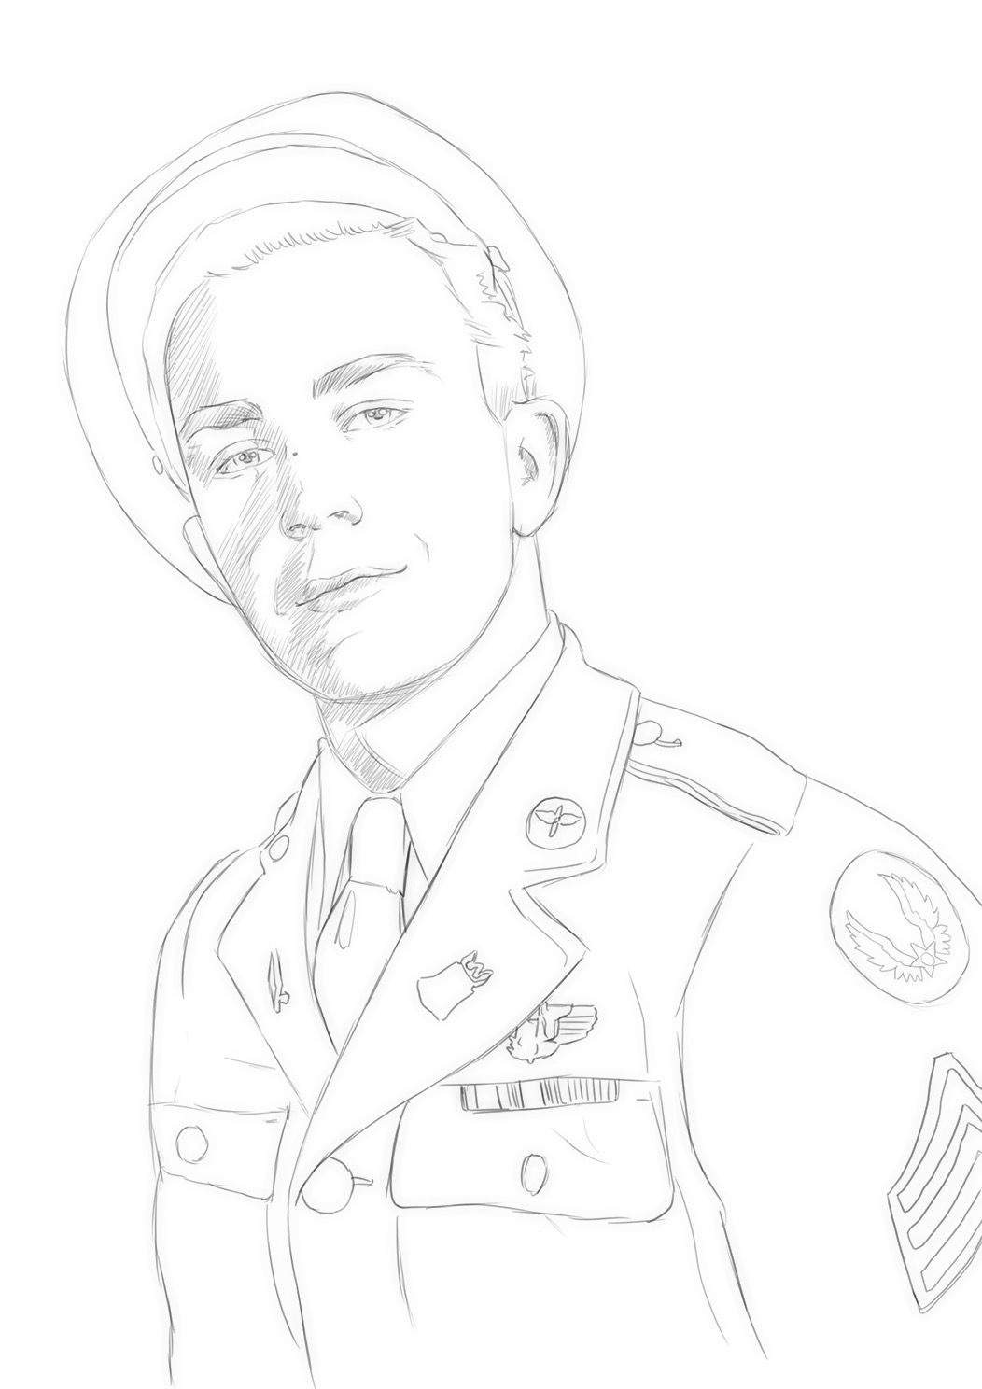
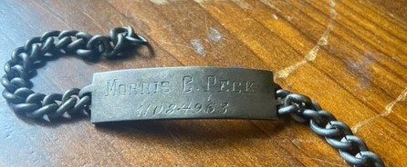
Proud to be Supporters of the Vis WWII Memorial Center!
In Memory of our Uncle
Sgt Morris Colby Peck
Nephews Jim & Jeff Peck

