Slide 1
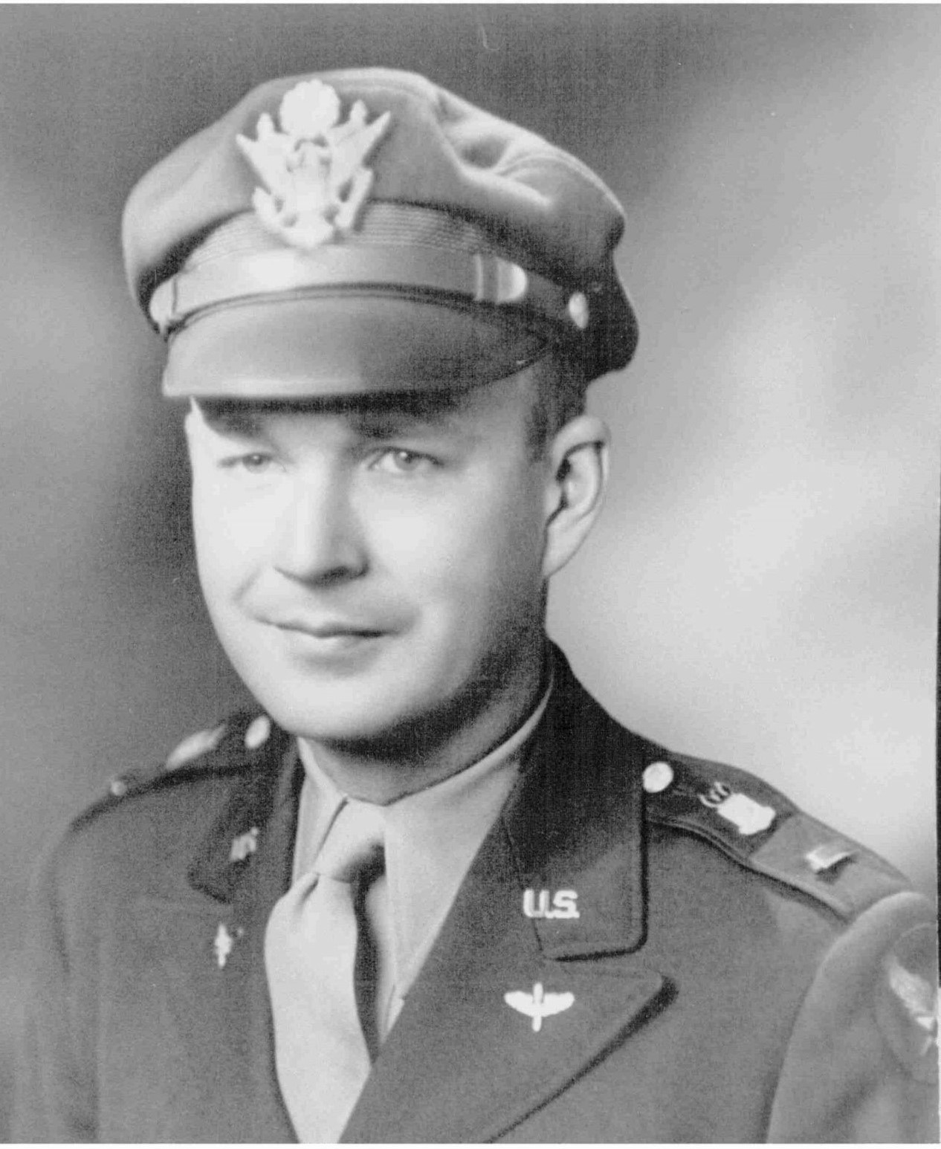
STORY #3A SYNOPSIS
Captain George Tudor OCTOBER 7, 1944
725th BS, 451st BG
B-24 Liberator: #41-28861
“Burma Bound”
Pilot
Returning from bombing oil refinery in Vienna, Austria
Shot up & out of fuel
Vis runway blocked by stuck B-24; advised to bail out
Seven crew members were wounded; couldn’t bail out
Made emergency landing; no brakes as hydraulic system was damaged
Landing gear manually cranked down and parachutes tied to waist gun mounts to stop
Born - Union, Iowa May 31, 1917

Slide 2
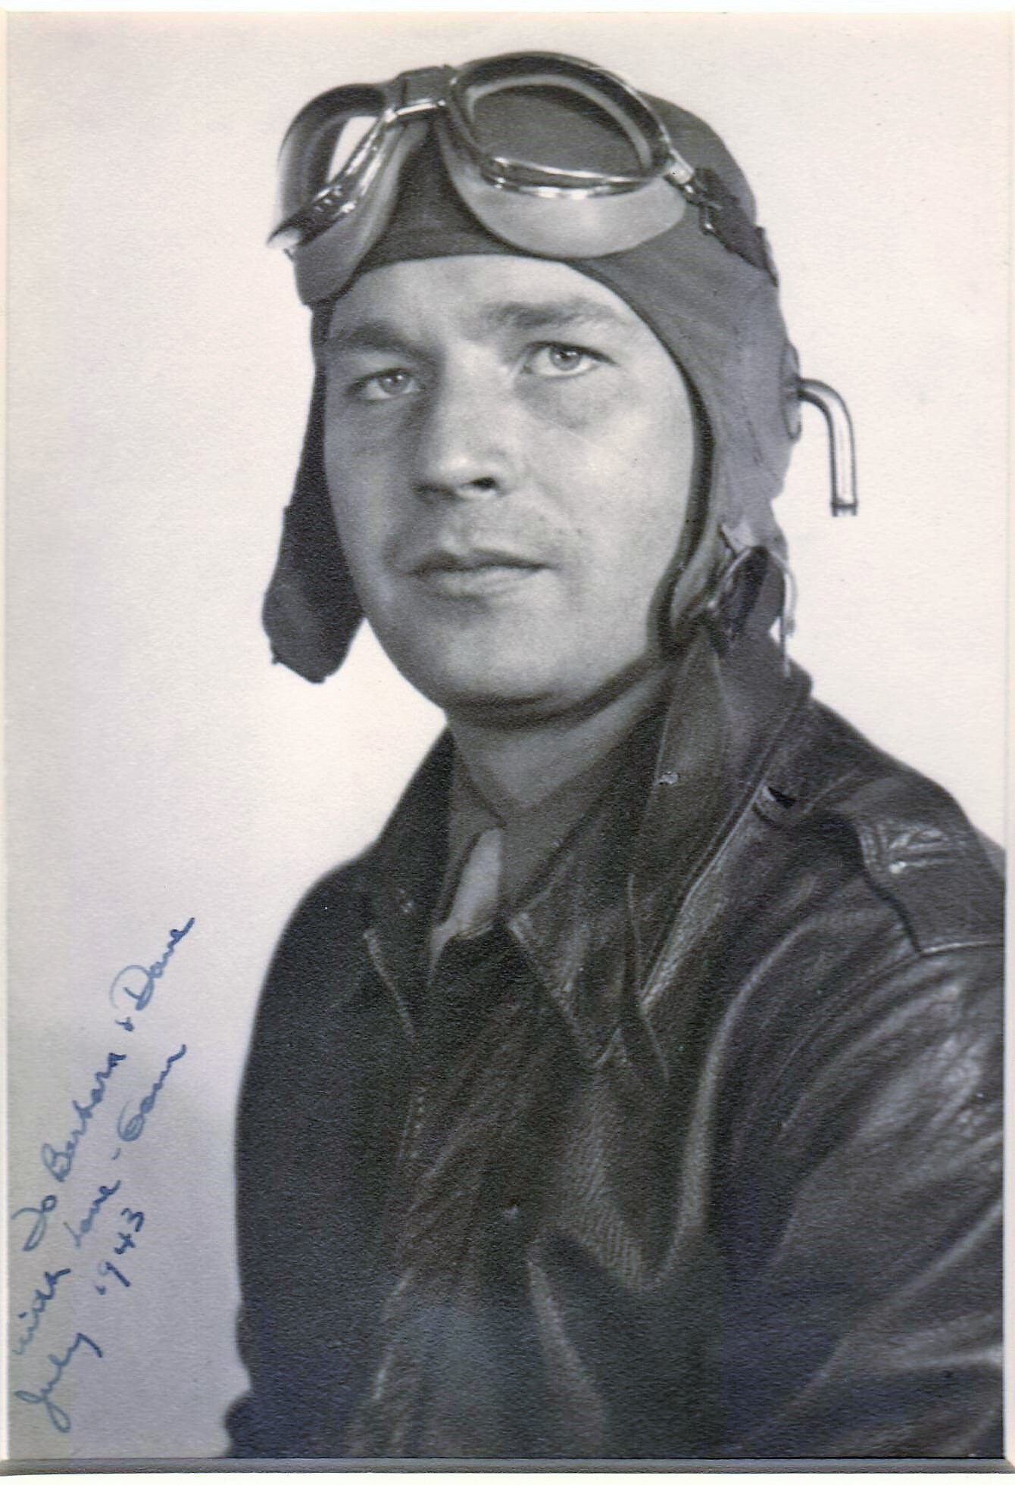
George Tudor after receiving his wings, July, 1943

Slide 3
WWII Highlights
Highlights
Flew 19 missions for 451st Bomb Group
Flew in mission to Markersdorf Airdrome; 451st BG awarded Distinguished Unit Citation; Group destroyed 29 enemy fighters in the air and 12 on the ground; nine B-24’s shot down by Luftwaffe
Last mission was to Vienna with an emergency landing on Vis
Awarded Silver Star, Distinguished Flying Cross, Purple Heart, Air Medal-2 oak leaf clusters,

Slide 4
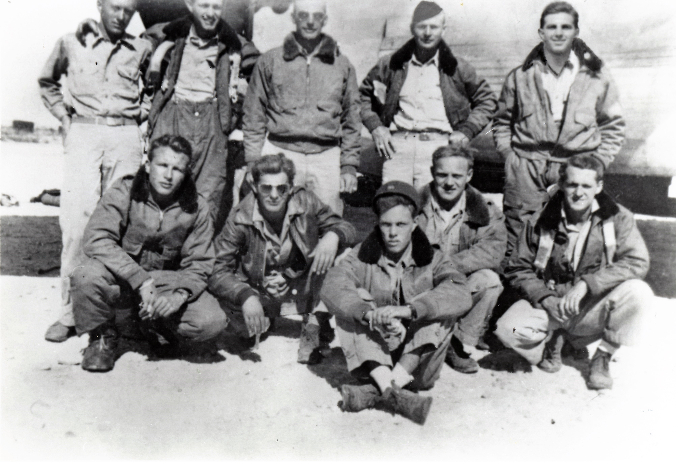
Captain George Tudor & crew

Slide 5
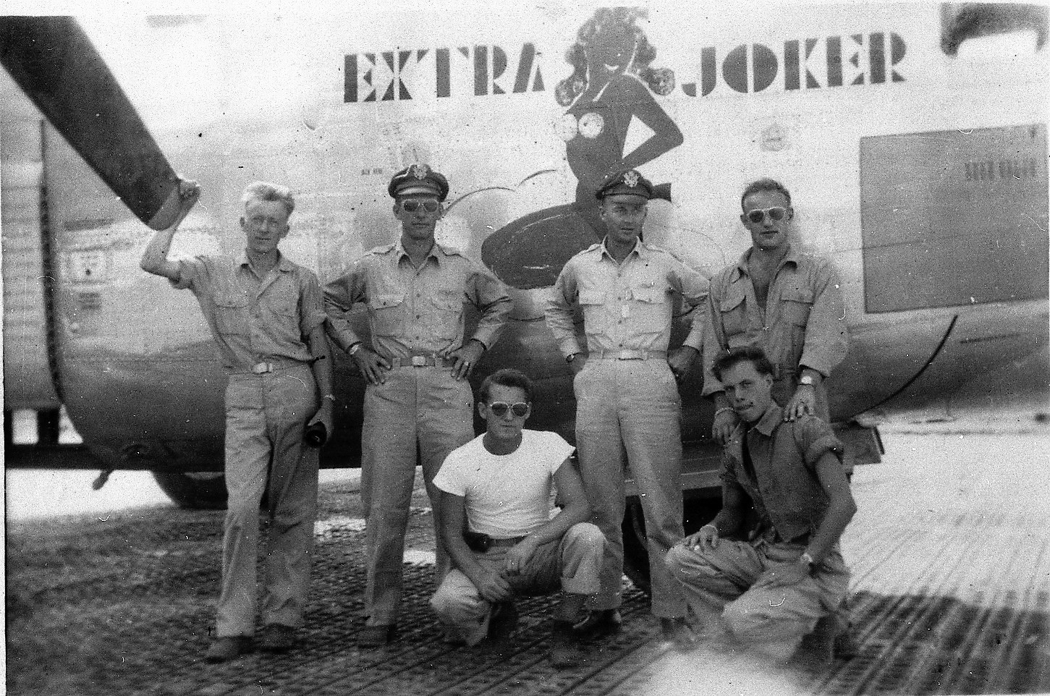
Captain George Tudor & crew flew the “Extra Joker” on all missions except one

Slide 6
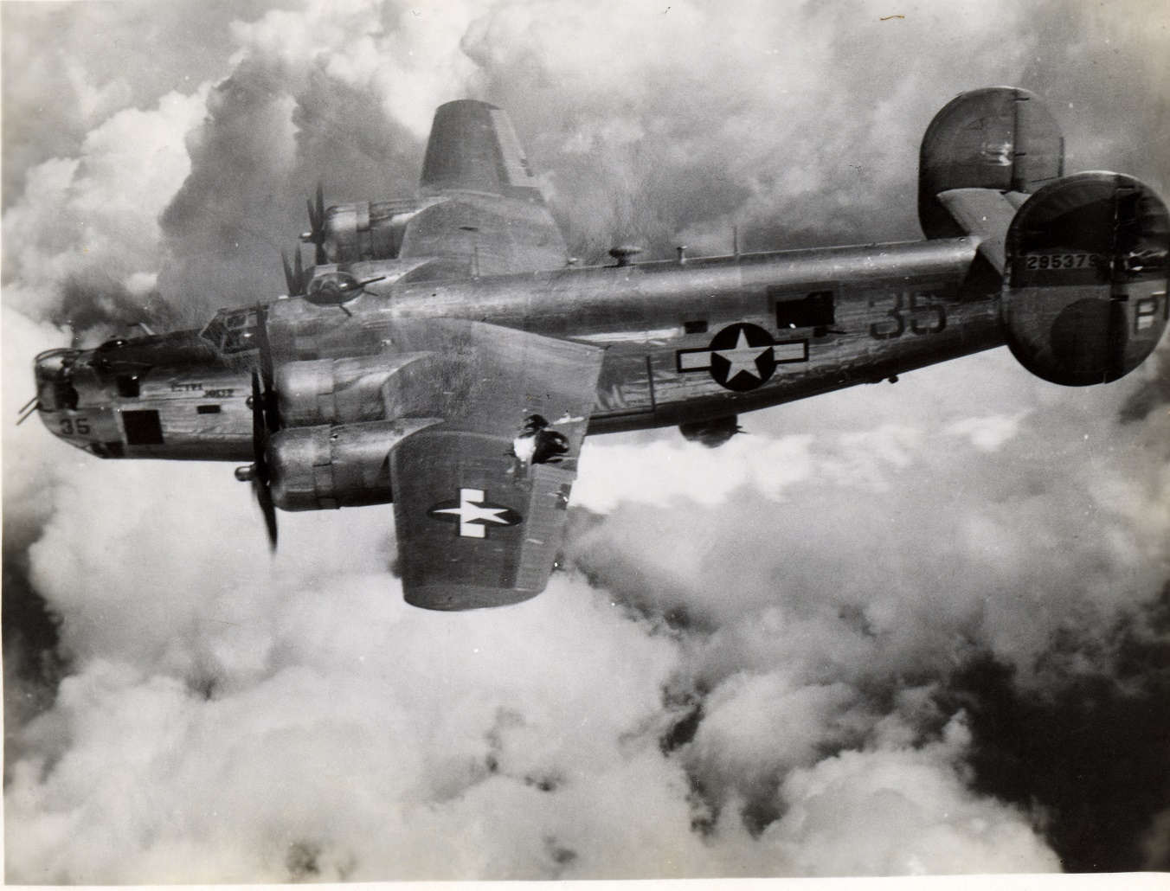
Tudor & crew switched planes on the Markerdorf mission of August 23, 1944 as a different bomb sight was needed to lead the bomb run

Slide 7
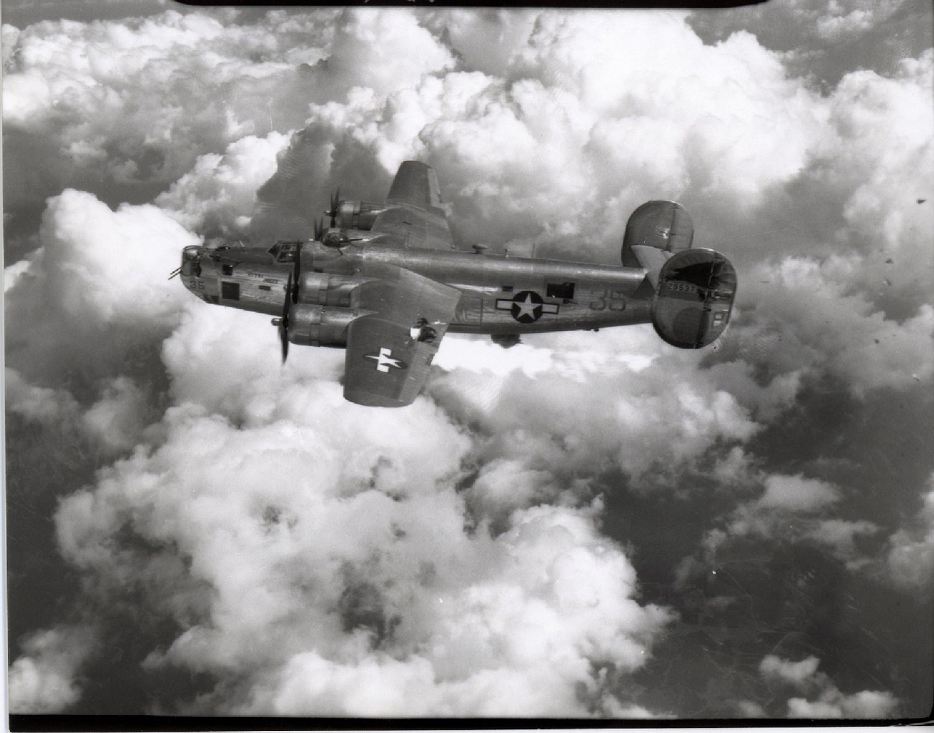
The unit photographer was in Captain Tudor’s plane and captured these photos of their B-24 being destroyed by German fighters

Slide 8
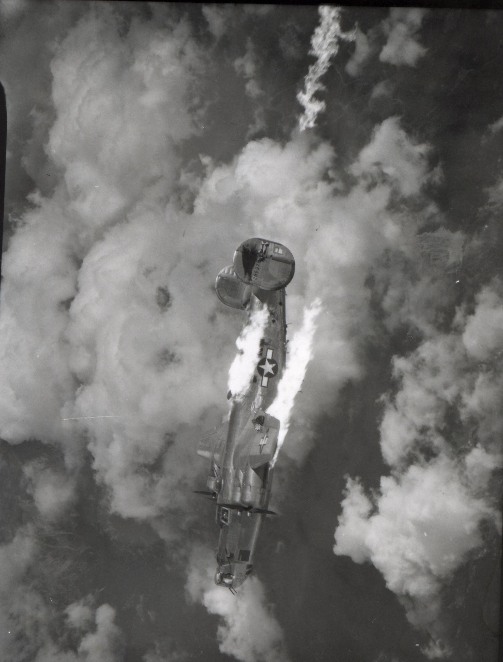
“Extra Joker” is lost on this mission with no survivors. The 451st BG received one of three unit citations for this mission.

Slide 9
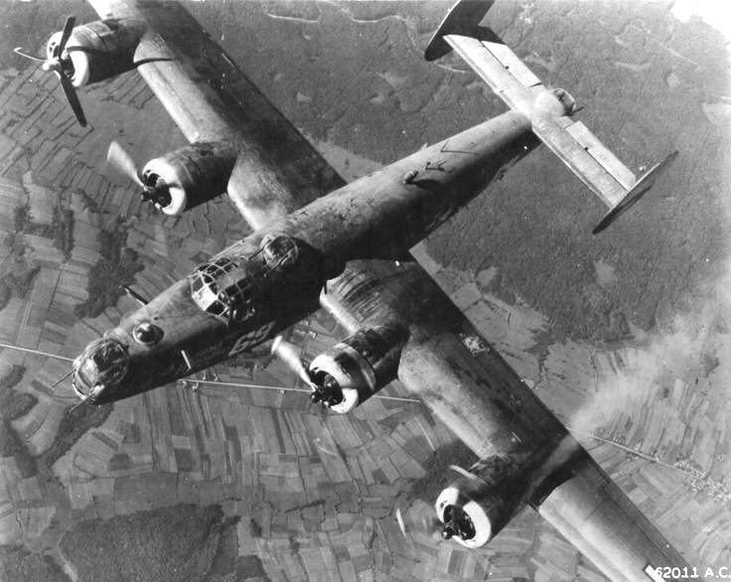
Last mission, October 7, 1944: Captain Tudor fights to keep “Burma Bound” airborne with 7 wounded on board (including himself) from flak on bomb run, before emergency landing at Vis

Slide 10
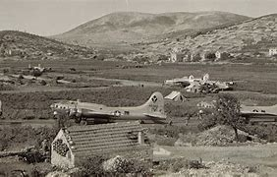
The landing strip on Vis was partially blocked by a disabled aircraft, and due to damage to the hydraulic system, parachutes were tied to the waist gun mounts to stop the plane.

Slide 11
Post WWII Highlights
Married Jane Pattison 1948
Two children, born 1957 and 1959
33 year career with American Airlines
Retired to Maine, designed his home and enjoyed piloting his boat, the Extra Joker II
Remained actively involved in the 451st Bomb Group Association, attending reunions from 1980-2008

Slide 12
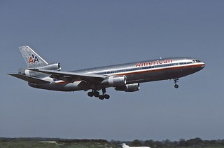
George Tudor retired as a Captain with American Airlines after 33 years as a commercial pilot
This Photo by Unknown Author is licensed under CC BY-SA-NC

Slide 13
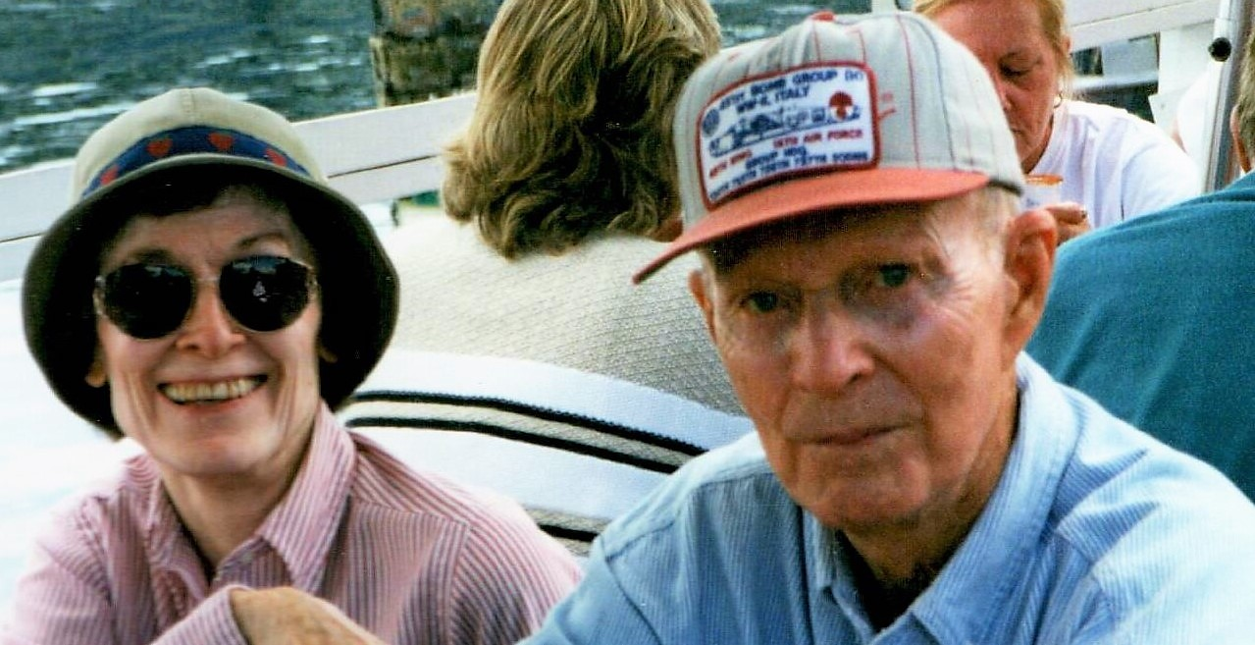
George and Jane Tudor retired to Maine in 1978 (proudly wearing his 451 BG hat)

